Slide 1
Microsoft UC Experience
Lync, Exchange, Office 365, S4B
Daryl Hunter, Solutions Architect
UC & Networking Practice Lead
Mirazon.com, @darylhunter

Slide 2
Quick Agenda
Microsoft Lync Server
Office 365
v.Next
Demo
Wrap Up / Q&A

Slide 3
Survey the Peanut Gallery
How many of you have heard a talk about Lync?
Who is using Lync today?
All functionality – including voice (PBX?)

Slide 4
Instant Messaging
The best place to “start” the Lync Conversation is with IM – Instant Messaging
Pop Quiz – Hotshots…
First use of instant messaging… was… when?

Slide 5
History Lesson - IM
1960s
Example: multics – to notify users of shared systems maintenance
Talk, ntalk, ytalk
BBSes
Talker and IRC
ICQ (1996 – this is a key player here) then AOL ruined it
~2000
Jabber / XMPP
Exchange Instant Messaging Service

Slide 6
Why do I care about IM?
Facebook
Twitter
Google Talk/Chat
WeChat / QQ
Microsoft – Lync & Skype

Slide 7
History Lesson – Microsoft UC
Standalone – NetMeeting
Exchange 2000 Instant Messaging
LCS 2003
LCS 2005 (then SP1)
OCS 2007
OCS 2007 R2
Lync 2010
Lync 2013
v.Next – Skype For Business – April (Client) & May (Server)

Slide 8
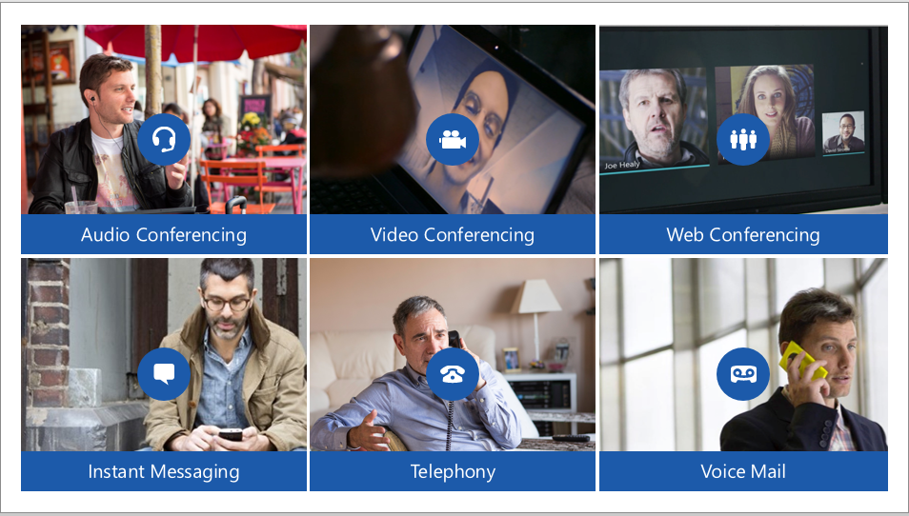
Lync – it’s more than IM

Slide 9
How Lync Helps You Work
Control Costs
Long Distance
Meeting Travel
Improve Productivity
Find the Right Person at the Right Time
Ad-hoc Collaboration
Find Me Anywhere (Single Number Reach)

Slide 10
How Lync Helps You Work
Support the Mobile Workforce
Any Internet Connection – No VPN Required
Single-user Experience – across PC, Mac, Mobile Device, Browser
Federation
B2B – Lync to Lync/XMPP
Skype
Maintain Regulatory Compliance
Built-in / Default Encryption
Archiving
Call Detail Records

Slide 11
Some HADR Discussion
Standard Edition
No HA – Zero
DR Only – Pool Pairing
Enterprise Edition
HA Pools – 3 Members for Best Practices Fabric
SQL Server Backend Required
Cannot cross physical sites
DR – Pool Pairing
License Cost is same – Depends on Architecture / Implementation

Slide 12
Some Cost Discussion
Lync Server 2013 itself – with SA
Upgrade Rights
Virtualization Rights
Lync Server 2013 CALs – with SA of course ☺
Standard – IM/P
Enterprise – Conferencing
Plus – Dialtone
Lync 201x Client (PC or Mac)
Included with Office 201x Pro/Plus
Exchange Enterprise CAL for UM

Slide 13
Moving Parts
Public IPs, Public & Private DNS
Firewall Rules
Reverse Proxy
Lync Server(s)
SBC – if Enterprise Voice
Exchange UM – if Enterprise Voice
Handsets and Headsets – if Enterprise Voice

Slide 14
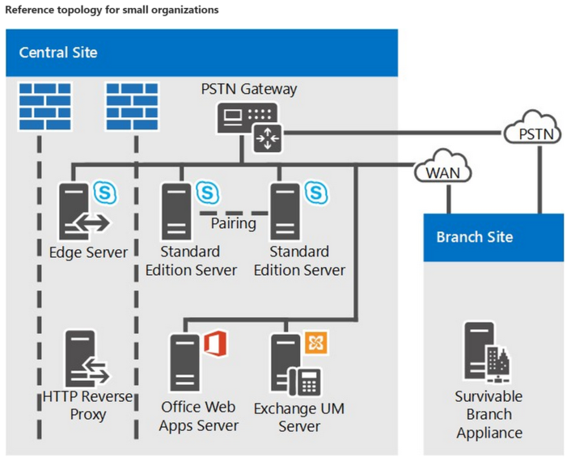
Reference Architectures

Slide 15
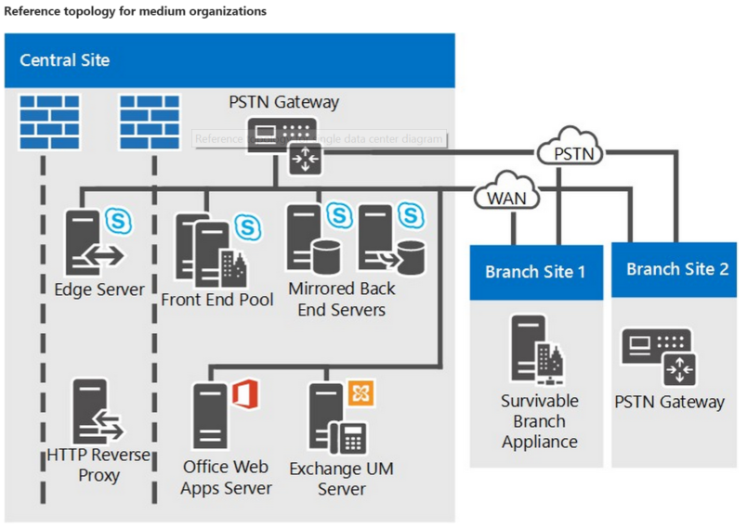
Reference Architectures

Slide 16
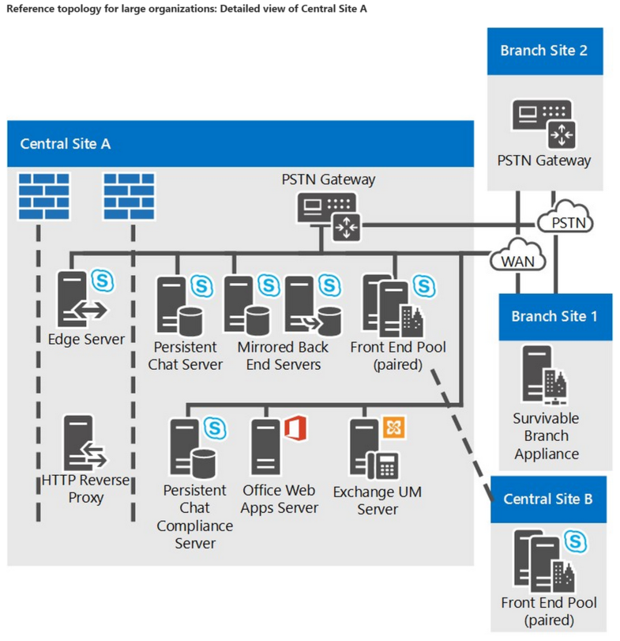
Reference Architectures

Slide 17
Shifting Topics
Let’s wrap up Lync
Anything to talk about or discuss that we haven’t gotten to yet related to Lync?

Slide 18
Office 365
Potentially A Giant Topic
Interop
Transition
Licensing

Slide 19
Office 365 - Interop
Interop
ADFS – Shoot me
Directory Sync / Password Sync
Hybrid Exchange is awesome & flexible
You MUST have some method of SSO for Lync / Office 365 Interop

Slide 20
Office 365 - Interop
Lync & Exchange Online (O365)
Fully compatible
Lync & Exchange Hybrid (On-Premises & O365)
Fully compatible
Exchange Online (O365) and On-premises PBX
“It works” but may not be supported
Cisco Example – easier to “see”

Slide 21
Office 365 - Interop

Slide 22
Office 365 - Interop

Slide 23
Office 365 - Transitioning
Long Term Hybrid
Staged
Cutover
There are third party products and services to help with this – like Skykick

Slide 24
Office 365 - Licensing
Licensing Stuff – Quick Flyover
E1 (or is that E2 now?)
“Free” for non-profits
$8/mo/user for Enterprise
NO CAL Equivalencies
NO “Installed” Office
E3
$4.50/mo/user for non-profits
$20/mo/user for Enterprise
Office 2013 Pro Plus included (could do $12 ala-carte) ($2 for non-profits)
Exchange Standard & Enterprise CAL Equivalency
Lync Standard & Enterprise CAL Equivalency (IM/P & Conferencing)
NO Lync PLUS CAL Equivalency (Dialtone)

Slide 25
Office 365 - Licensing
Licensing Stuff – Quick Flyover
E4
$22/mo/user for Enterprise (no comparable non-profit plan)
All of E3 - INCLUDING Lync PLUS CAL Equivalency (Dialtone)
If Lync for Dialtone – still have to handle Lync Server license & on-premises deployment (for now)
Dialtone via Skype For Business Online via Azure ExpressRoute (Details TBD)

Slide 26
Moving Forward
Let’s wrap up Office 365
Anything to talk about or discuss that we haven’t gotten to yet related to Lync or Office 365?

Slide 27
v.Next – Skype For Business
April 2015 – Client Availability
May 2015 – Server Availability
Can Upgrade Pools, or Transition side-by-side
New Server Role: VIS / Video Interoperability Server
Client: Undockable Call Monitor
Further Enhanced Consumer Skype Interoperability

Slide 28
Demo
Demo of Lync 2013 Client & S4B Client
Demo of Collaboration
Demo of Conferencing (Escalation from IM)

Slide 29
Q&A – Wrap Up
Email/Lync: daryl.hunter@mirazon.com
Blog: http://mirazon.com/blog
Twitter: @darylhunter

