Slide 1
PowerShell, Your Way
LouMug March 2020

Slide 2
Who Am I?
Tony Morrow
Principal Solutions Architect
Bellarmine University
amorrow@bellarmine.edu
11 years working at Bellarmine
Focus
  Networking
  Wireless
  Servers/Virtualization
  Systems Integration
  Problem Solving
  PowerShell, PowerShell, PowerShell

Slide 3
Disclaimer 😏
I am not a Microsoft MVP or Partner
I have no inside knowledge of Microsoft or PowerShell
Bellarmine has paid licenses for technologies showcased
All the opinions here are my own
Nobody is paying me for this presentation
Nobody has reviewed or approved this presentation before hand
I don’t look at the camera like a professional streamer
And I will talk to fast

Slide 4
Topics
What is PowerShell?
What do I (me) do with PowerShell?
Live Demo (fingers crossed)

Slide 5
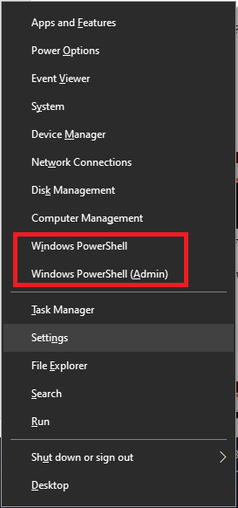
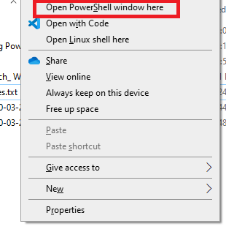
What is PowerShell?
That annoying blue/black window you must use anytime you want to manage Exchange.
That thing Microsoft is pushing on us to replace Command Prompt with

Slide 6
What is PowerShell? (Seriously)
PowerShell is a task-based command-line shell and scripting language built on .NET.
Brainchild of Jeffery Snover @jsnover
Designed to recreate the tools experience of Unix in the world of Windows API
  Standardized syntax
  Pipes
1.0 Released in 2006
7.0 Released in 2020
https://docs.microsoft.com/en-us/powershell/scripting/overview?view=powershell-7

Slide 7
Two Products, One Name
Windows PowerShell
  Built on the .NET Framework
  Preinstalled on Windows 7+
  Latest release is 5.1
    https://docs.microsoft.com/en-us/powershell/scripting/wmf/setup/install-configure
    7, 8.1, 2008R2, 2012, 2012R2
  No longer being developed
PowerShell Core
  Built on .NET Core
  Announced in 2016
  Latest release is 7.0
  Cross-platform (Windows 7+, MacOS 10.12+, Linux)
  The future of PowerShell
  Much more compatible with existing modules and cmdlets as of v7
https://docs.microsoft.com/en-us/powershell/scripting/whats-new/module-compatibility

Slide 8
Two Products, One Name
Which one should I use?
  5.1
    Using prebuilt modules and cmdlets
    “Operations work” with Azure/Office365
  7.0
    Developing your own cmdlets and modules
    Don’t require “types” only available in .NET Framework

Slide 9
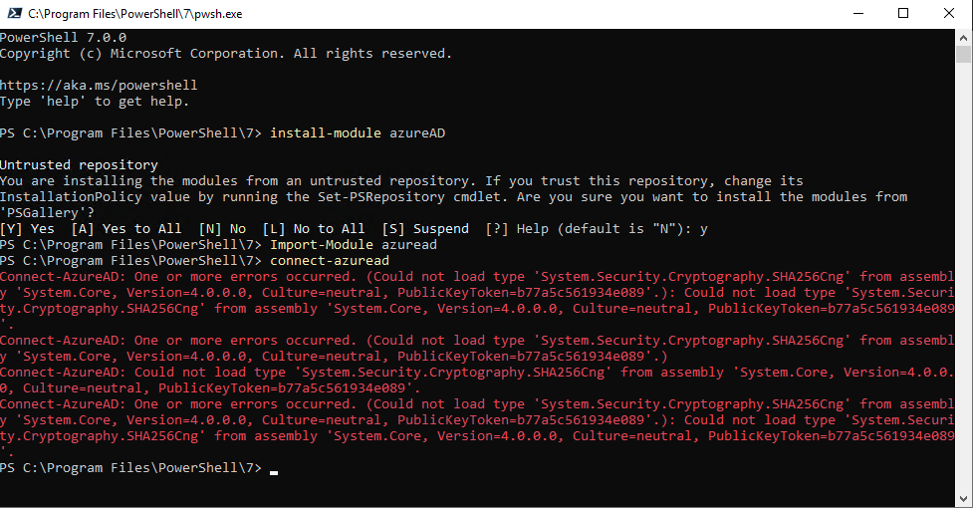
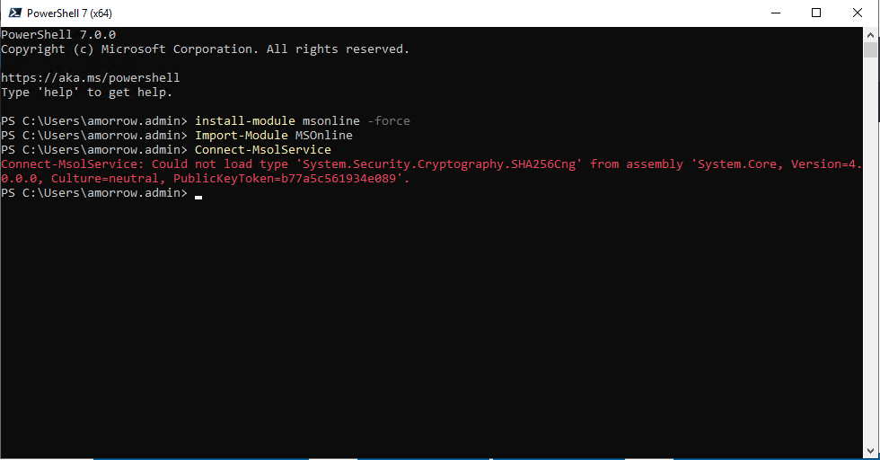
Not everything works in 7.0

Slide 10
What do I use PowerShell for?
Everything:
Getting answers to questions
  How many users are a member of a group?
  Who has permissions to send to a distribution list?
Automating tasks
  Automatically add users/computers to groups
  Update AD user information based on data from our ERP system
  Download and deploy common software using SCCM
  (not mine) Identity management

Slide 11
What do I use PowerShell for?
Bulk changes
  AD, O365, Exchange
Fixing mistakes
  Moodle-Teams integration
Talking to APIs
  Microsoft Graph
  Ruckus SmartZone wireless controller

Slide 12
Resources
Books
  Learn Windows PowerShell in a Month of Lunches, Third Edition
    https://www.manning.com/books/learn-windows-powershell-in-a-month-of-lunches-third-edition
  Learn PowerShell Scripting in a Month of Lunches
    https://www.manning.com/books/learn-powershell-scripting-in-a-month-of-lunches
Videos
  PowerShell Unplugged with Jeffery Snover
    https://www.youtube.com/results?search_query=%22powershell+unplugged%22
Get-Help -Online
  https://docs.microsoft.com

Slide 13
DEMO TIME!!!!!

