Slide 1
Azure Multi-Factor Authentication (MFA)
Jacques Guibert De Bruet
Microsoft Premier Field Engineer

Slide 2
Agenda:
What is Azure MFA? What are its Security Benefits?
Capabilities
Implementation
Q&A
Service Settings configuration
Azure MFA registration – Azure Portal
Conditional access policies – Enabling MFA
Azure MFA registration – Use PowerShell
Azure AD Identity Protection – MFA registration
Checking current registration status
Available versions of Azure MFA
Feature comparison of versions
Azure MFA Value Proposition

Slide 3
What is Azure MFA?

Slide 4
What is multi-factor authentication?
Any two or more of the following factors:
Something you know: a password or PIN.
Something you have: a phone, credit card or hardware token.
Something you are: a fingerprint, retinal scan or other biometric.
Stronger when using two different channels (out-of-band).
01234
Hardware token
Certificates
Smartcard
Phone

Slide 5

What is Azure Multi-Factor Authentication?
An Azure Identity and Access management service that prevents unauthorized access to both on-premises and cloud applications by providing an additional level of authentication
Trusted by thousands of enterprises to authenticate employee, customer, and partner access.

Slide 6




Azure MFA
Easy to Use
Simple to set up and use and users can manage their own devices
Scalable
Utilizes the power of the cloud and integrates with on-premises Active Directory and custom apps
Always Protected
Provides strong authentication using the highest industry standard
Reliable
Guarantee of 99.9% availability

Slide 7
Azure AD reliability
    Geo-distributed, high availability design
    Running out of 50+ regions worldwide with automated failover.
    SLA for Azure Active Directory – 99.9%

Slide 8
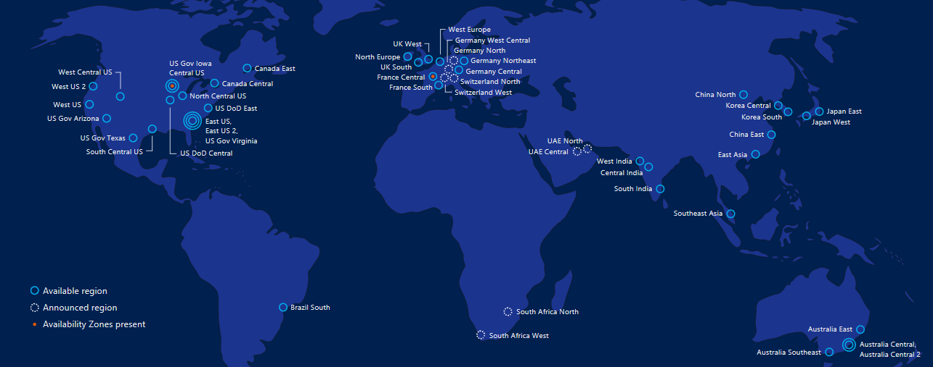
Azure AD reliability

Slide 9
Azure MFA Security benefits

Slide 10






Identity is the new security control plane
Cloud Apps
Partners &
Customers
Employees
Identity
On-premises apps
Devices

Slide 11
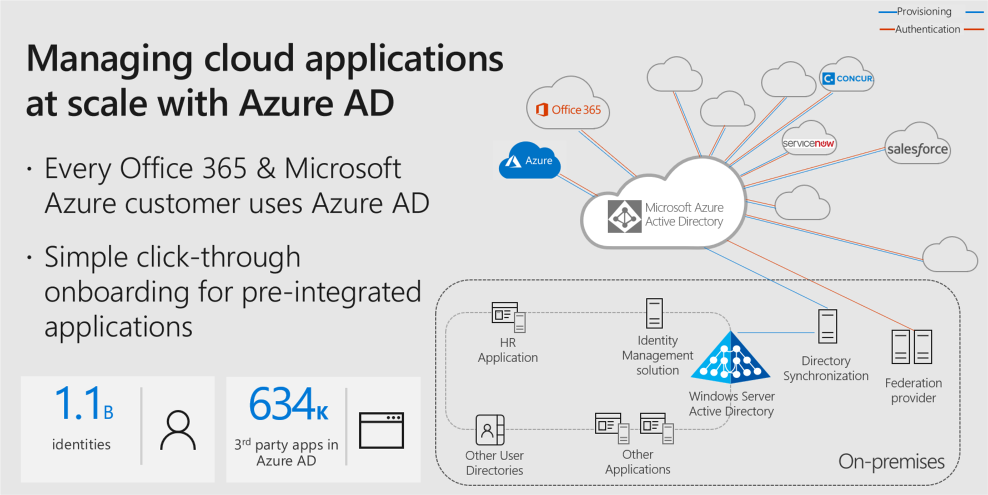

Slide 12
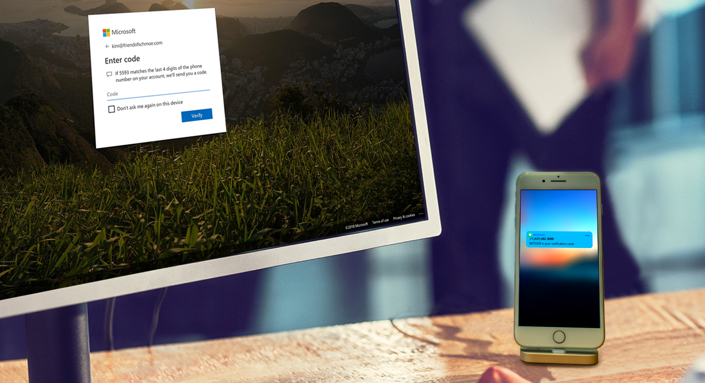
MFA reduces the risk of an attack by 99.9%

Slide 13
Azure MFA Capabilities

Slide 14
Available versions of Azure MFA
Multi-Factor Authentication for Office 365
Azure Multi-Factor Authentication
Multi-Factor Authentication for Azure Administrators

Slide 15
Convenience
Strong multi-factor authentication
Works with all leading on-premises applications
01234
No devices or certificates to purchase, provision, and maintain
Supports Active Directory Federation Services (AD FS) and
SAML-based apps for federation to the cloud
No user training is required
Real-time fraud alert
Scale
Users replace their own lost or broken phones
Built into Azure Active Directory (Azure AD) for use with cloud apps
PIN option
Users manage their own authentication methods
and phone numbers
SDK for integration with custom apps and directories
Reporting and logging for auditing
Security
Integrates with existing directory for centralized user
management and automated enrollment
Reliable, scalable service supports high-volume,
mission-critical scenarios
Enables compliance with National Institute of Standards and Technology (NIST) 800-63 Level 3, HIPAA,
PCI DSS, and other regulatory requirements

Slide 16
Feature comparison of versions
Feature | MFA for Office 365 | MFA for Azure Administrators | Azure MFA
Protect admin accounts with MFA | ● | ● (Global Administrator accounts only) | ●
Mobile app as a second factor | ● | ● | ●
Phone call as a second factor | ● | ● | ●
SMS as a second factor | ● | ● | ●
App passwords for clients that don't support MFA | ● | ● | ●
Admin control over verification methods | ● | ● | ●
Protect non-admin accounts with MFA | ● (Only for Office 365 apps) |  | ●
PIN mode |  |  | ●
Fraud alert |  |  | ●
MFA Reports |  |  | ●
One-Time Bypass |  |  | ●
Custom greetings for phone calls |  |  | ●
Custom caller ID for phone calls |  |  | ●
Trusted IPs |  |  | ●
Remember MFA for trusted devices | ● | ● | ●
MFA for on-premises applications |  |  | ●
Integration with Conditional Access |  |  | ●
Integration with Azure AD Identity Protection |  |  | ●

Slide 17
Azure MFA Implementation

Slide 18
Which Authentication Method to Use
Voice
Pros: No data connection or smartphone needed
Cons: PIN necessary, no SLA from carrier perspective
Text
Pros: No data connection or smartphone needed
Cons: SLA from a carrier provider
Application
Pros: No Dual-Tone Multi-Frequency (DTMF) in use, best user experience
Cons: Smartphone needed
Notes:
DTMF stands for Dual Tone Multi Frequency and it is the basis for your telephone system.

Slide 19
How to get Azure MFA
Bundled licenses that include MFA
Azure Active Directory Premium
Enterprise Mobility + Security
MFA licenses
MFA consumption-based model
Per Enabled User
Per Authentication
More to come!

Slide 20
Azure MFA registration
Service Settings configuration:
Methods available to users
Require MFA registration for all cloud users
Using Azure portal
Enabling Azure MFA with a conditional access policy
Use PowerShell
Azure AD Identity Protection: MFA registration
Azure MFA - current registration status

Slide 21
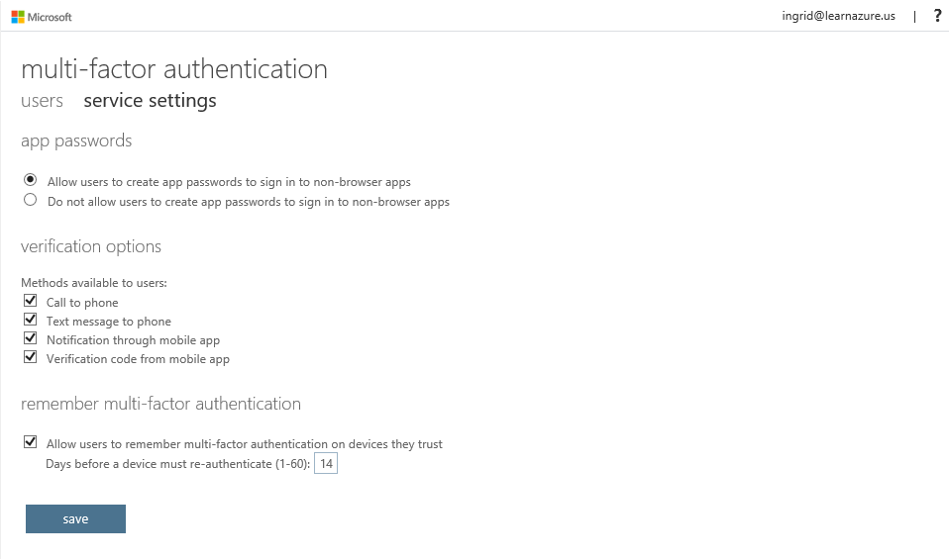
Service Settings configuration
Azure AD > Users and groups > All users > Multi-factor authentication > Service Settings

Slide 22
MFA enrollment
Classical way
Enable user’s MFA
User asks about MFA enrollment and input data
Classical portal shows “Enforces” status
Result – MFA is “on” for every Azure AD authentication
Using aka.ms/MFASetup
Ask end-user to accomplish enrollment by opening a resource http://aka.ms/MFASetup
User prompts about MFA based on Conditional Access (CA) policies configuration
Conditional Access policies
Create CA to require MFA
User sign-in in a scope of the CA
It initiates MFA enrollment
Azure AD Identity Protection
Assign Azure AD P2 license
Assign Azure AD P1 license
Assign Azure AD P1 license
Assign Azure AD P1 license
Configure Azure AD Identity Protection – MFA registration
User sign-in initiates MFA enrollment with option to postpone

Slide 23
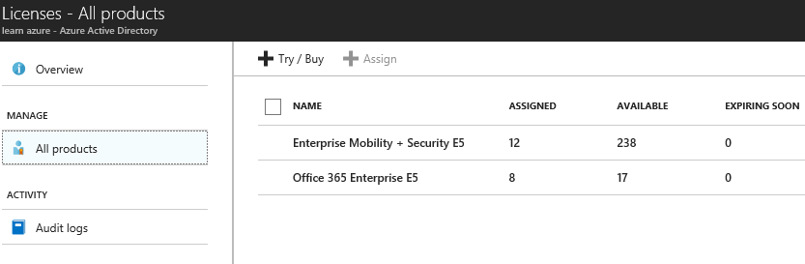
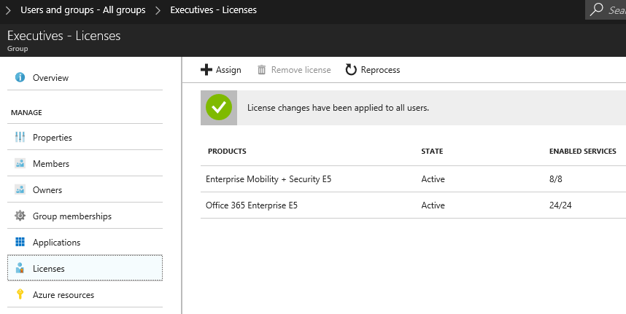
Assign Azure AD Premium or EMS License

Slide 24
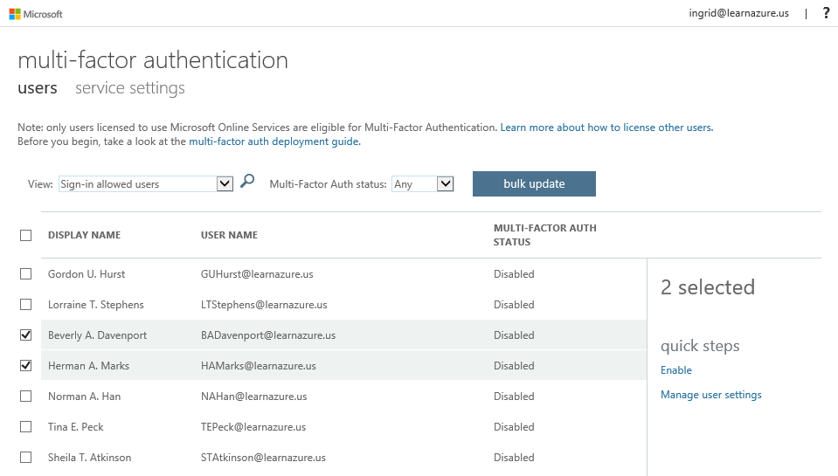
MFA registration – Azure Portal
Azure AD > Users and groups > All users > Multi-factor authentication > Users

Slide 25
Three States of the Users
State | Description | Non-browser apps affected | Notes
Disabled | The default state for a new user not enrolled in multi-factor authentication | No | The user is currently not using multi-factor authentication
Enabled | The user has been enrolled in multi-factor authentication | No. They will continue to work until the registration process is completed | The user is enabled but has not completed the registration process. They will be prompted to complete the process at next sign in
Enforced | The user has been enrolled and has completed the registration process for using multi-factor authentication | Yes. They will not work until app passwords are created and used | The user may or may not have completed registration. If they have completed the registration process then they are using multi-factor authentication. Otherwise, the user will be prompted to complete the process at next sign in

Slide 26
Use PowerShell
Change the user status:
$users = "bsimon@contoso.com","jsmith@contoso.com","ljacobson@contoso.com"
foreach ($user in $users)
{
$st = New-Object -TypeName Microsoft.Online.Administration.StrongAuthenticationRequirement
$st.RelyingParty = "*"
$st.State = “Enabled”
$sta = @($st)
Set-MsolUser -UserPrincipalName $user -StrongAuthenticationRequirements $sta
}

Slide 27
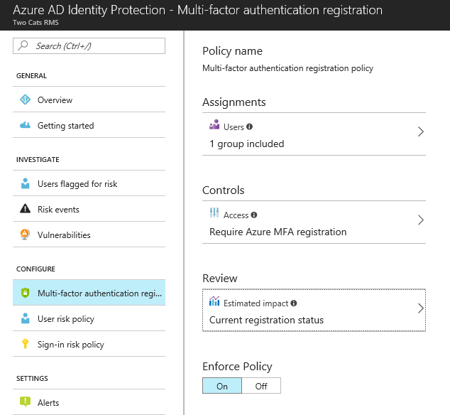
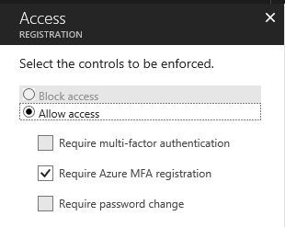
Azure AD Identity Protection - MFA registration
Assignments:
Controls:
Who?
Do this.

Slide 28
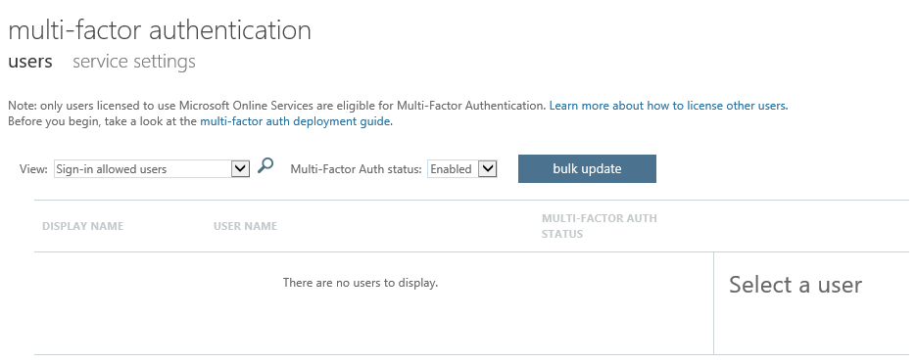
Azure MFA - current registration status
If you use CA policies enabling MFA:
Azure AD > Users and groups > All users > Multi-factor authentication > Users

Slide 29
Use PowerShell - current registration status
Identify users who have registered for MFA:
Get-MsolUser -All | where {$_.StrongAuthenticationMethods -ne $null} `
| Select-Object -Property UserPrincipalName
Get-MsolGroupMember -GroupObjectId "793e2d3c-ebae-4b0f-aa76-d95921d3b801" `
| Get-MsolUser | where {$_.StrongAuthenticationMethods -ne $null} `
| Select-Object -Property UserPrincipalName
Identify users who have not registered for MFA
Get-MsolUser -All | where {$_.StrongAuthenticationMethods.Count -eq 0} `
| Select-Object -Property UserPrincipalName

Slide 30
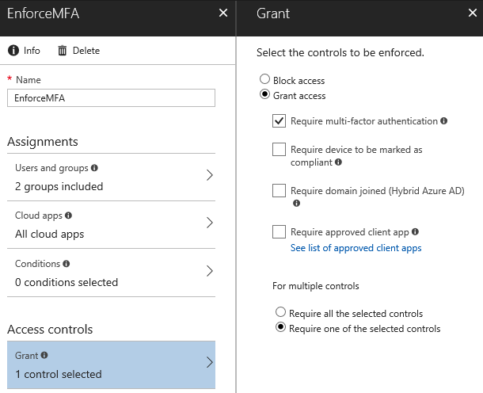
Conditional access policies. Enabling MFA
Assignments:
Controls:
Who? &
Cloud App &
Do this.
Conditions
Sign-in risk &
Device Platform & Locations &
Client App

Slide 31


User and location
Device
Zero Trust
with
Azure AD Conditional Access
Application
Real time risk

Slide 32
Password-less phone sign-in

Slide 33
Announcing
Azure AD password-less login

Slide 34
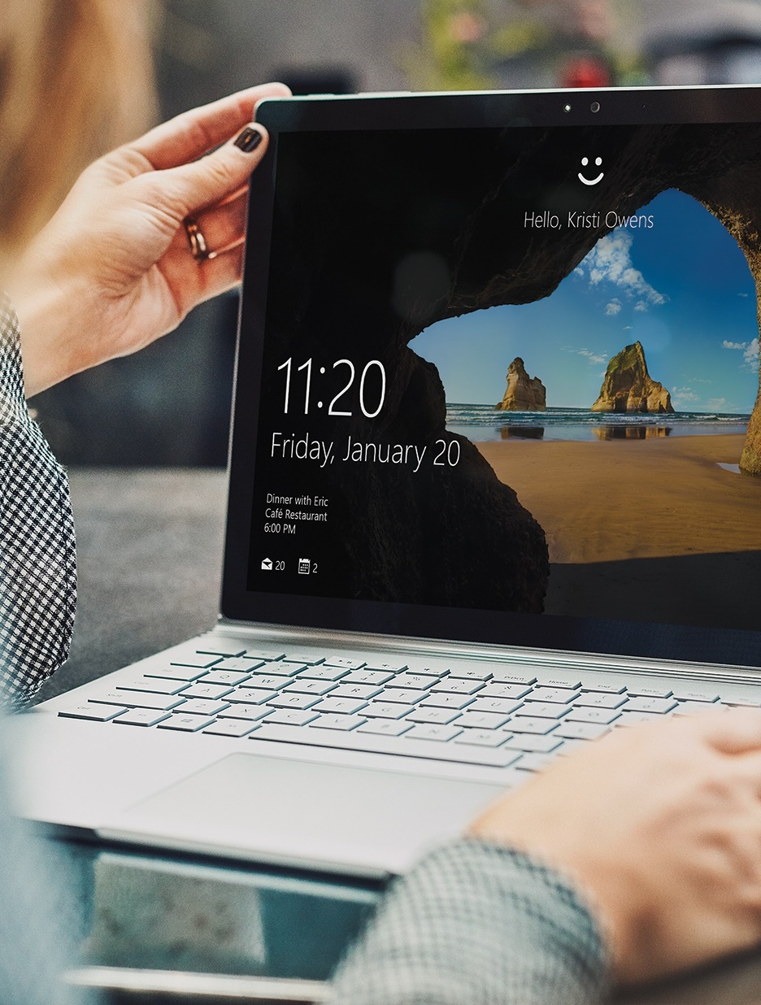
Identity & access
management
Turn on MFA
Protect your apps Azure AD conditional access
Begin your password-less journey

Slide 35
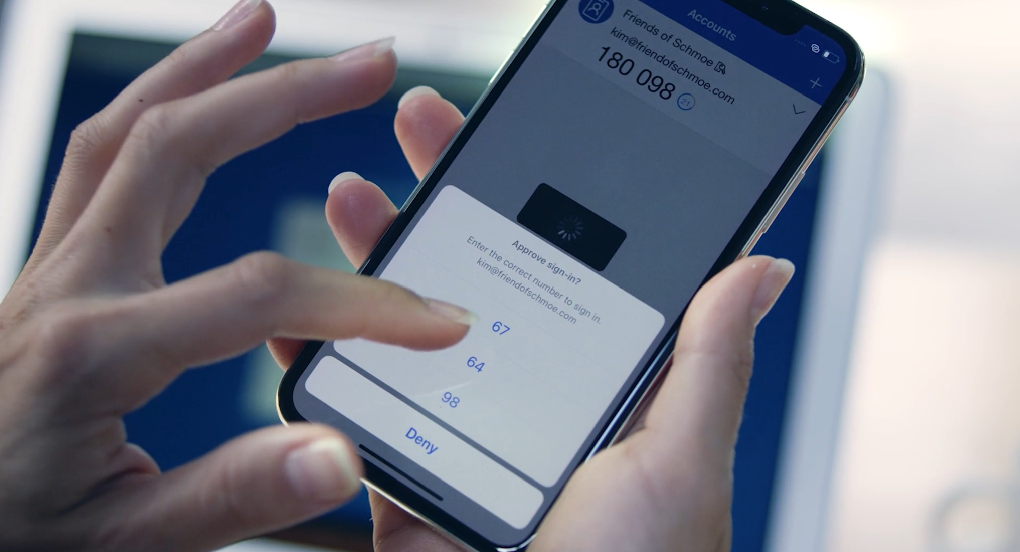

Let’s put an end to the era of passwords

Slide 36
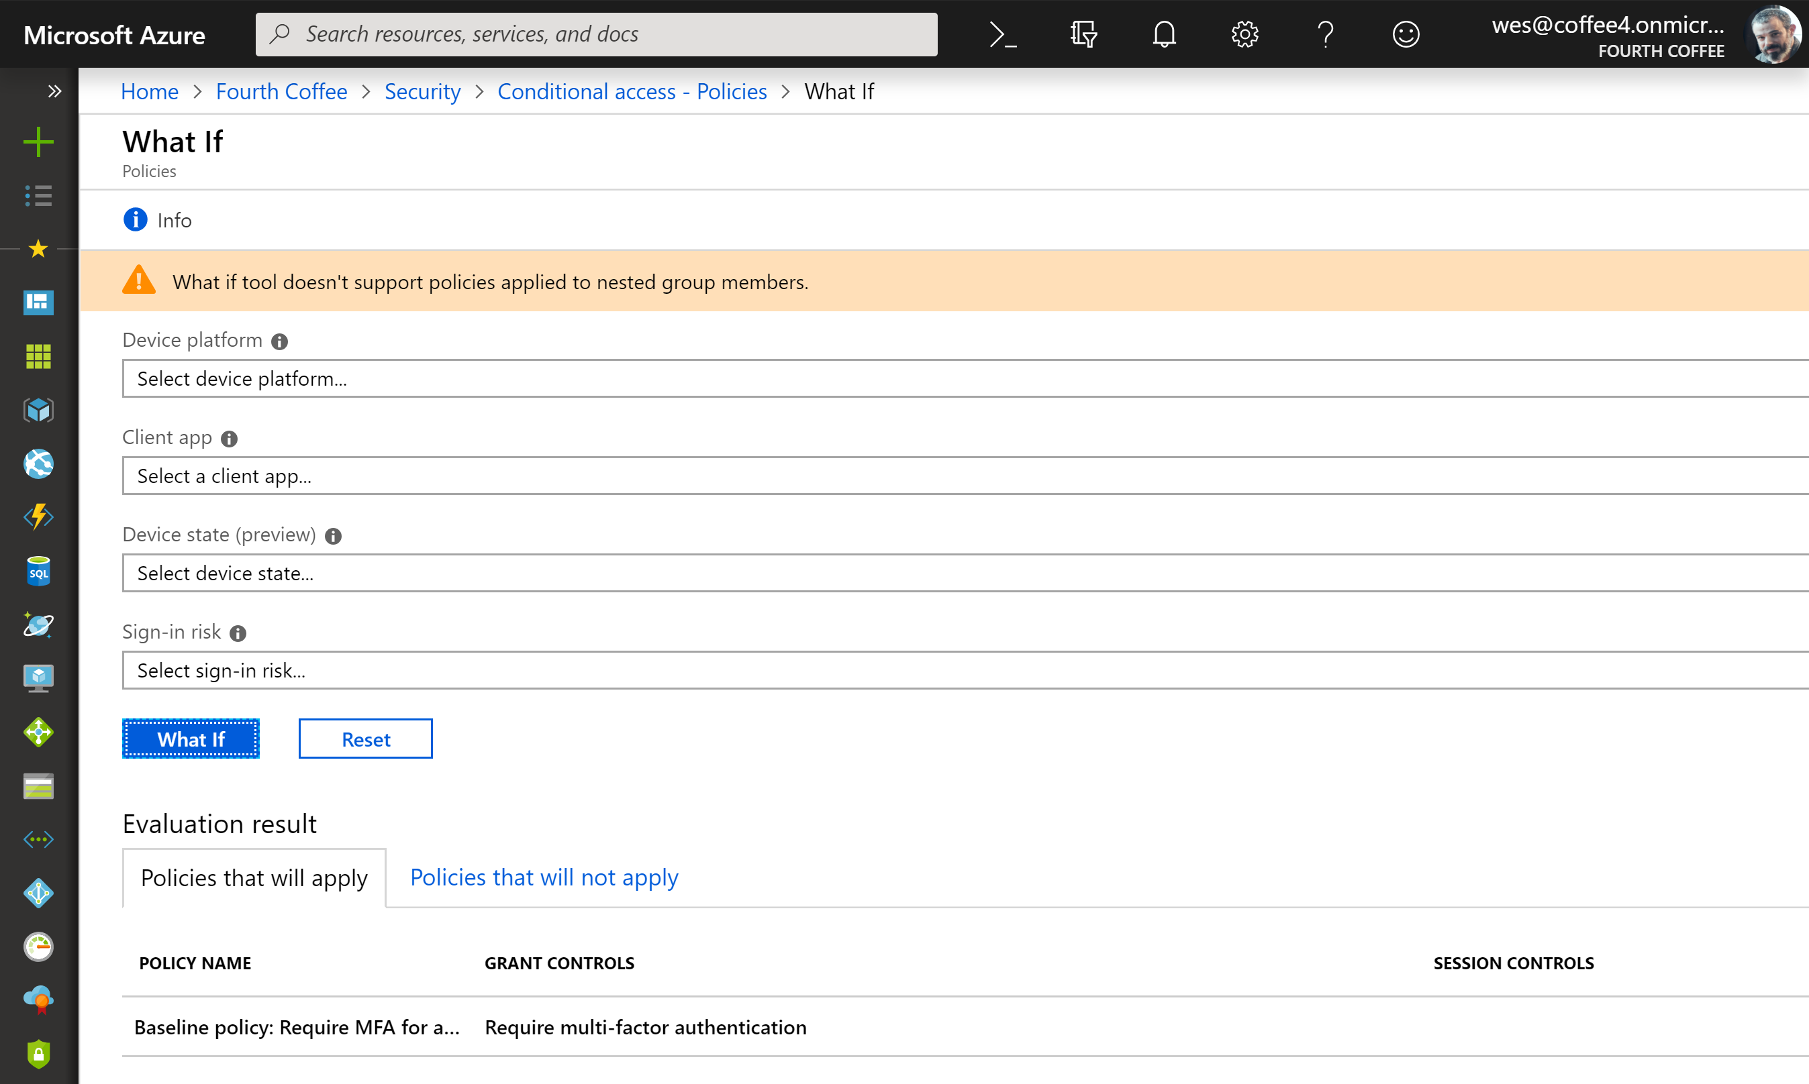
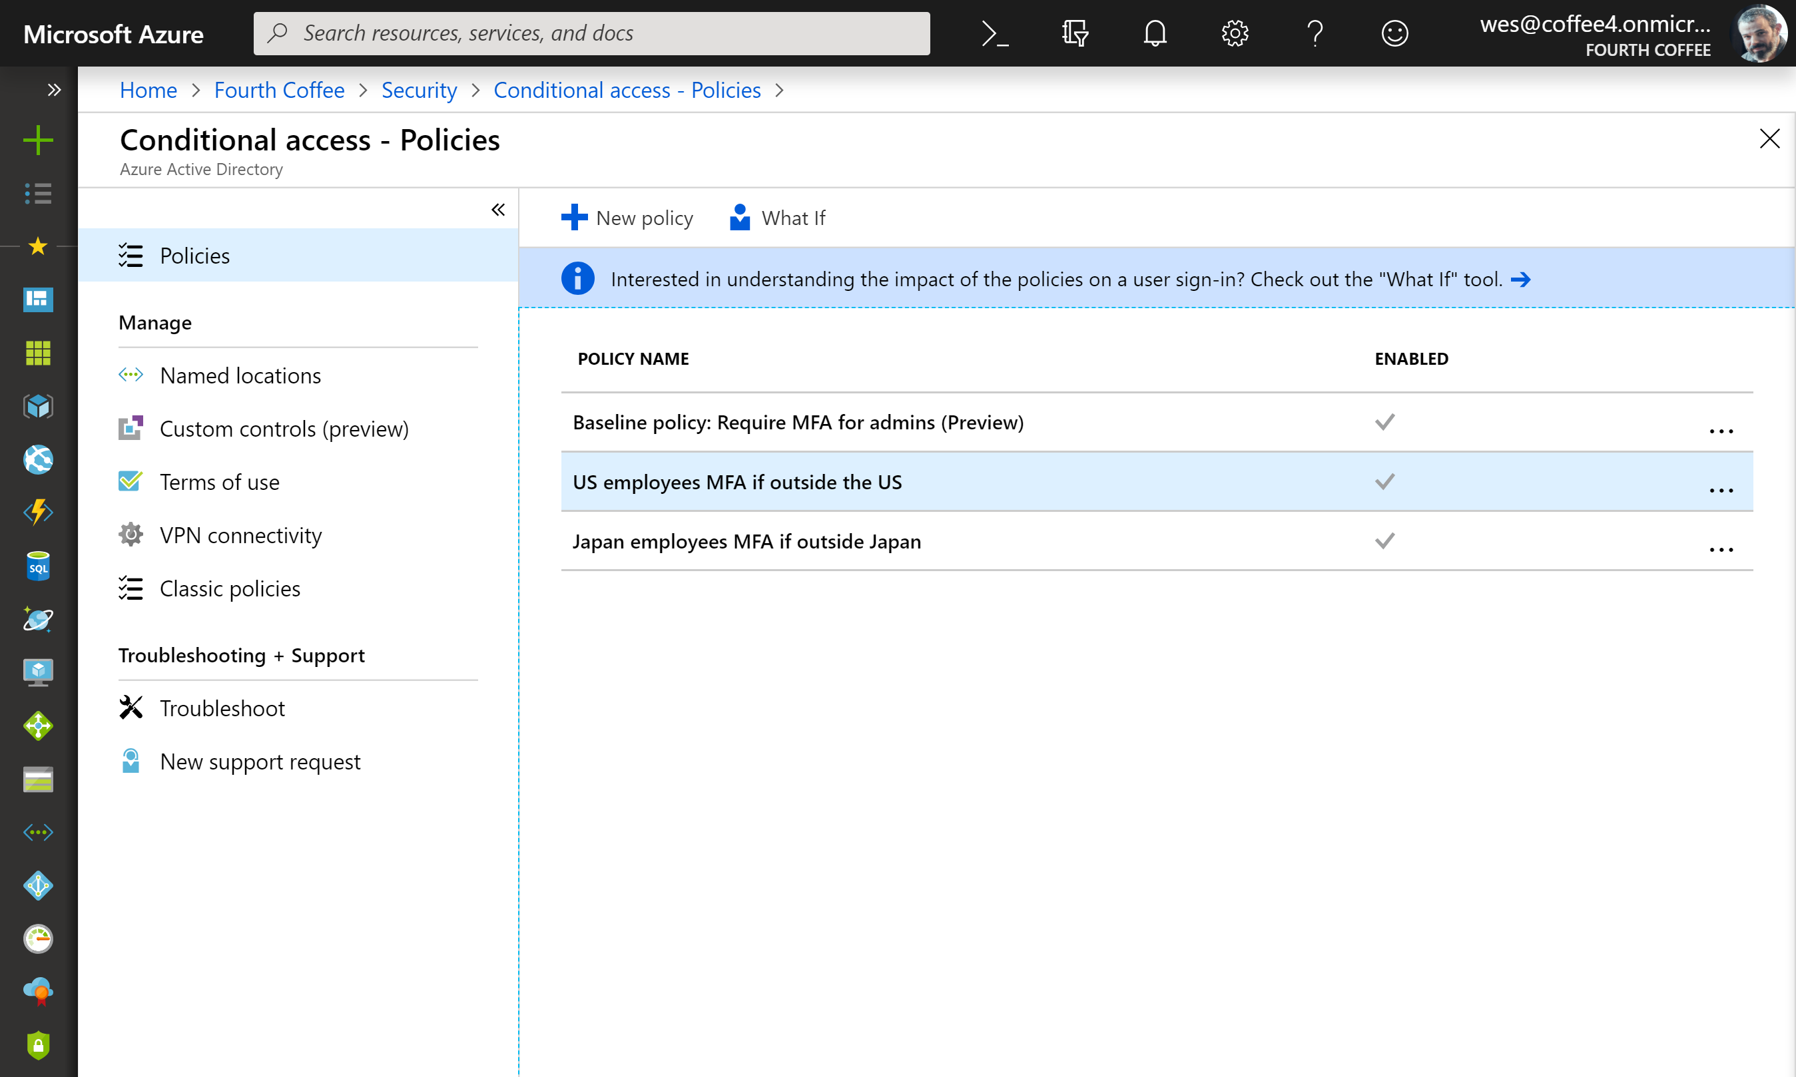
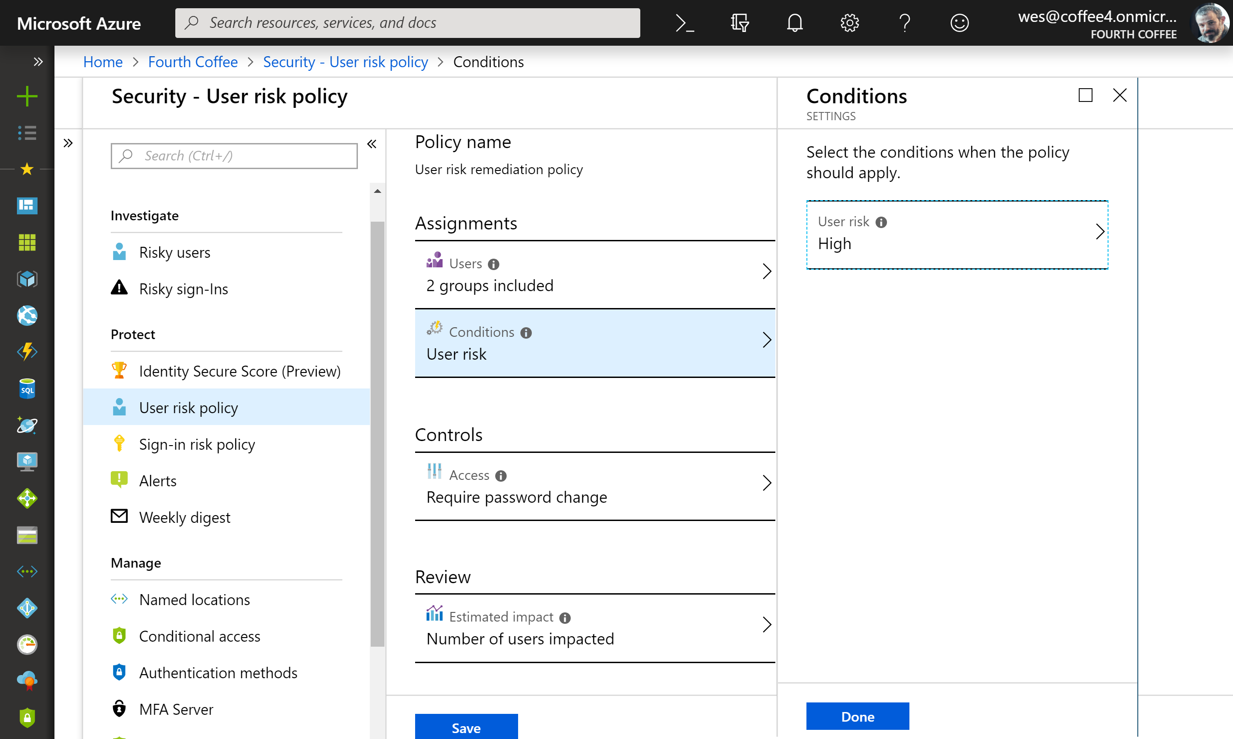
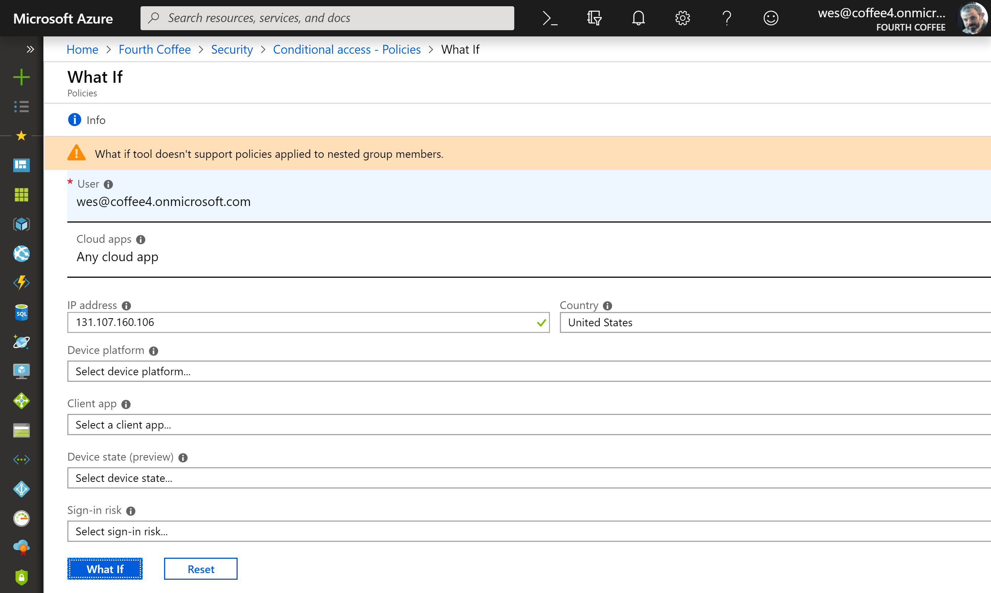
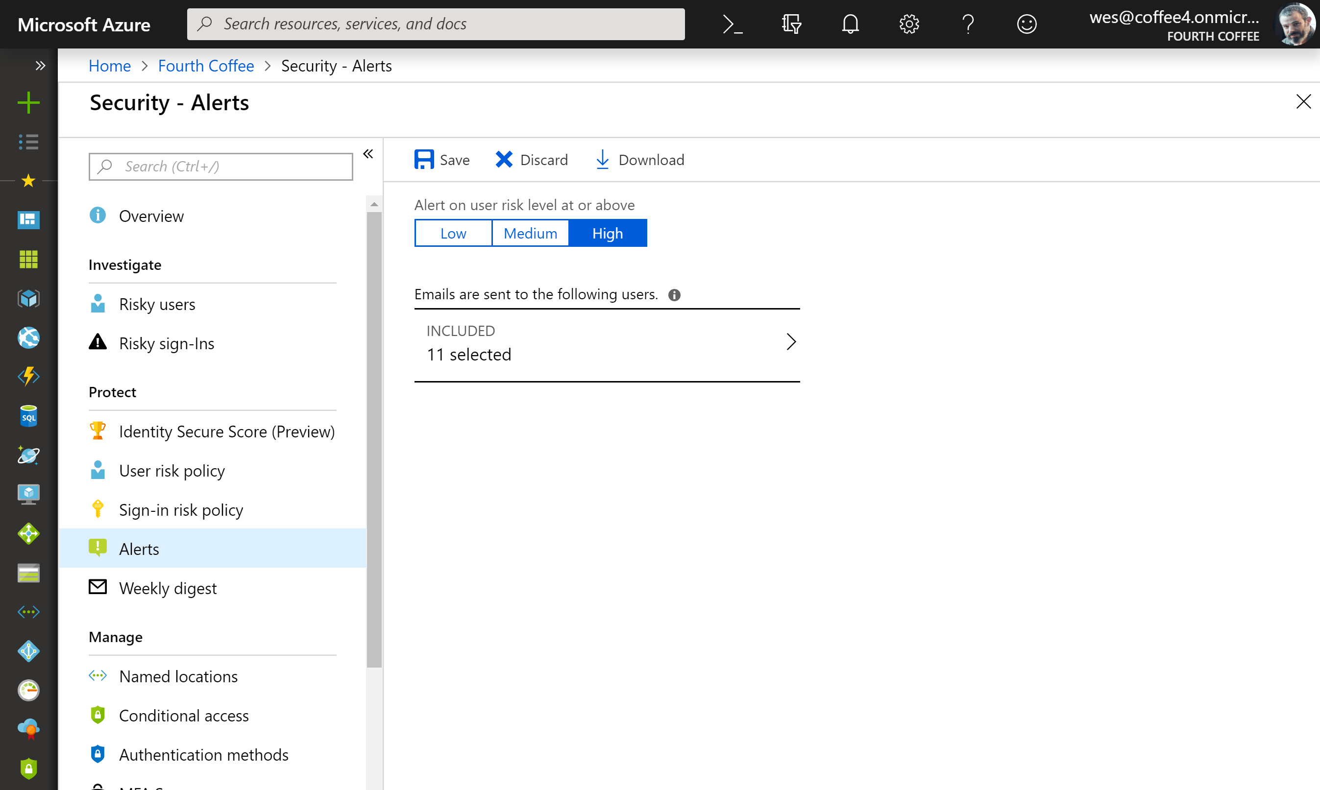
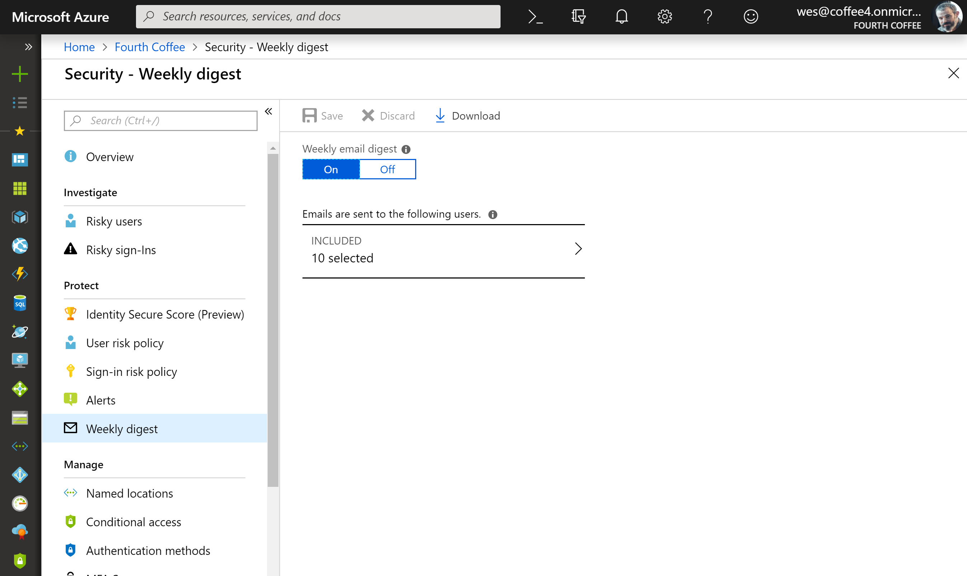
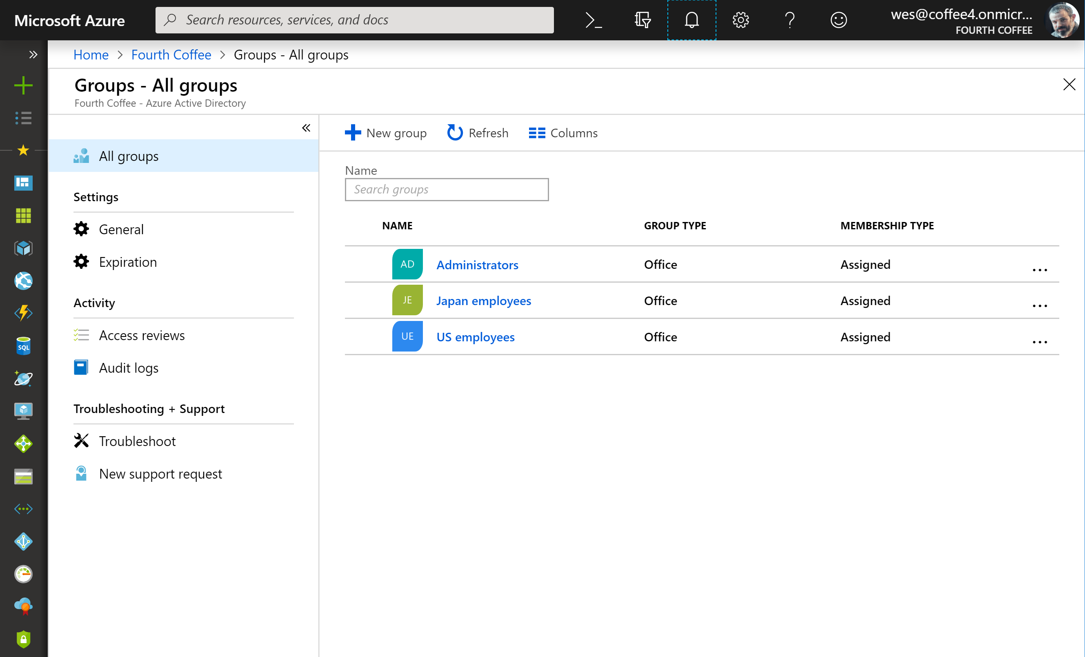
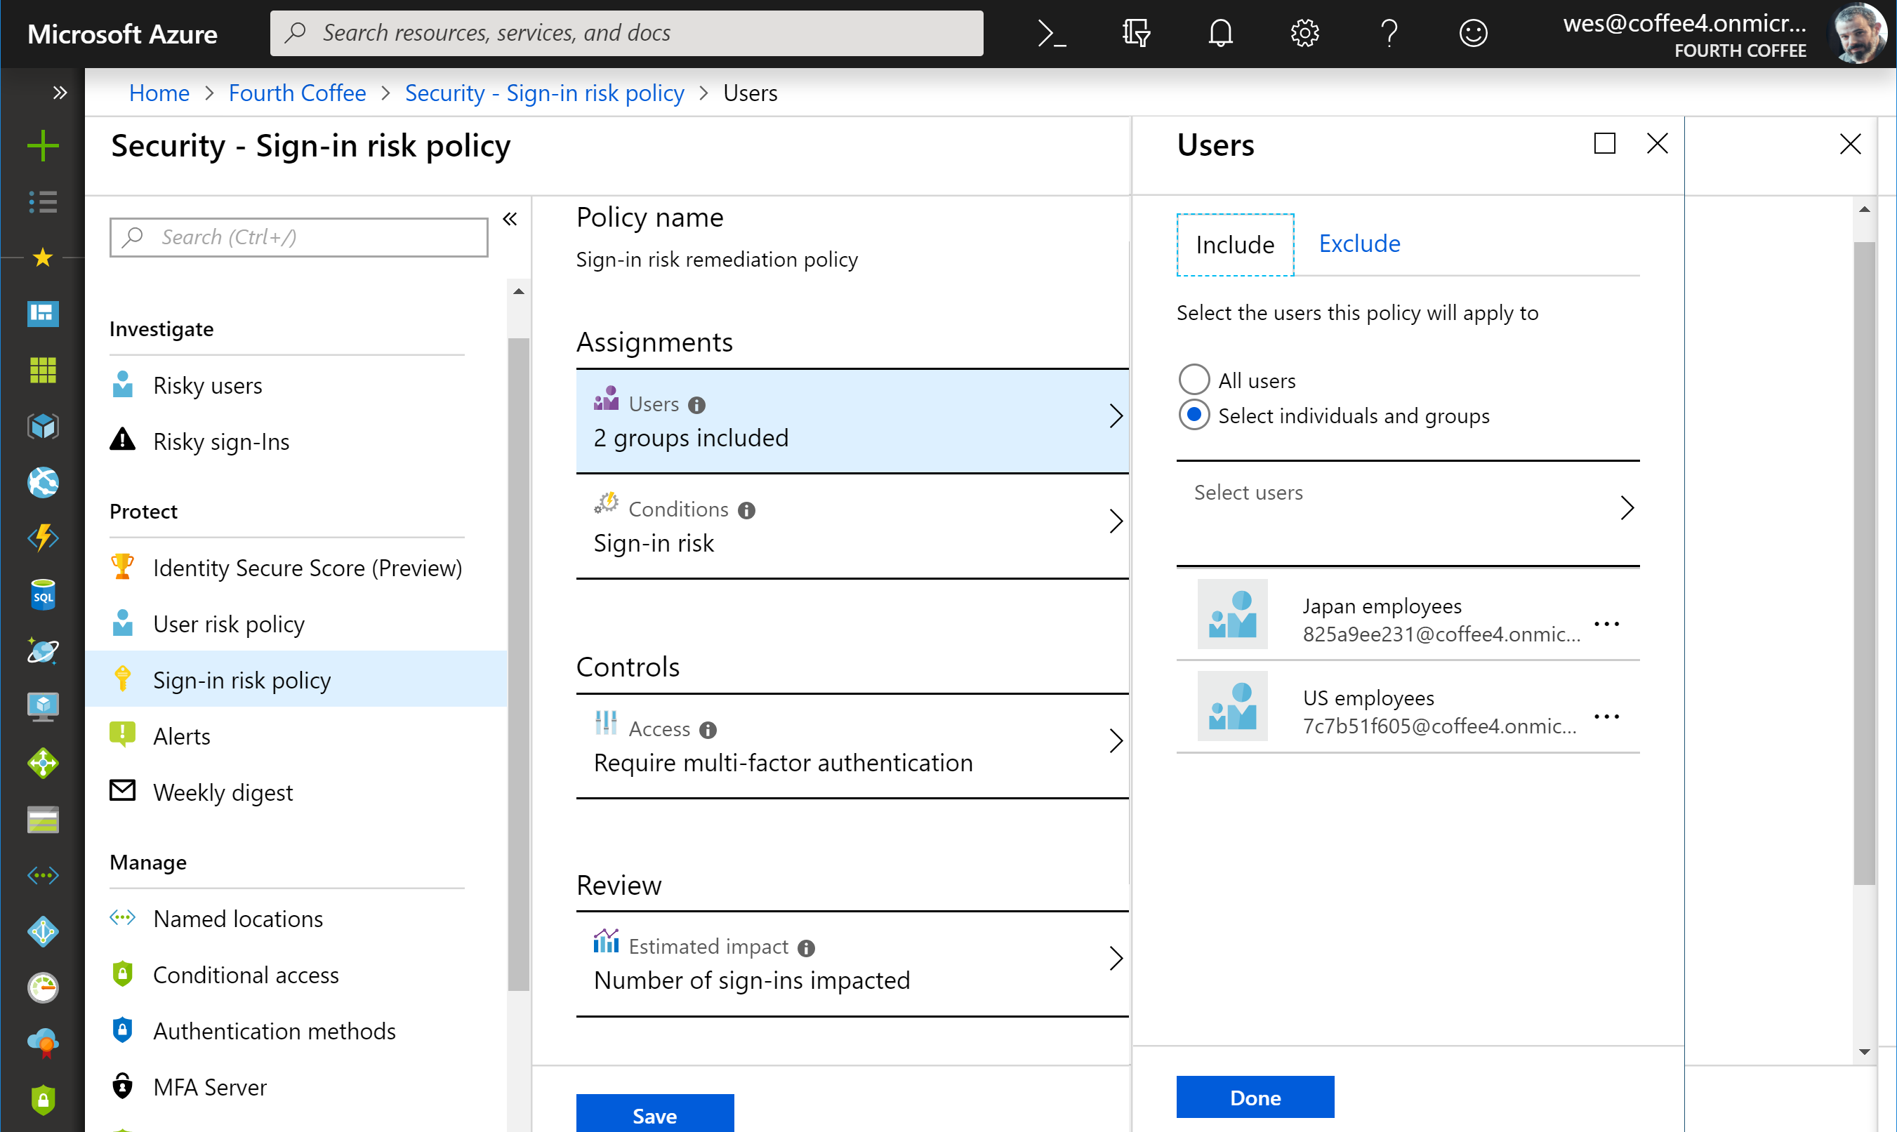
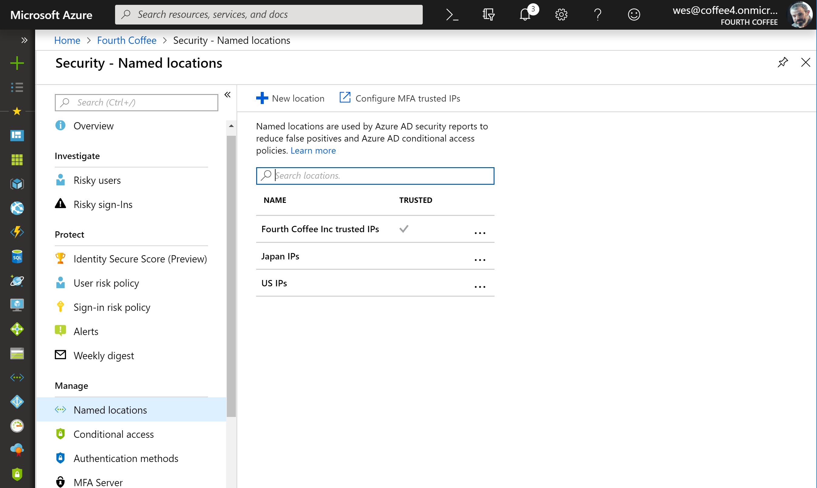
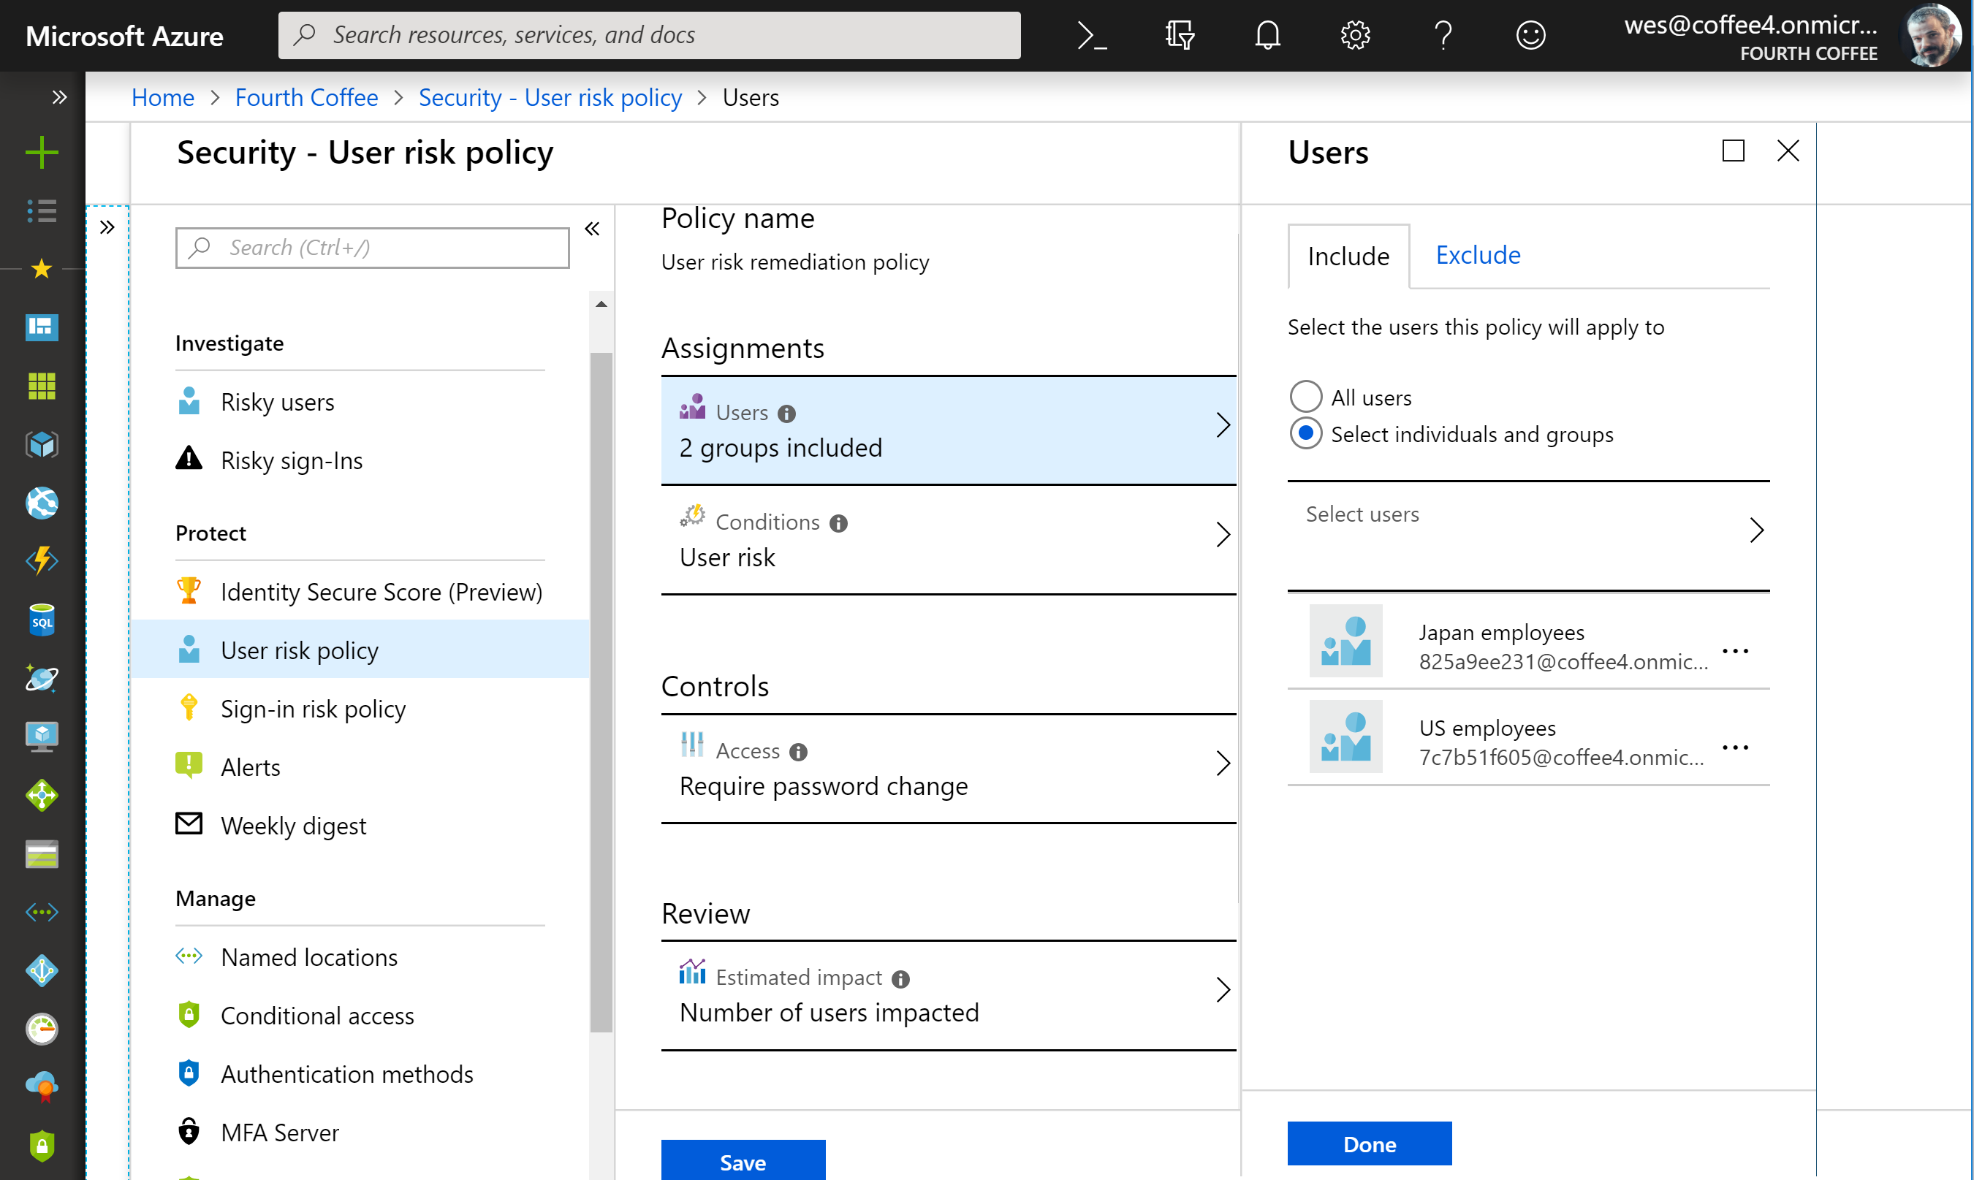
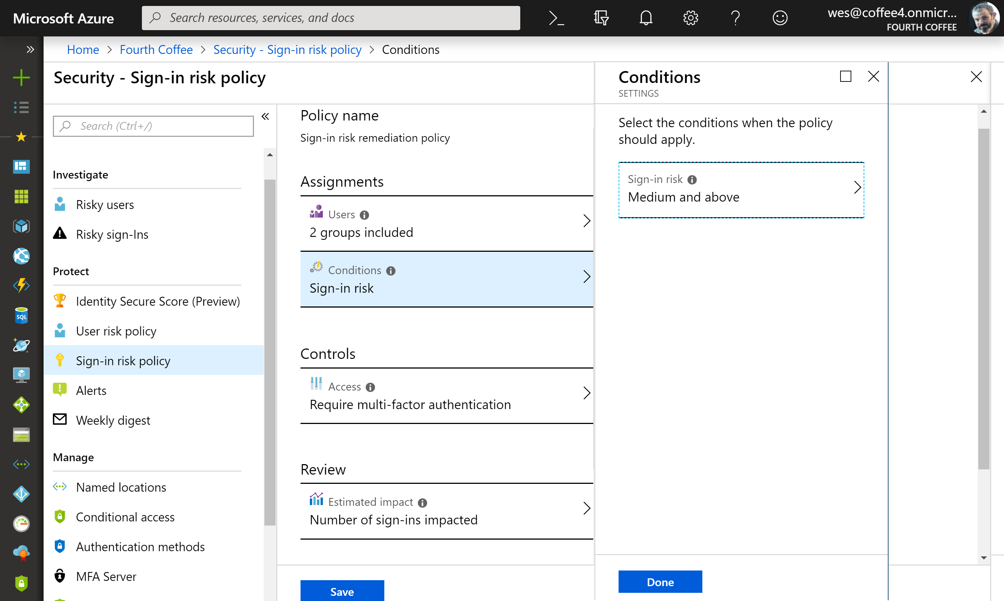
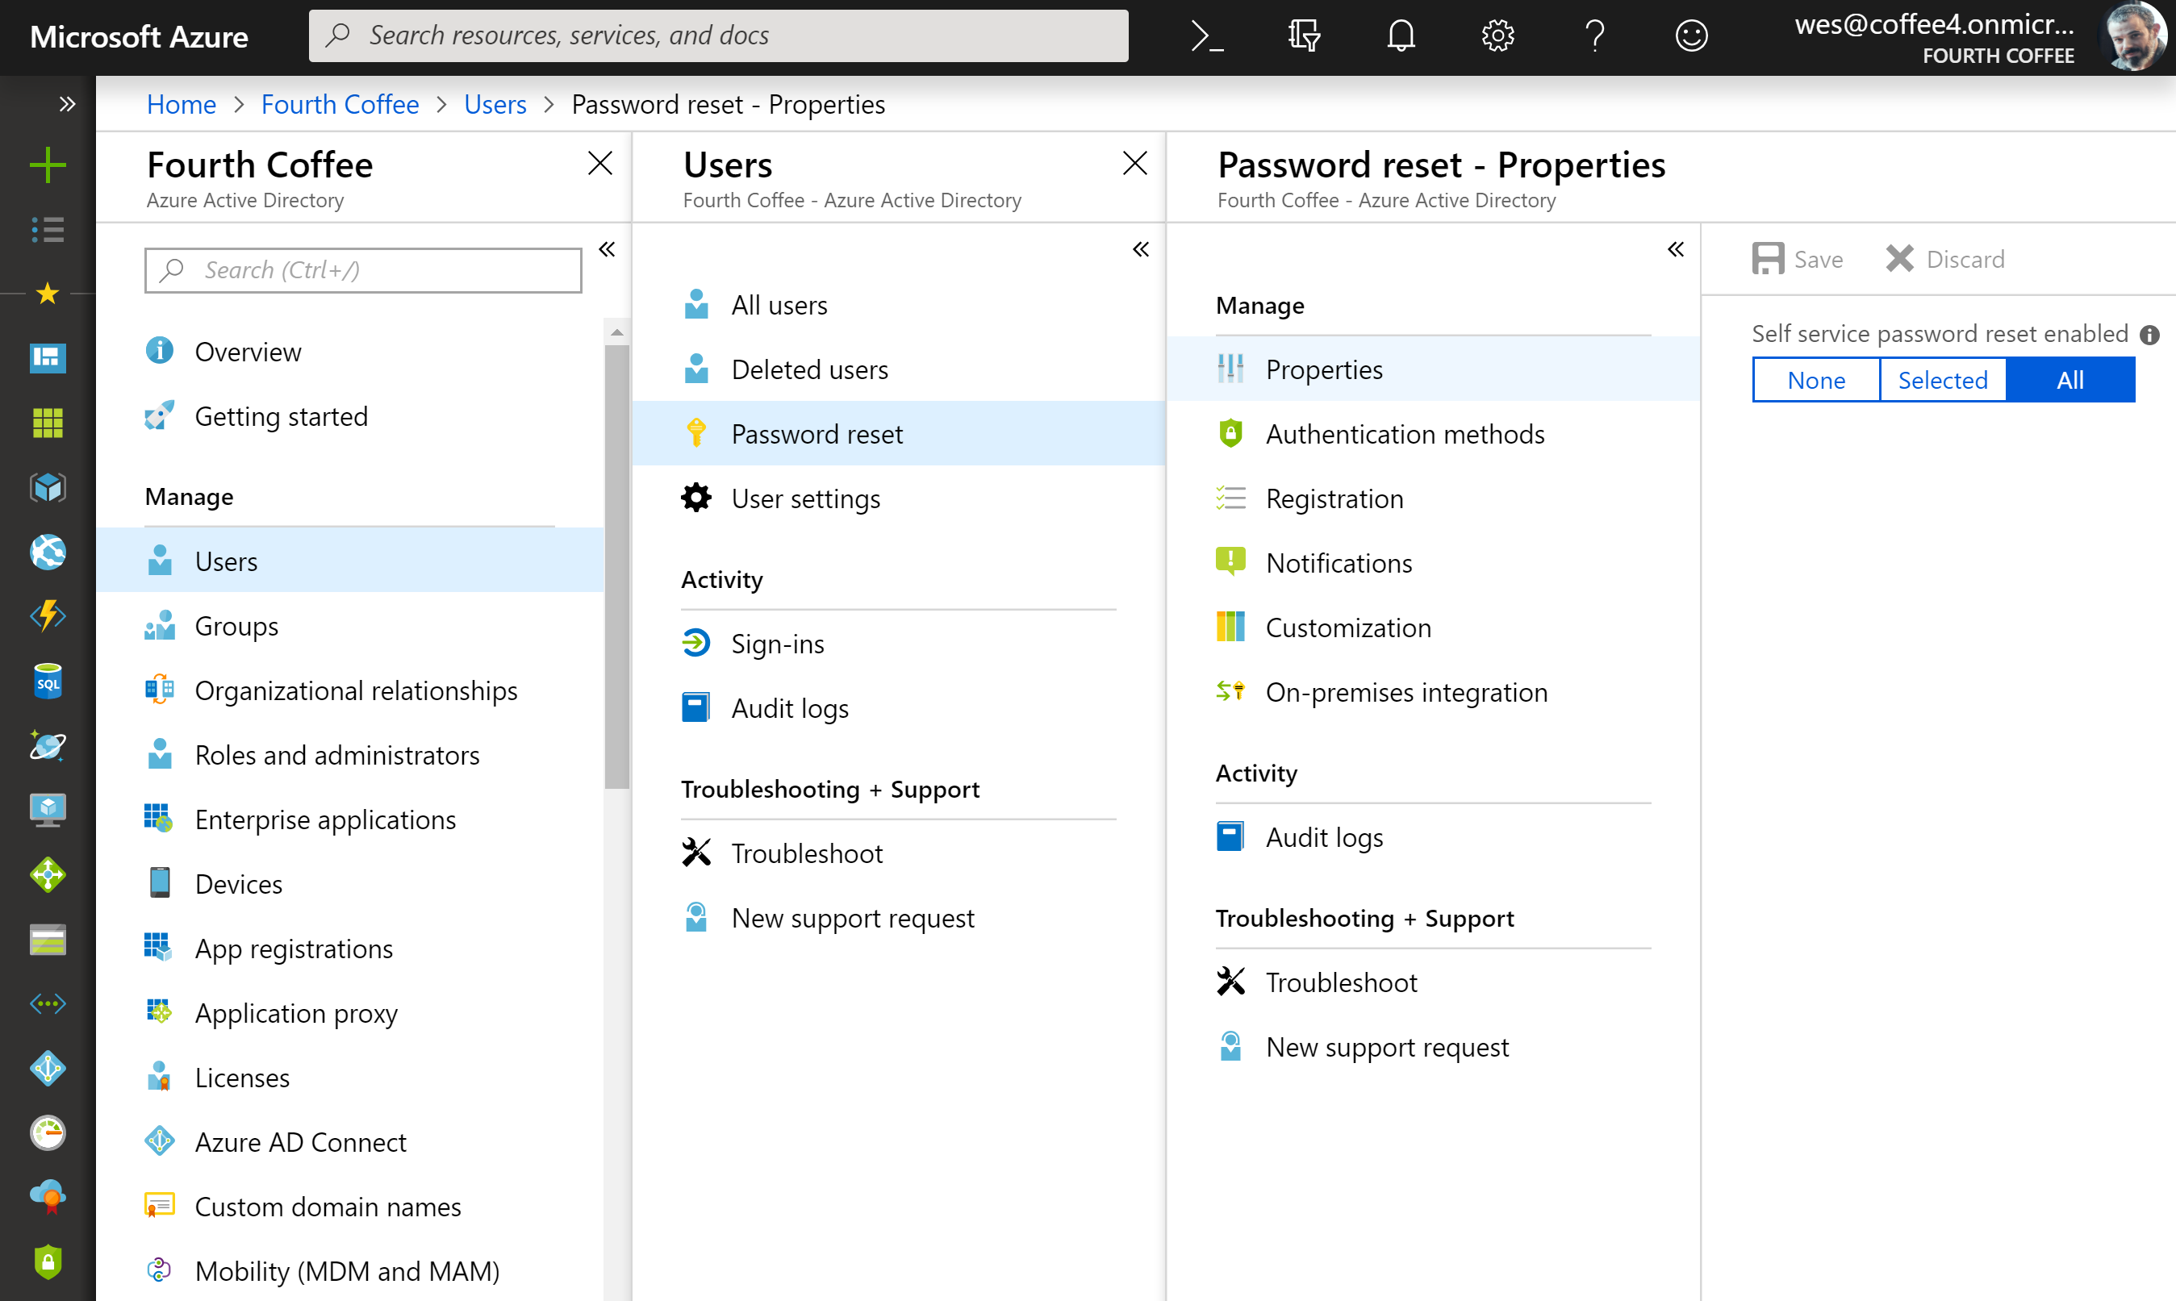
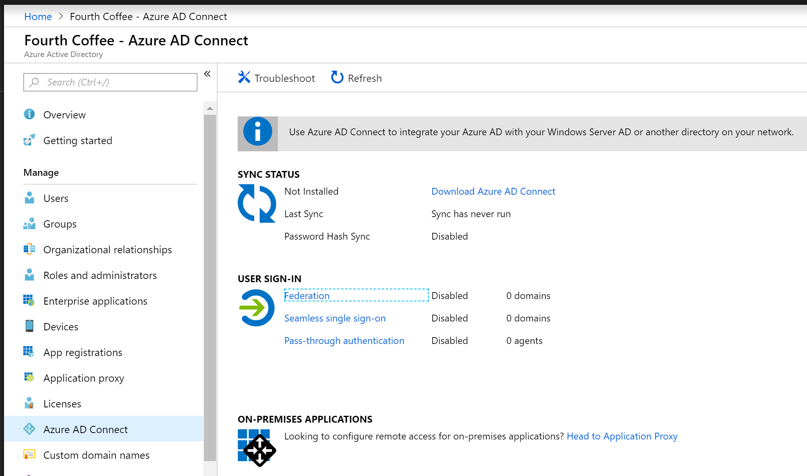
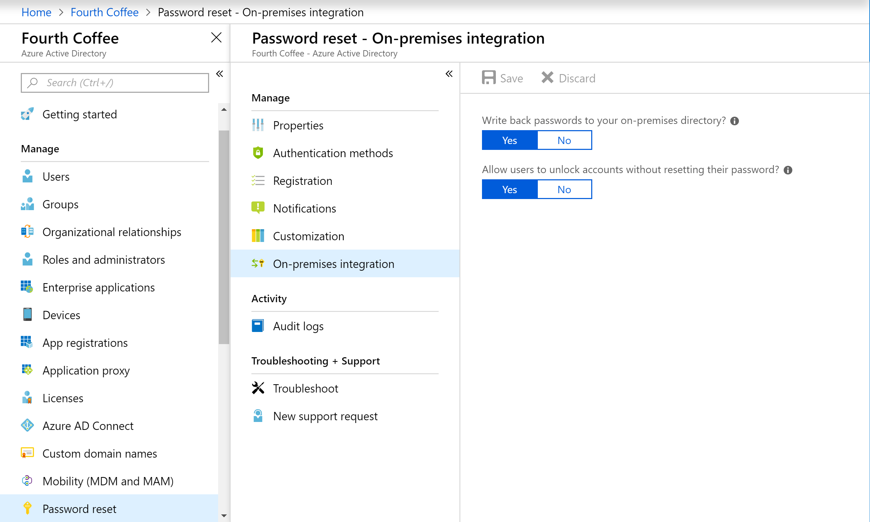
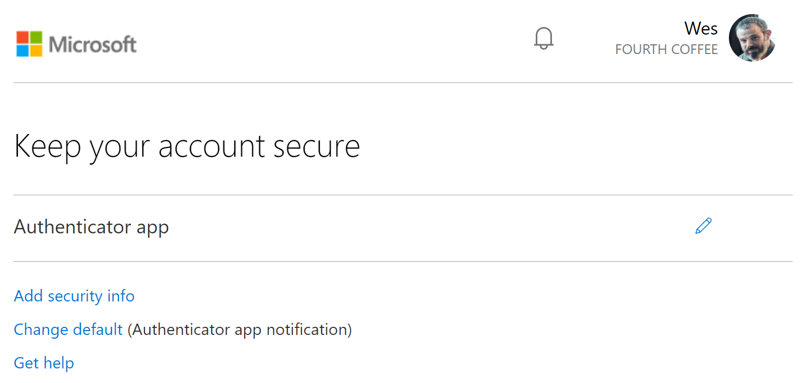
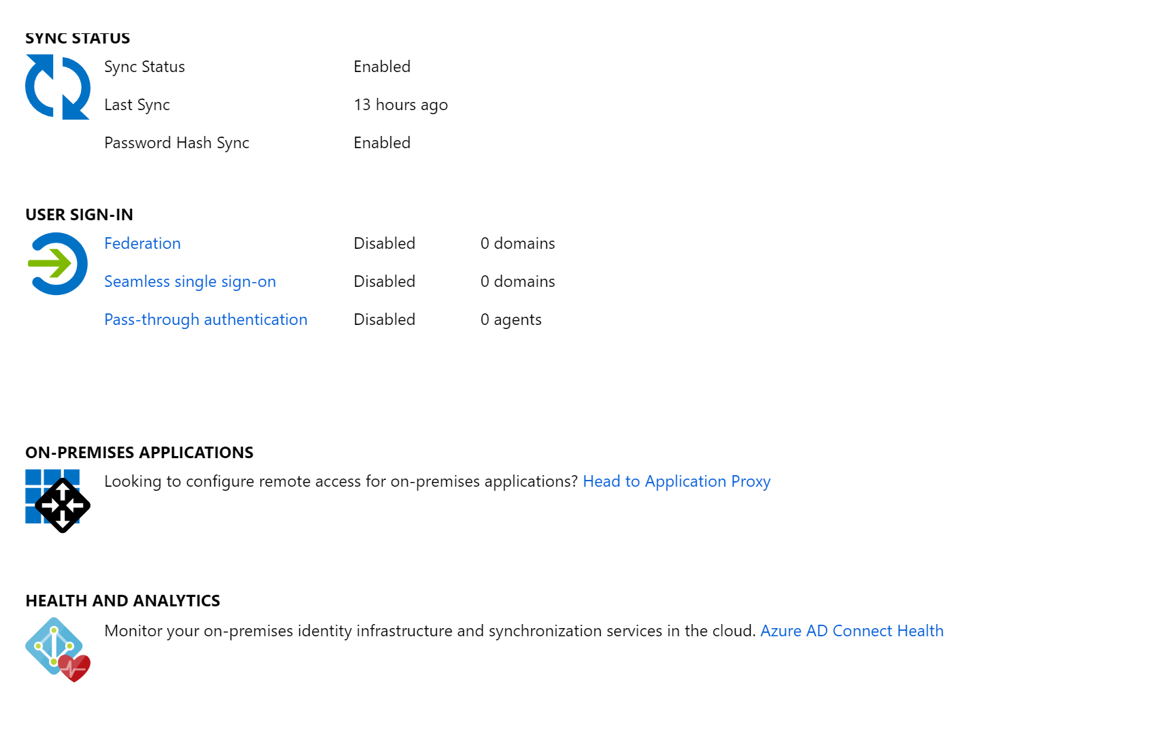
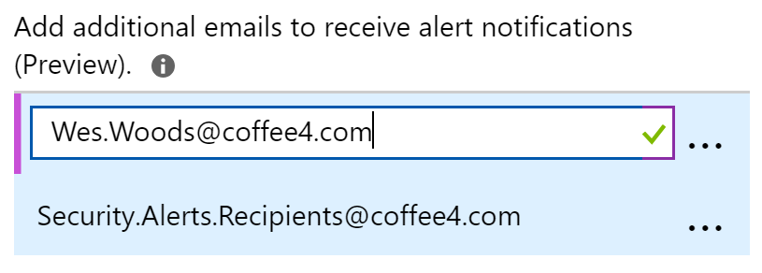
Security Identity Tools
MFA
  Groups
  Self Service Pass Reset
  Conditional Access
  What If
  Identity Protection
  User risk policy
  Sign-in risk policy
  Alerts
  Weekly digest
  Trusted IPs
  Password hash sync
  Password writeback

Slide 37
Questions?

