Slide 1
Windows Admin Center
Information Here
1/25/2019

Slide 2
Agenda
What is it?
  How do I get it?
  Why do I want it?
  How much is it?
What’s this environment we’re seeing?
Installation
Upgrading
Setting a client server up for it
Adding a server
Importing servers
Desktop Management?
Server Management
  Generic Management
    Device Manager
    Registry
    Firewall
  Storage Migration Service
  System Insights

Slide 3
Agenda
Failover Cluster Management
  Hyper-V
    VMs
    Switches
    Network
    Disks
Hyper-converged Management
  VMs
  Storage
  Hardware

Slide 4
Windows Admin Center (WAC)
What is it?
HTML 5 based management tool for Windows Servers
Extensible APIs
Stateless
Semi-annual update frequency

Slide 5
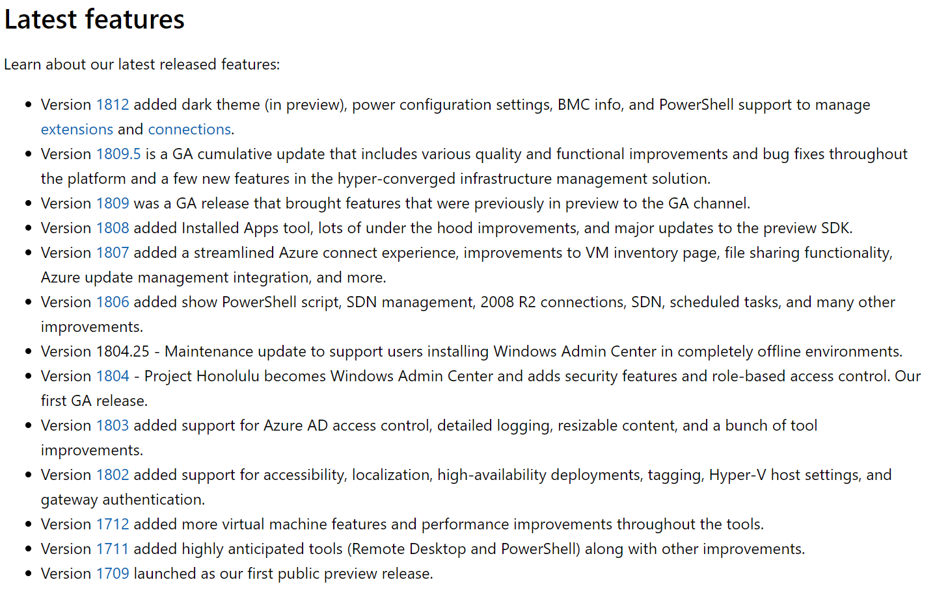
Windows Admin Center (WAC)
Updates

Slide 6
Windows Admin Center (WAC)
Why do I want it?
HTML 5 based management tool for Windows Servers
Extensible APIs
Stateless
(sound familiar?)
The first Microsoft management tool to make core viable for normal humans

Slide 7
Windows Admin Center (WAC)
How much is it?
Free with (any version of) Windows Server!

Slide 8
What’s this environment?

Slide 9
What’s this environment?
Cobbled together scraps – but this will generate 90% of the questions
In total:
  14 cores at reasonably high clock speeds
  104 GB of RAM
  512 GB NVME flash (template VHDXes and OS)
  1.75 TB SSD (differencing VHDXes and bulk data)
  6x gigabit NICs

Slide 10
What’s this environment?
Cobbled together scraps – but this will generate 90% of the questions
My current laptop
Dell Precision M7530 (2 months old):
  Windows 10 1809 – Hyper-V
  Six core i9-8950HK
  40 GB RAM
  256 GB NVME
  500 GB MLC SSD
  1x Intel NIC
  1x USB 3.0 NIC
My previous desktop
Intel NUC6i7KYK (2 years old):
  Server 2019 – Hyper-V
  Quad core I7-6770HQ
  32 GB RAM
  256 GB NVME
  1x Intel NIC
  1x USB 3.0 NIC
My previous, previous, previous laptop
Dell Precision M4600 (8 years old)
  Server 2019 – Hyper-V
  Quad core I7-2720QM
  32 GB RAM
  256 GB SSD (9 years old)
  1 TB SSD
  1x Intel NIC
  1x USB 3.0 NIC
Netgear GS108T
  8 ports gigabit

Slide 11
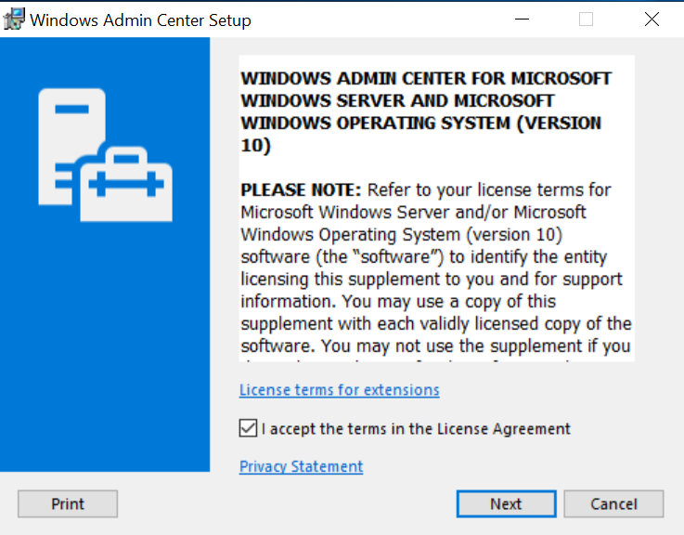
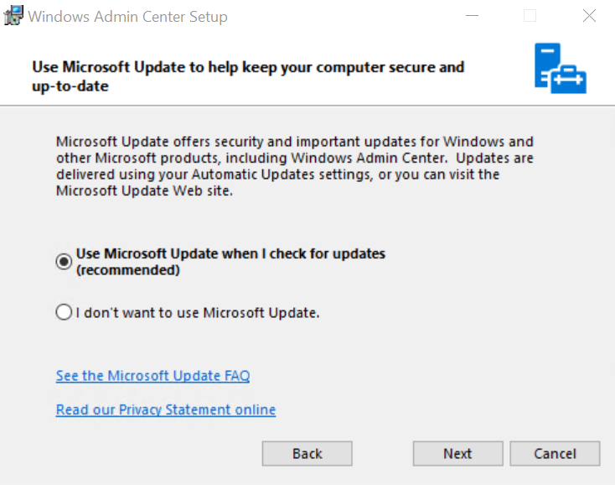
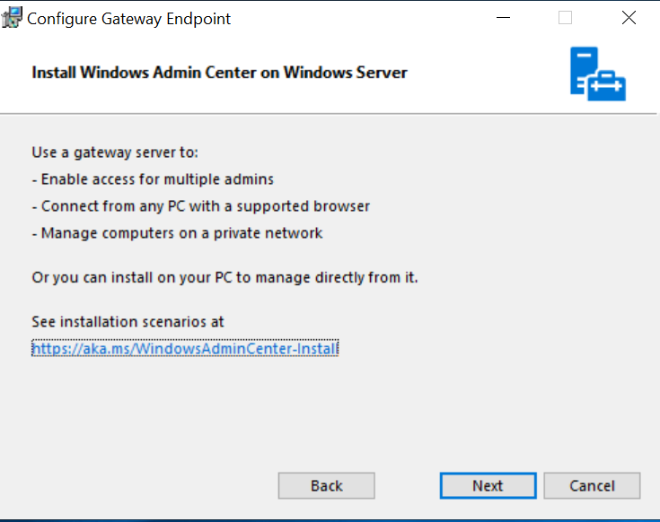
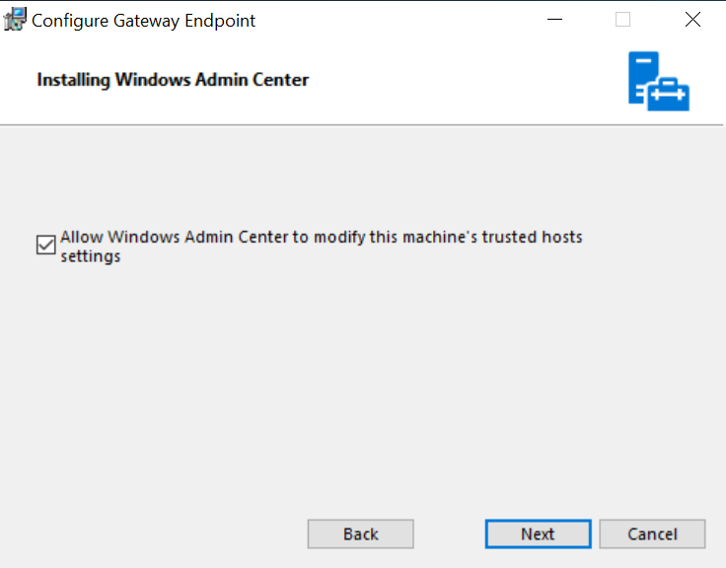
Installation
Hopefully the demo isn’t dead this early

Slide 12
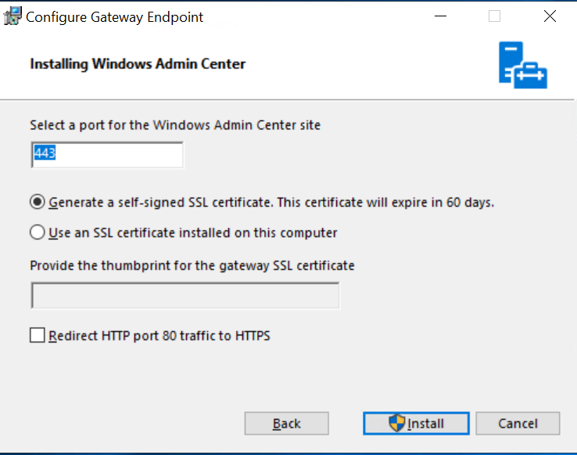
Installation
Hopefully the demo isn’t dead this early
Most important screen
Do you have an internal PKI?
Note: that the self signed expires every 60 days. This is, conveniently, roughly the release cycle of WAC.
Almost like they’re forcing upgrades….
Don’t forget this, or you’ll get a lot of frustration.

Slide 13
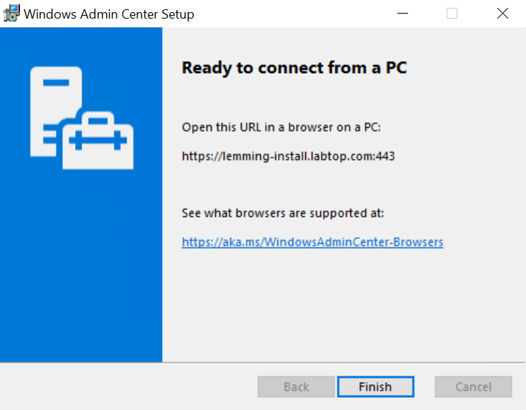
Installation
Hopefully the demo isn’t dead this early
HTML5 means IE doesn’t work
Edge can’t install on servers
2 options:
  Connect from desktop
  Install Firefox/Chrome on a server

Slide 14
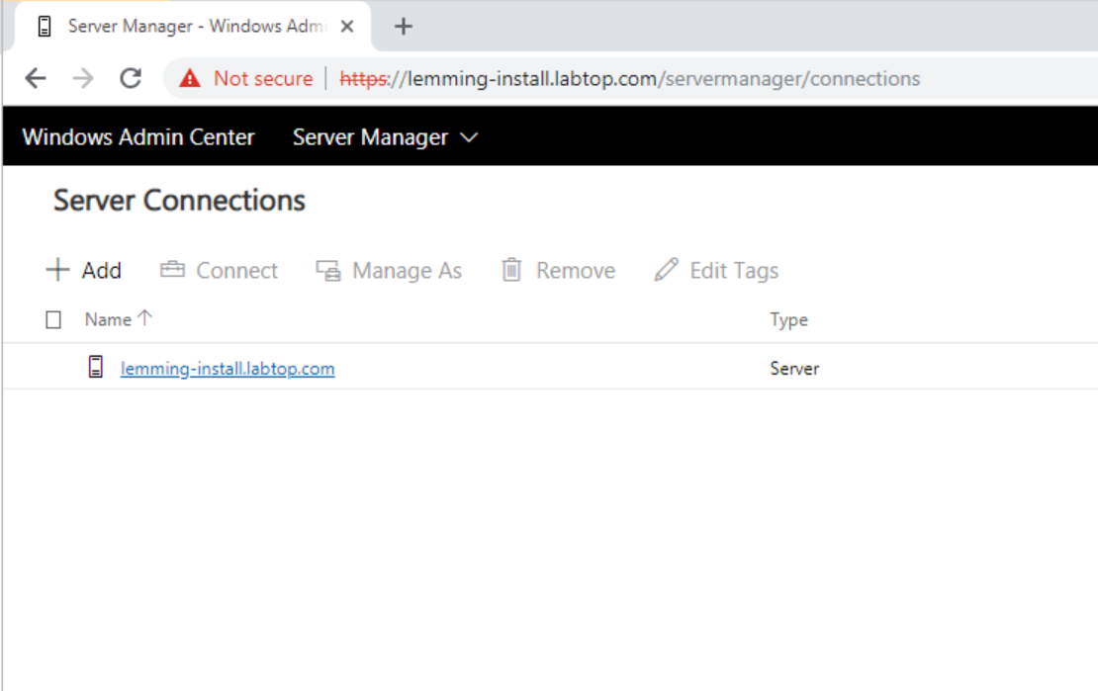
Installation
Hopefully the demo isn’t dead this early
That’s it!

Slide 15
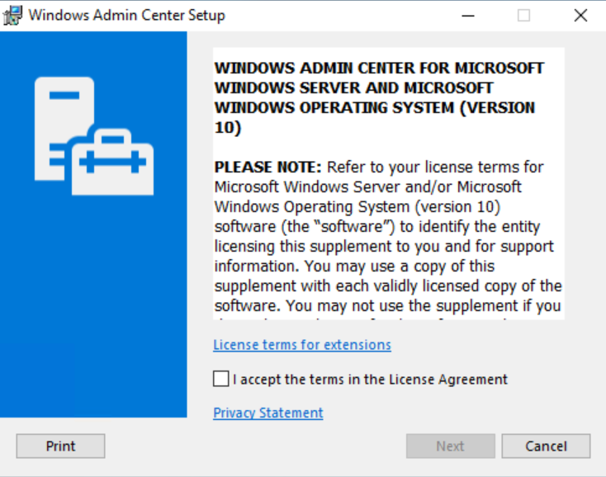
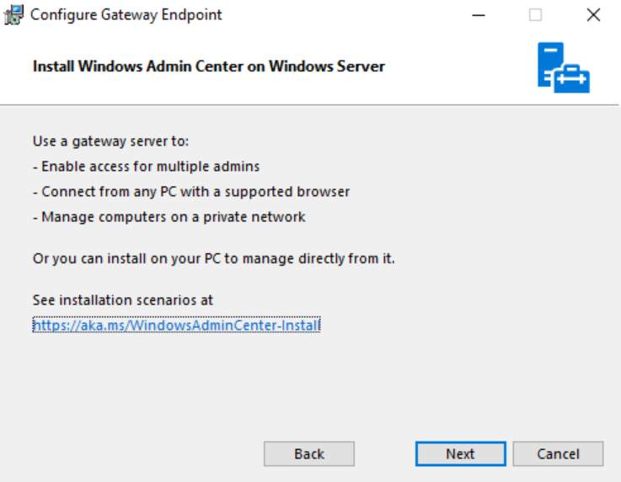

Upgrade
Unrealistic to live demo this

Slide 16
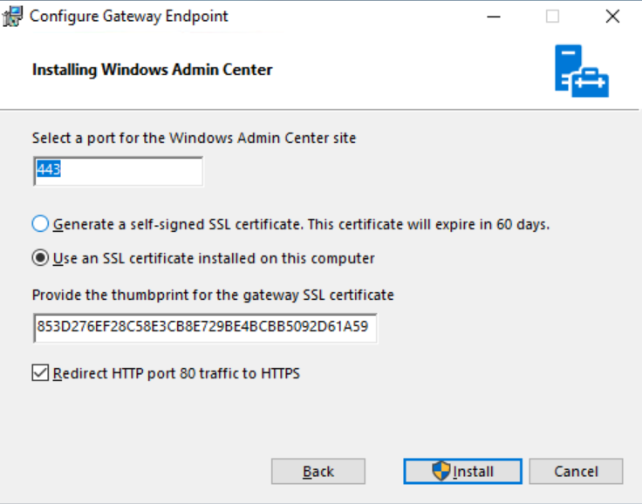
Upgrade
Unrealistic to live demo this
Most important screen
Did you use a real cert?
If not, THIS is the previous self signed cert
that will expire 60 days from original install.
So, let’s do THIS top one so that we don’t get angry in a few days

Slide 17
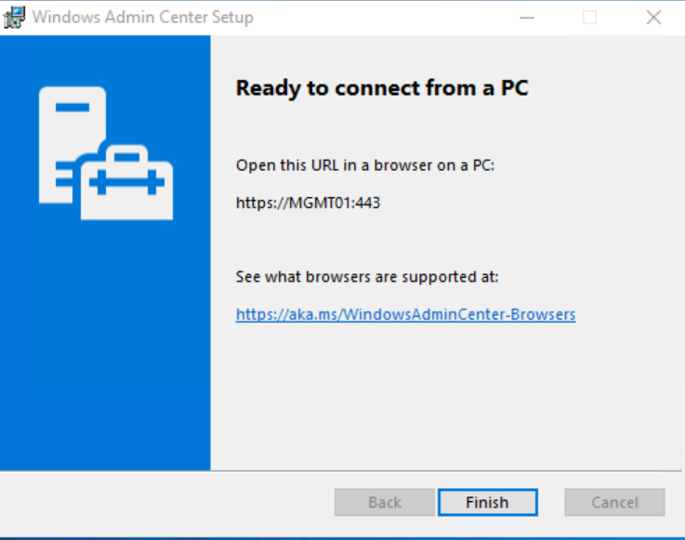
Upgrade
Unrealistic to live demo this

Slide 18
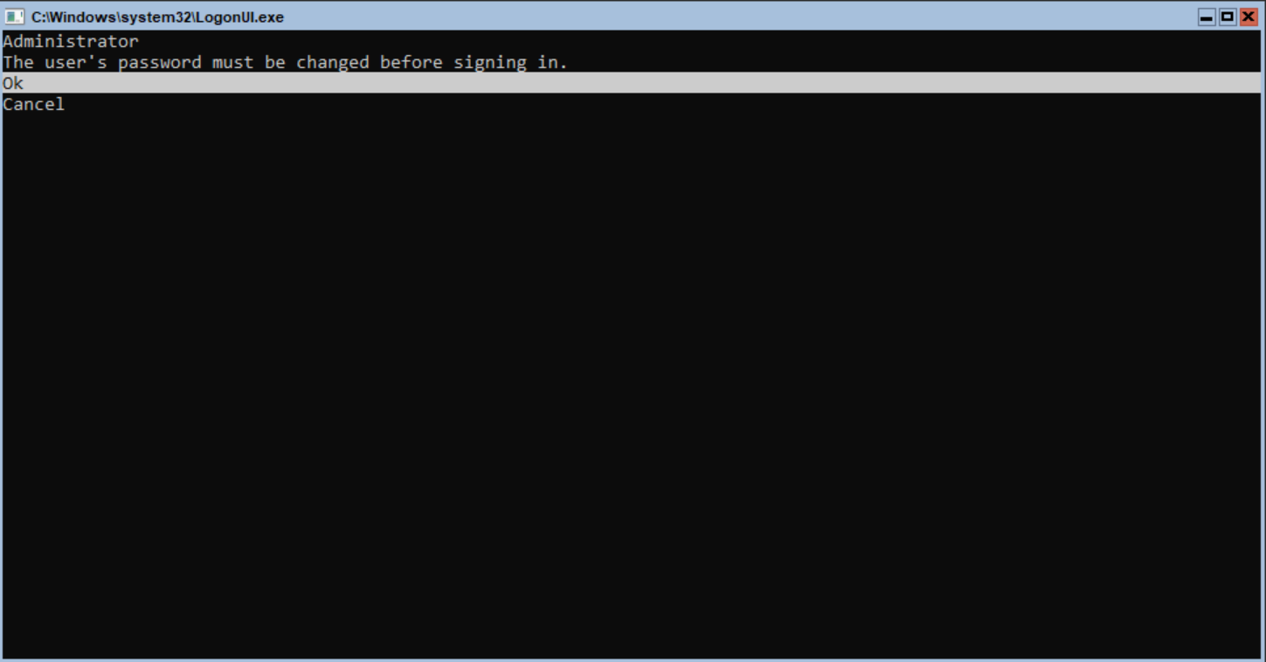
Setting up a server for WAC
Basic 2019 Core install
Set your password

Slide 19
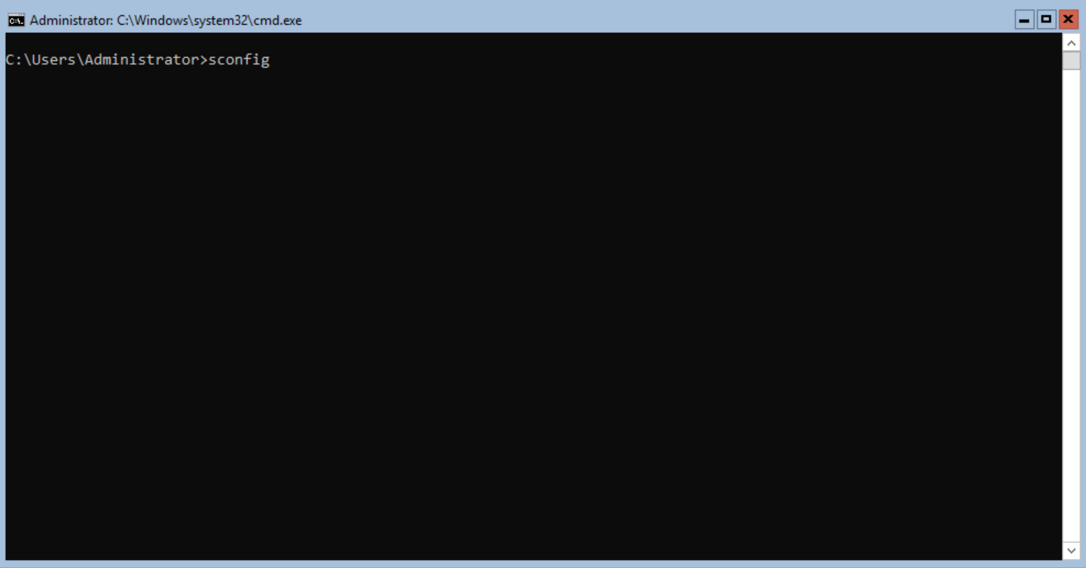
Setting up a server for WAC
Type sconfig to launch text-based menu
This has been around since 2008 R2

Slide 20
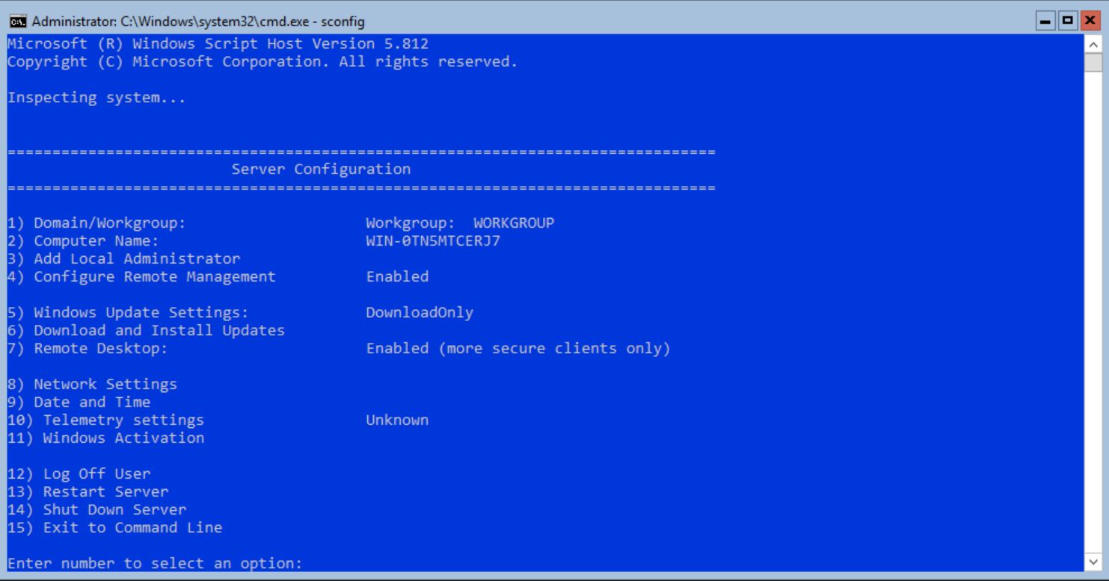
Setting up a server for WAC
Hit 8 and fill out your network information when prompted

Slide 21
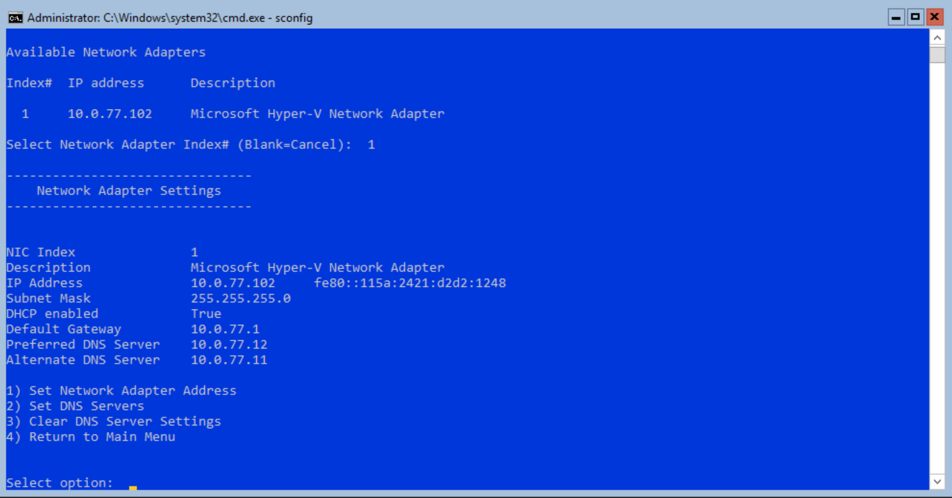
Setting up a server for WAC
For my lab, the servers are DHCP
Hit 4 to go back to the previous menu

Slide 22
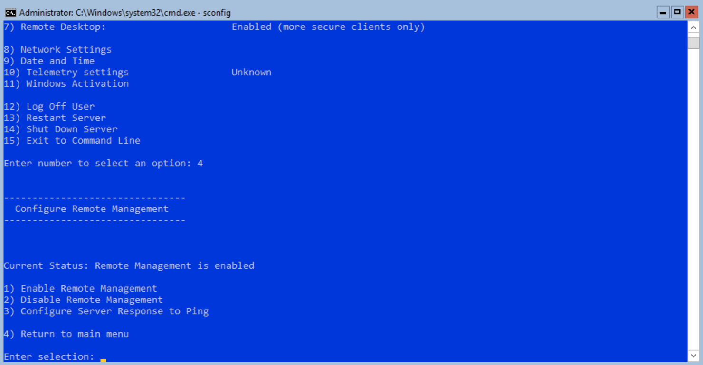
Setting up a server for WAC
Hit 4 to change remote management
Enable it… and maybe ping
4 to return to previous screen

Slide 23
Setting up a server for WAC
Hit 1 to set your domain/workgroup

Slide 24
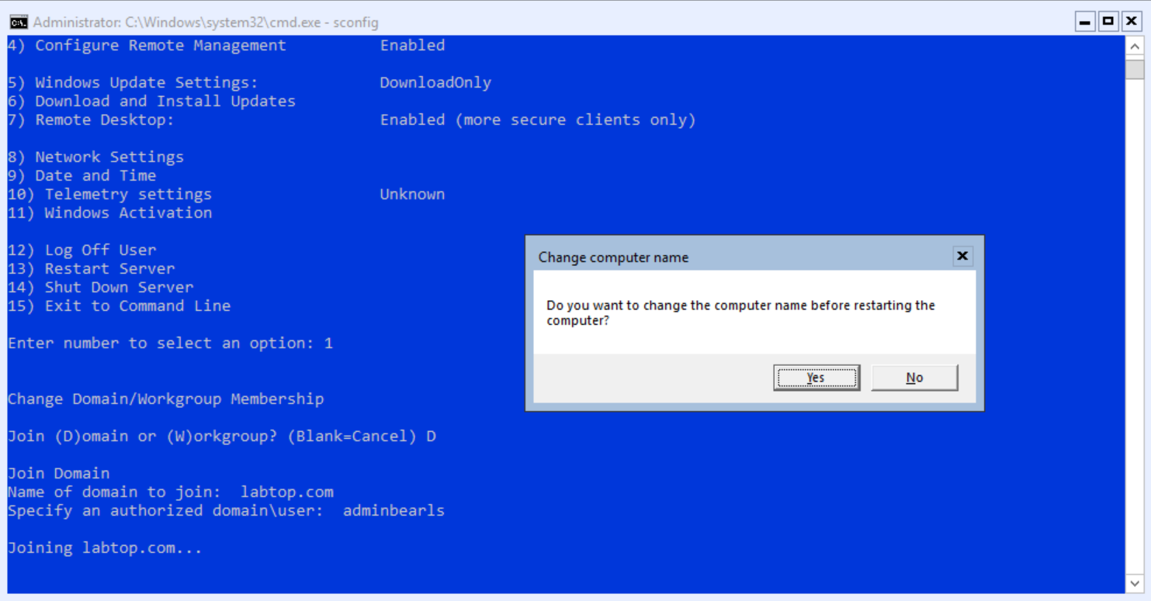
Setting up a server for WAC
Type your domain, credentials
Say Yes you want to change the name

Slide 25
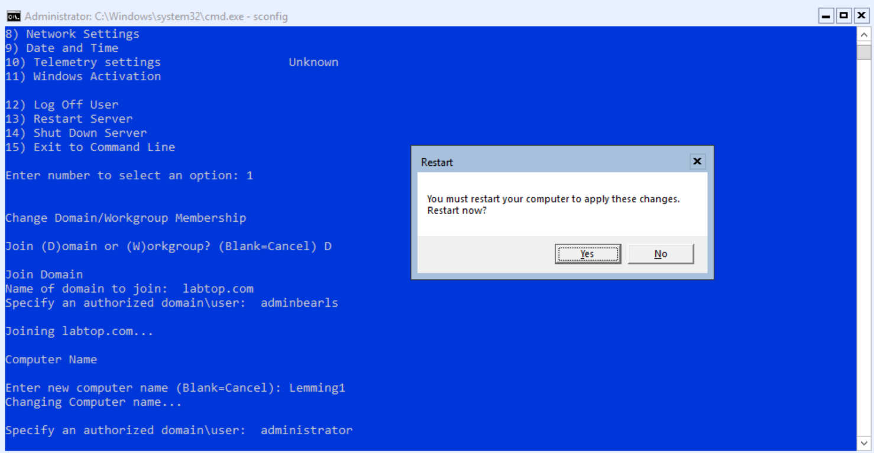
Setting up a server for WAC
Put in a new name, local credentials
Restart

Slide 26
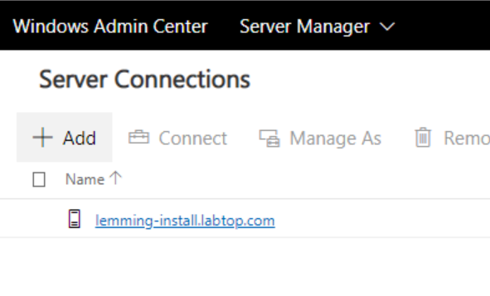
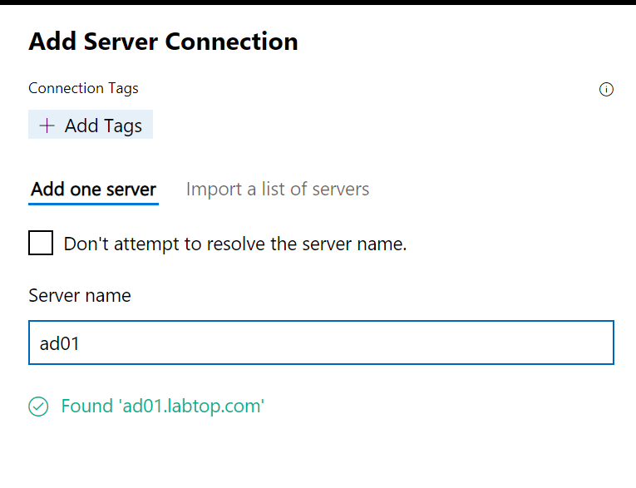
Adding a Server

Slide 27
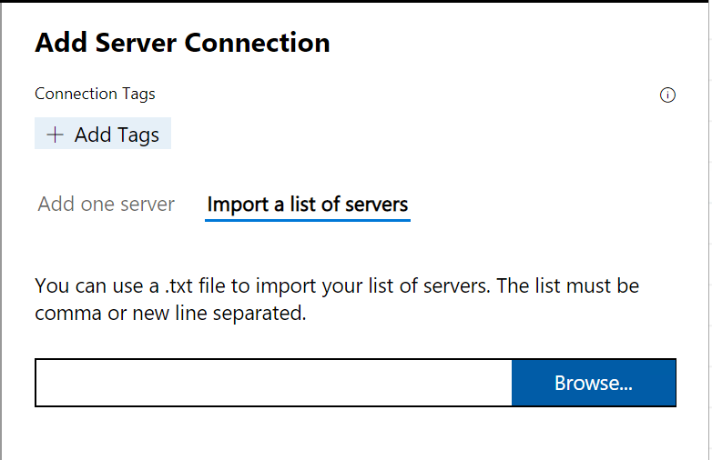
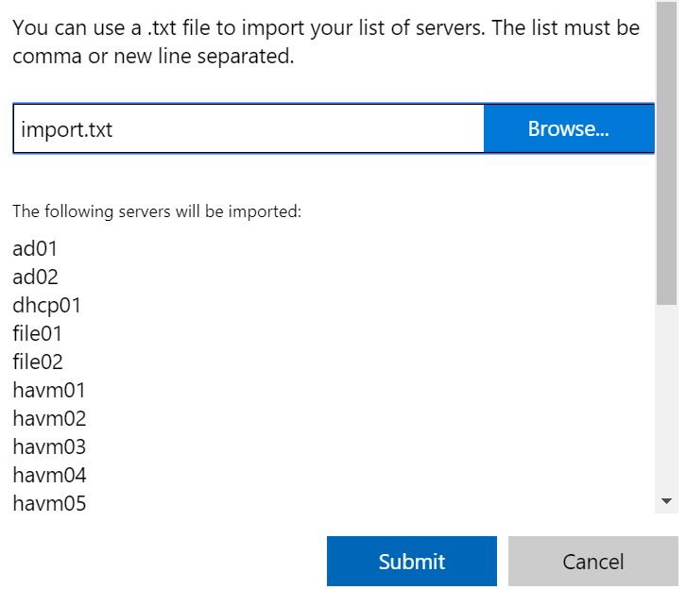
Importing Servers
Add a comma separated list

Slide 28
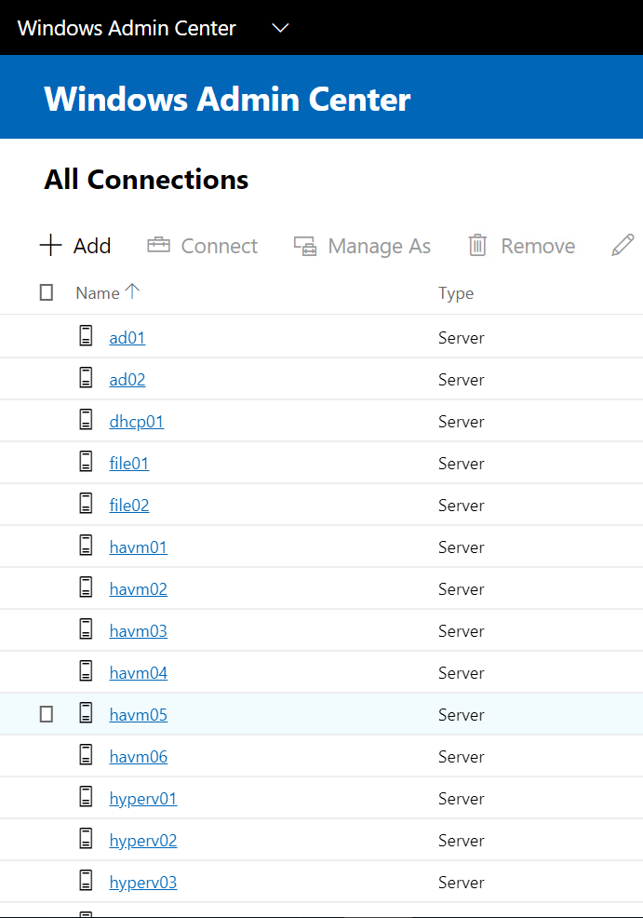
Importing Servers
That was easy.

Slide 29
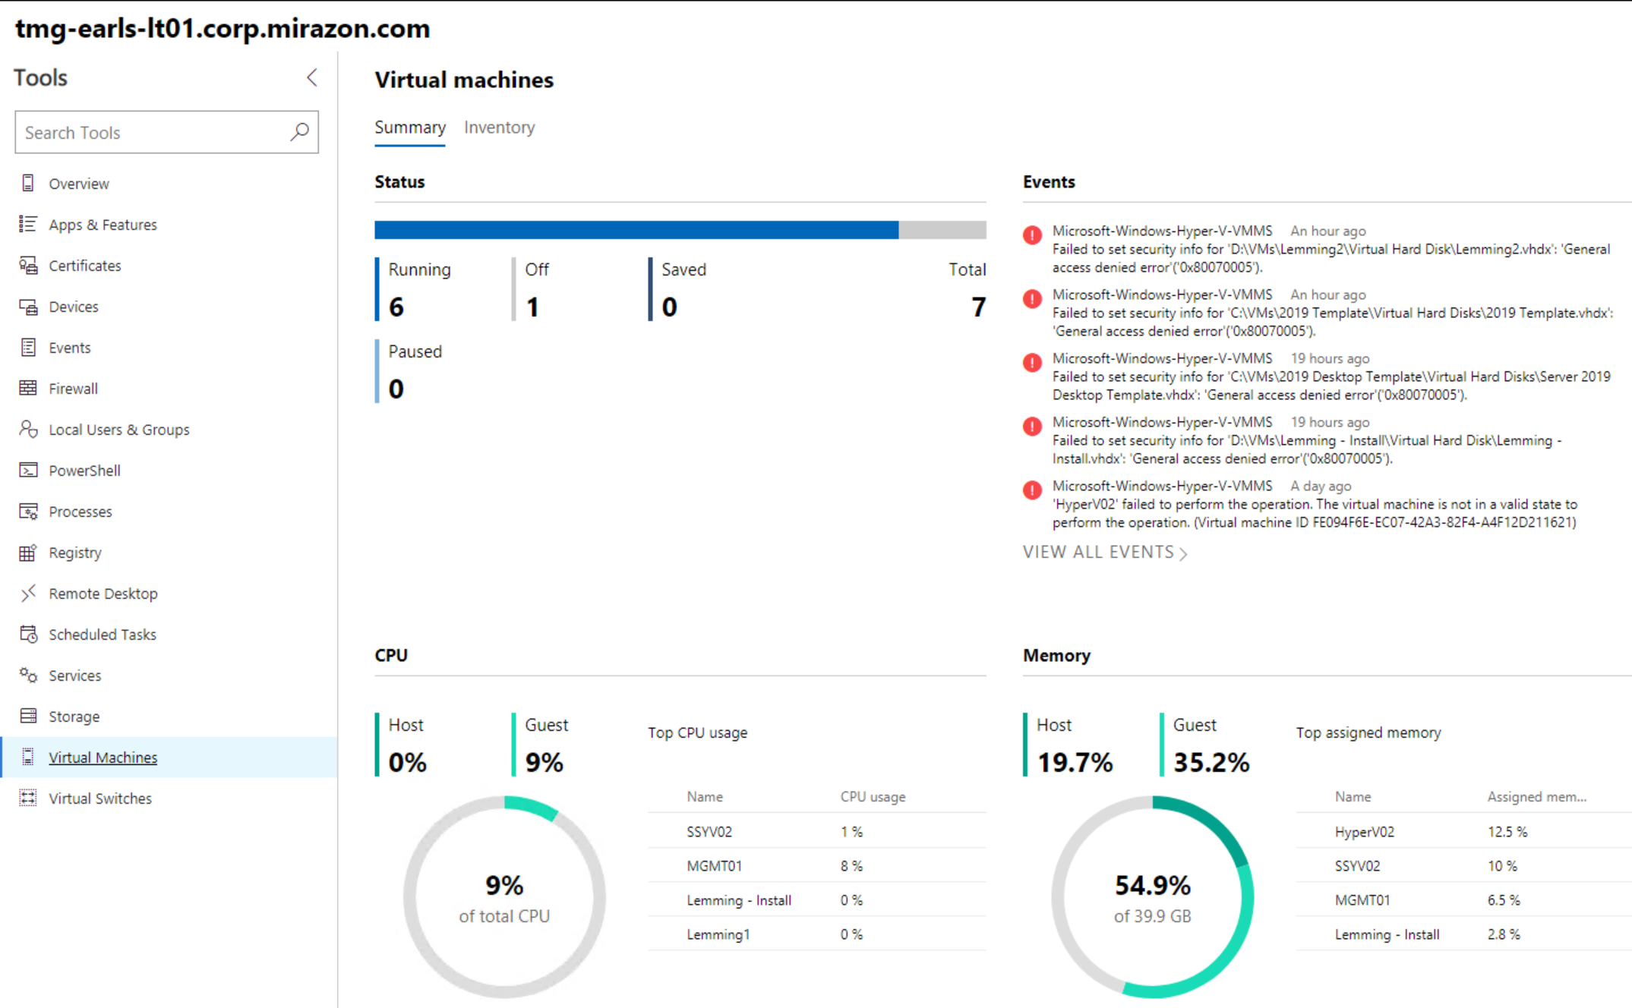
Desktop Management

Slide 30
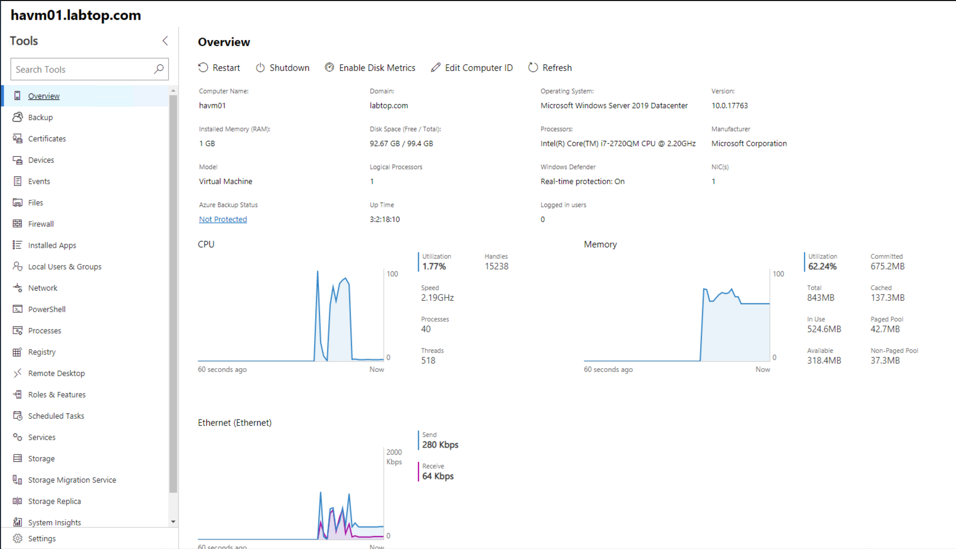
Server Management
Generic overview

Slide 31
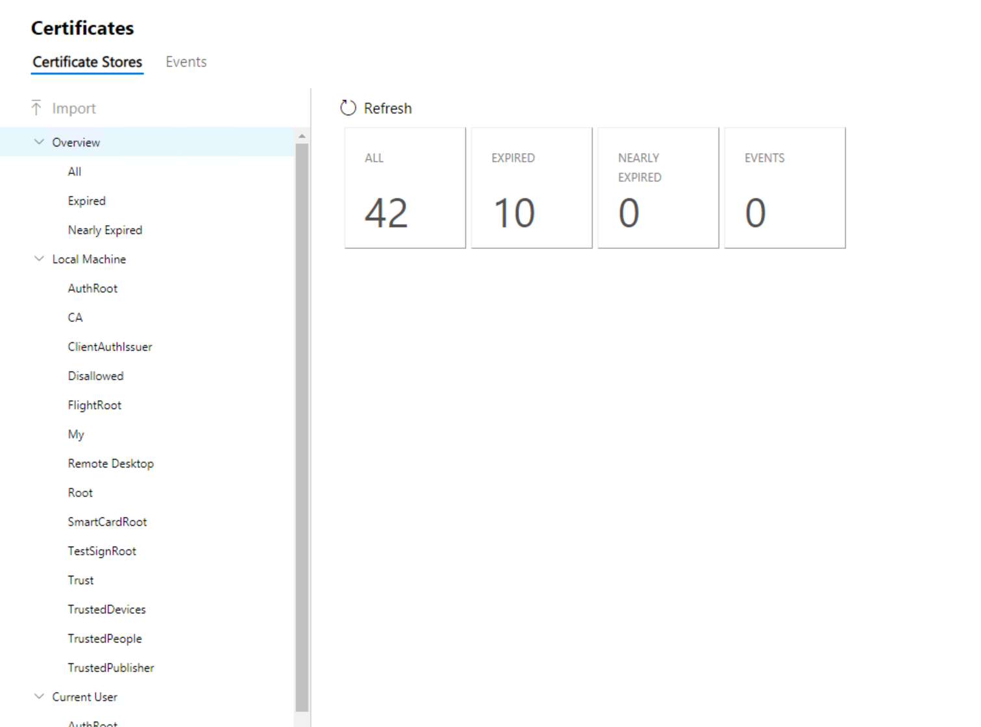
Server Management
Certificates

Slide 32
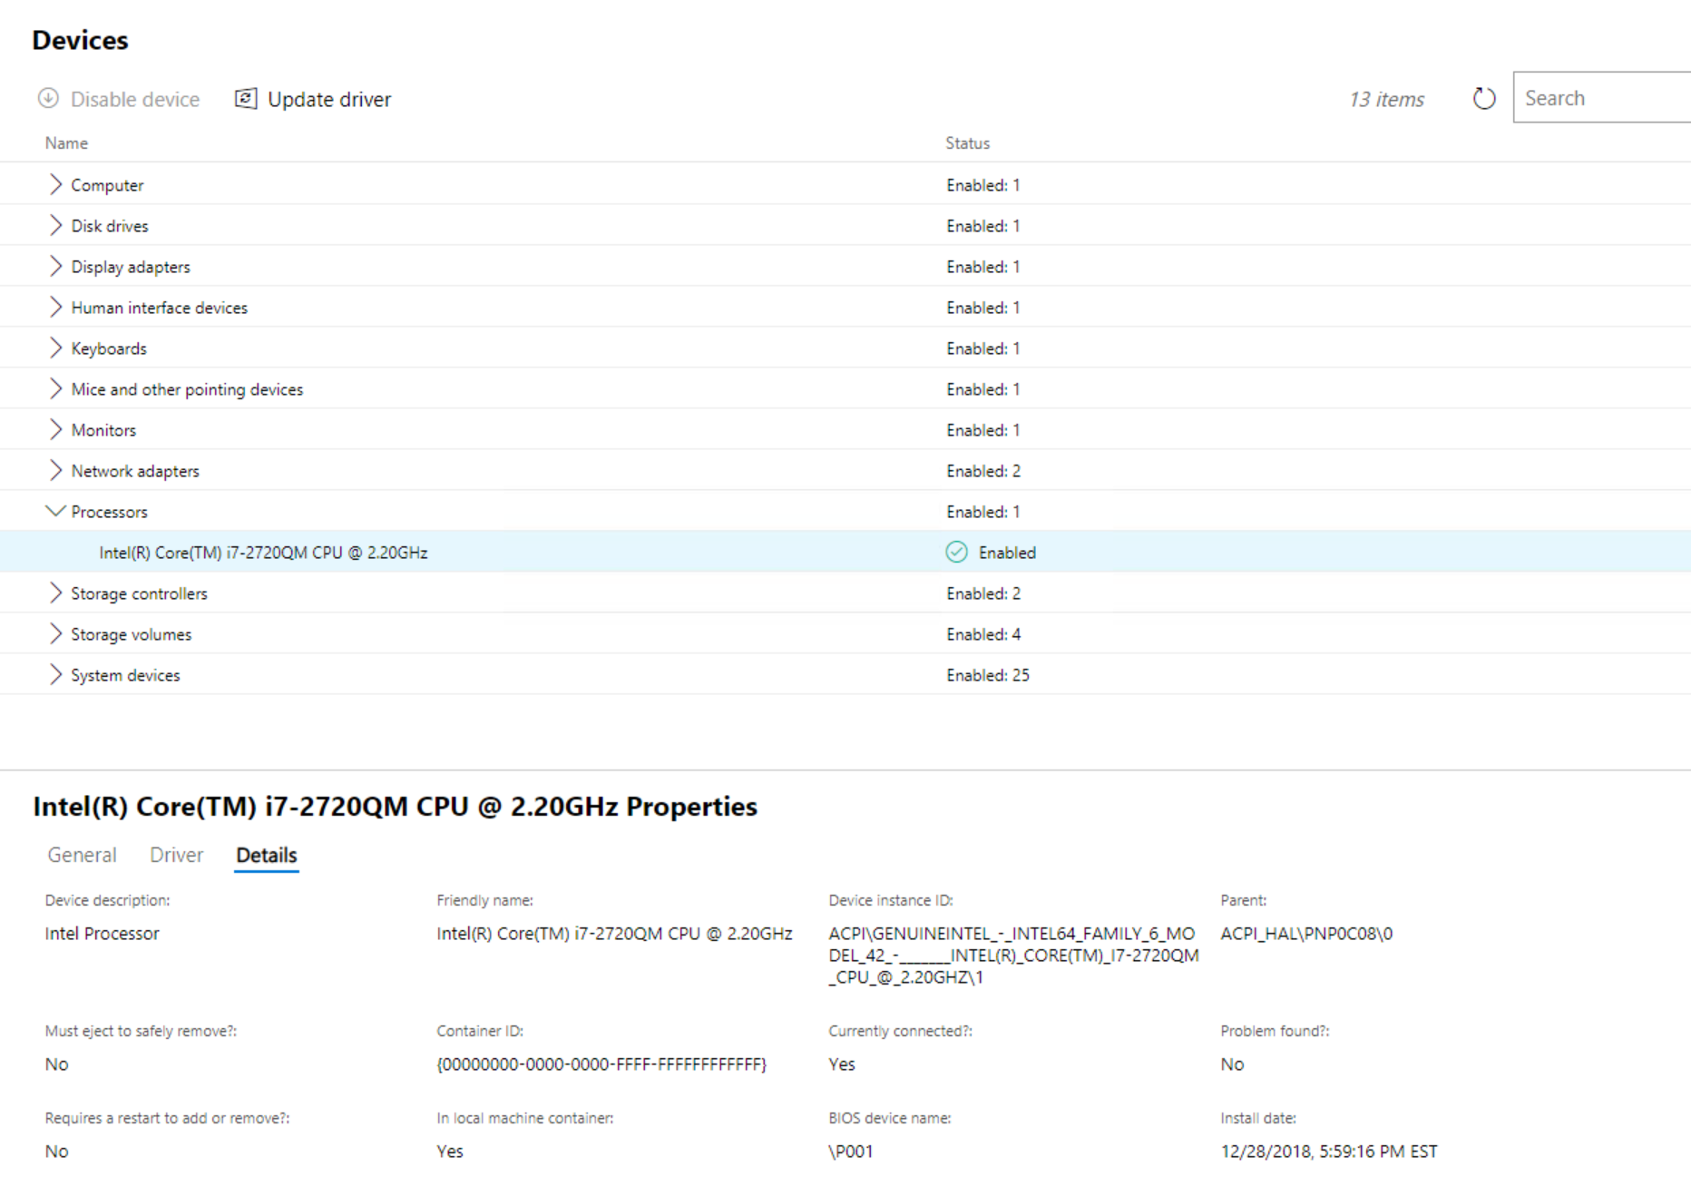
Server Management
Devices

Slide 33
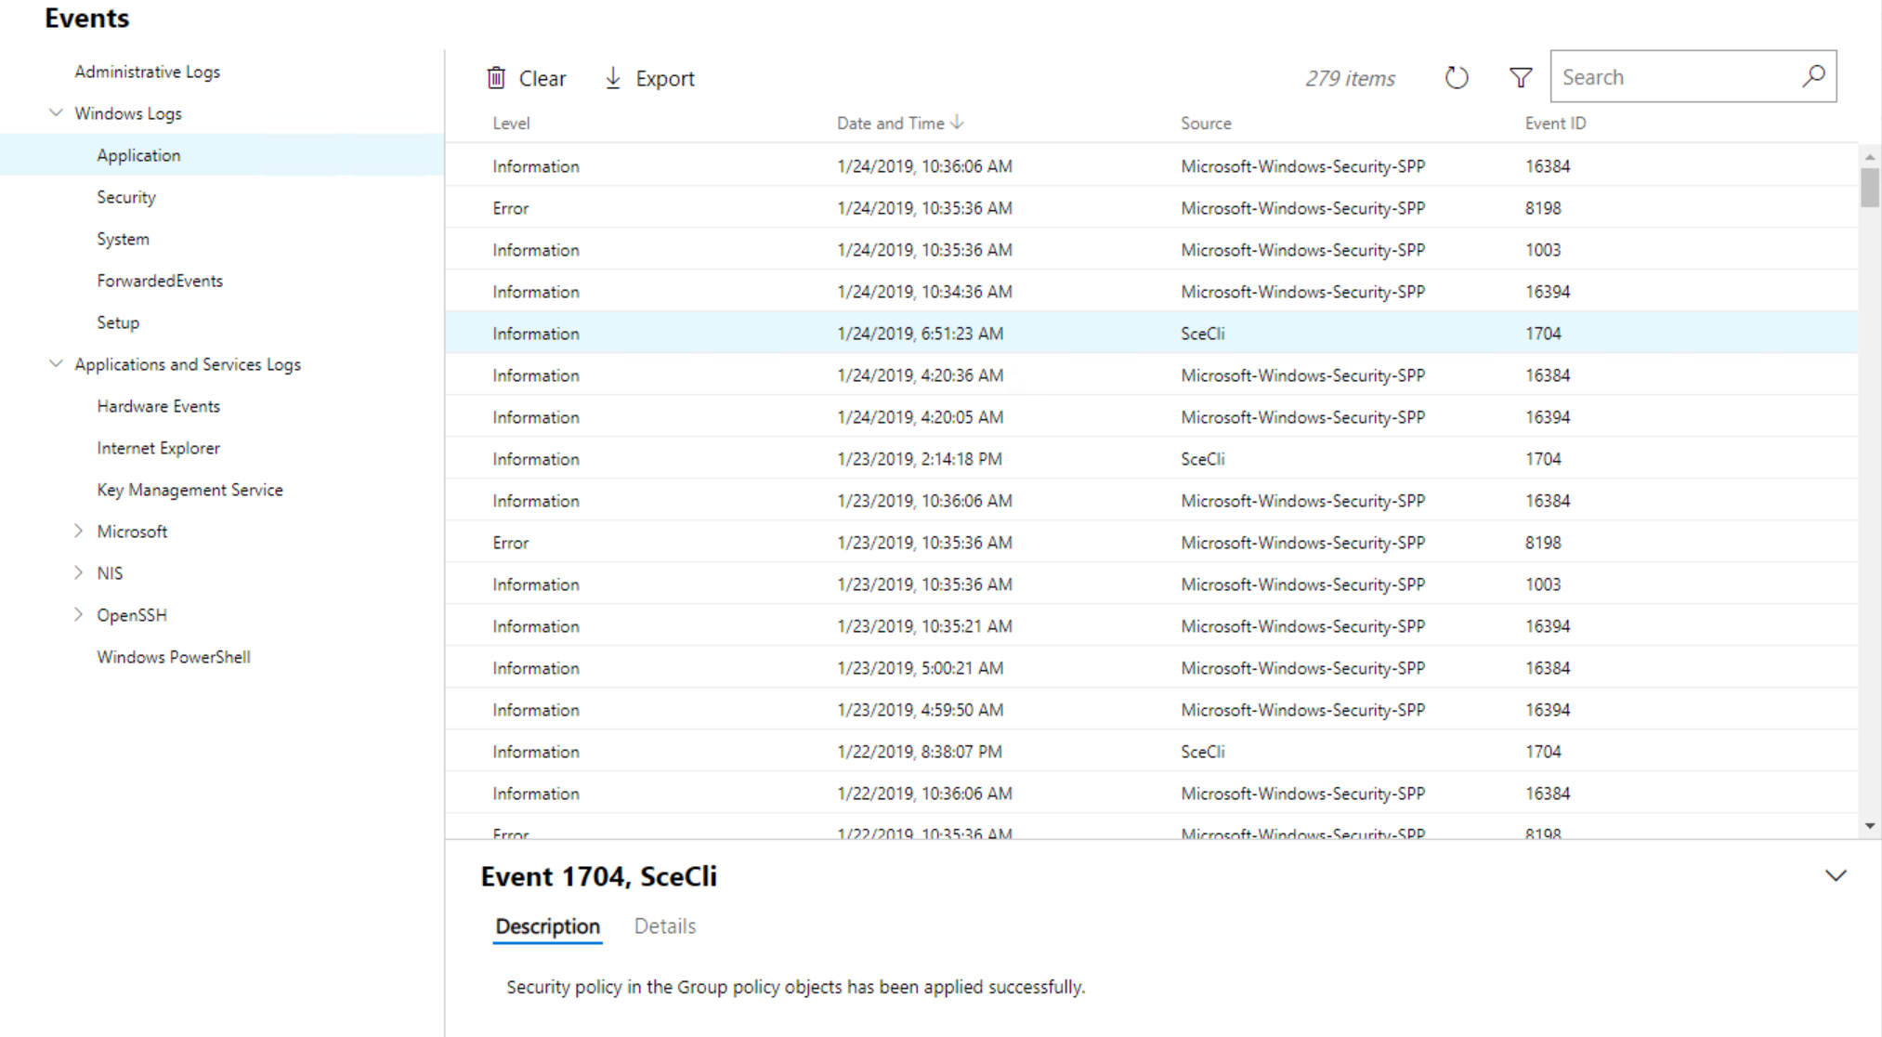
Server Management
Events

Slide 34
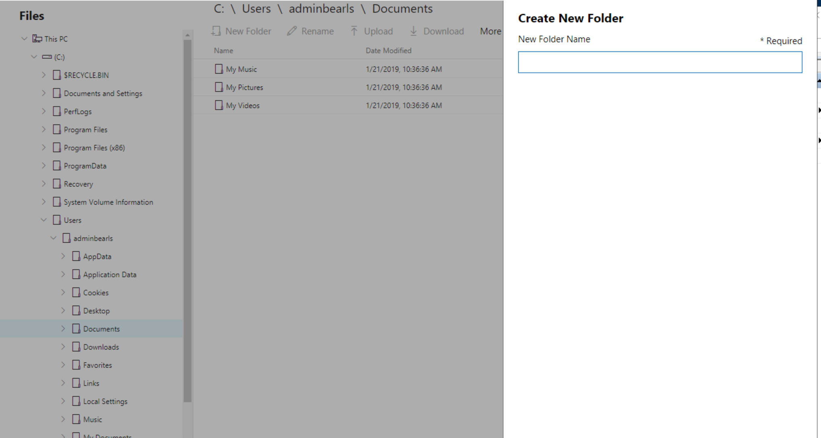
Server Management
Files

Slide 35
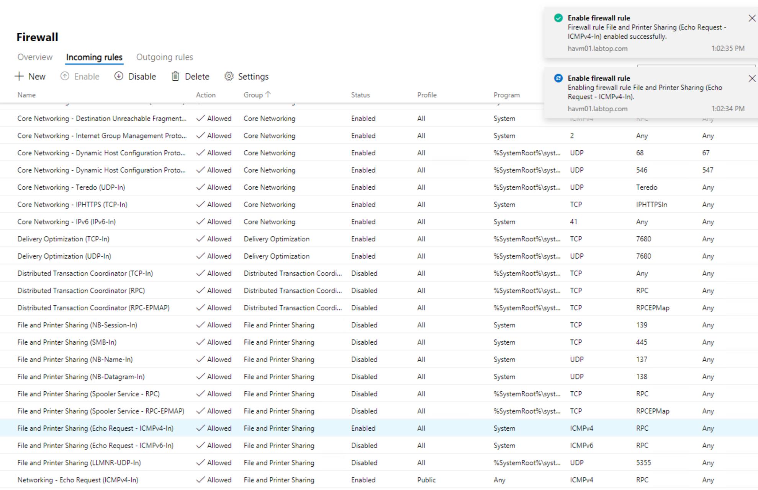
Server Management
Firewall

Slide 36
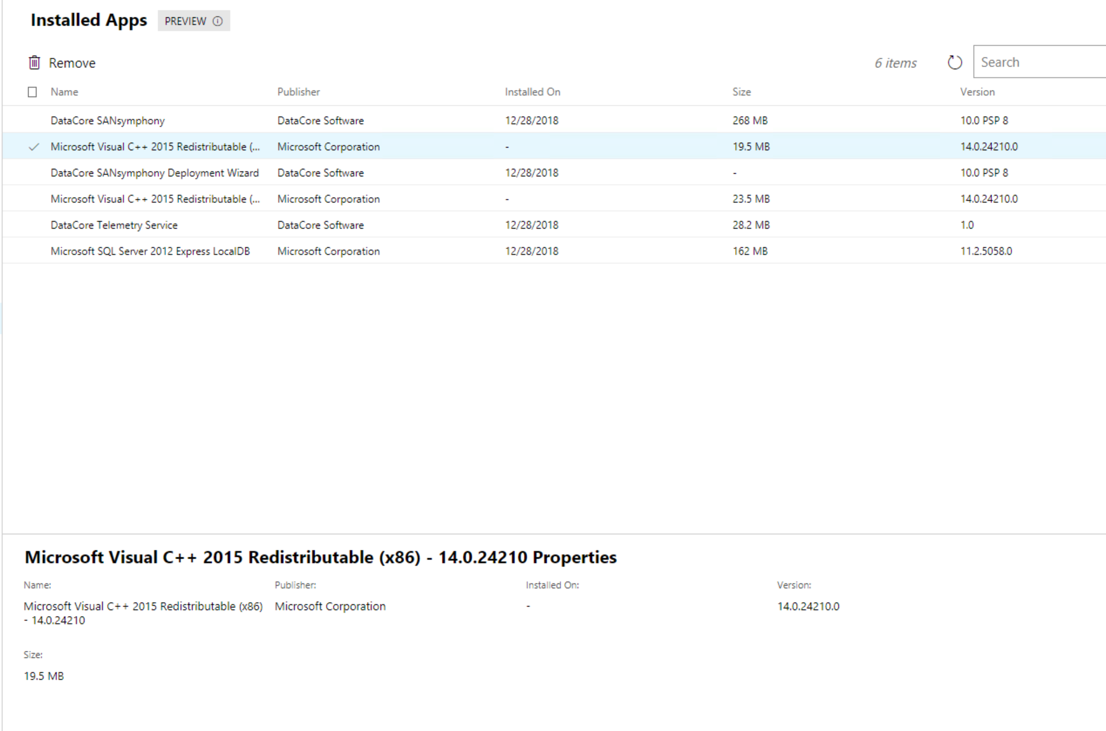
Server Management
Installed Apps

Slide 37
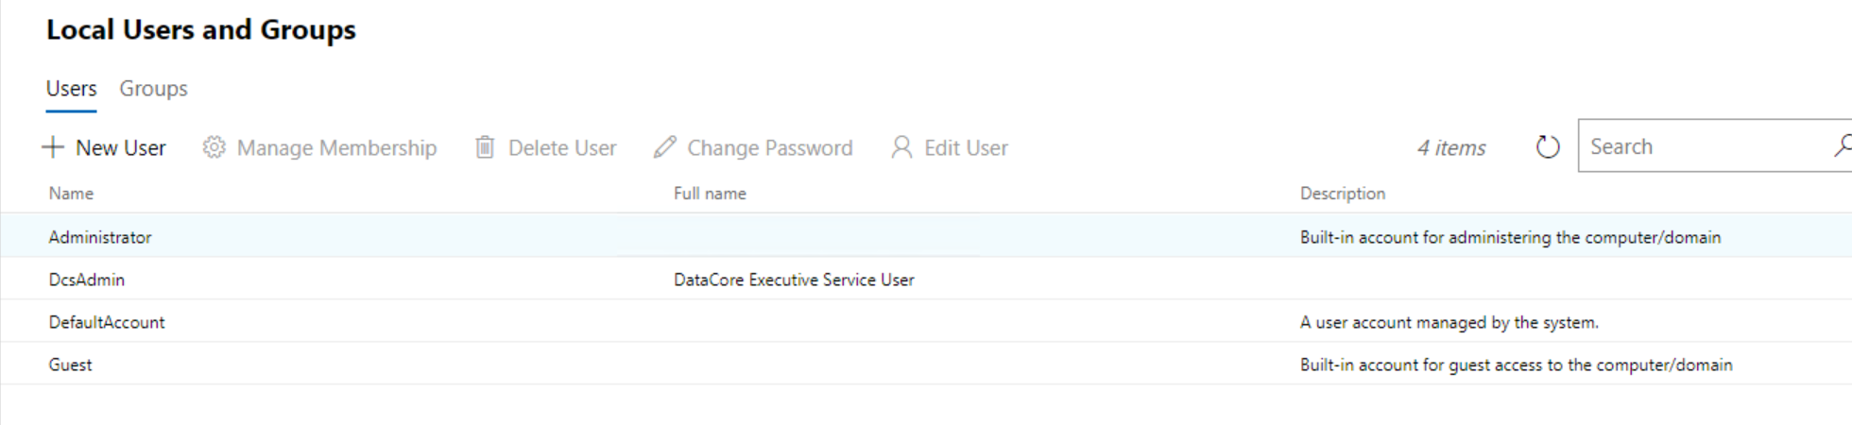
Server Management
Local Users and group

Slide 38
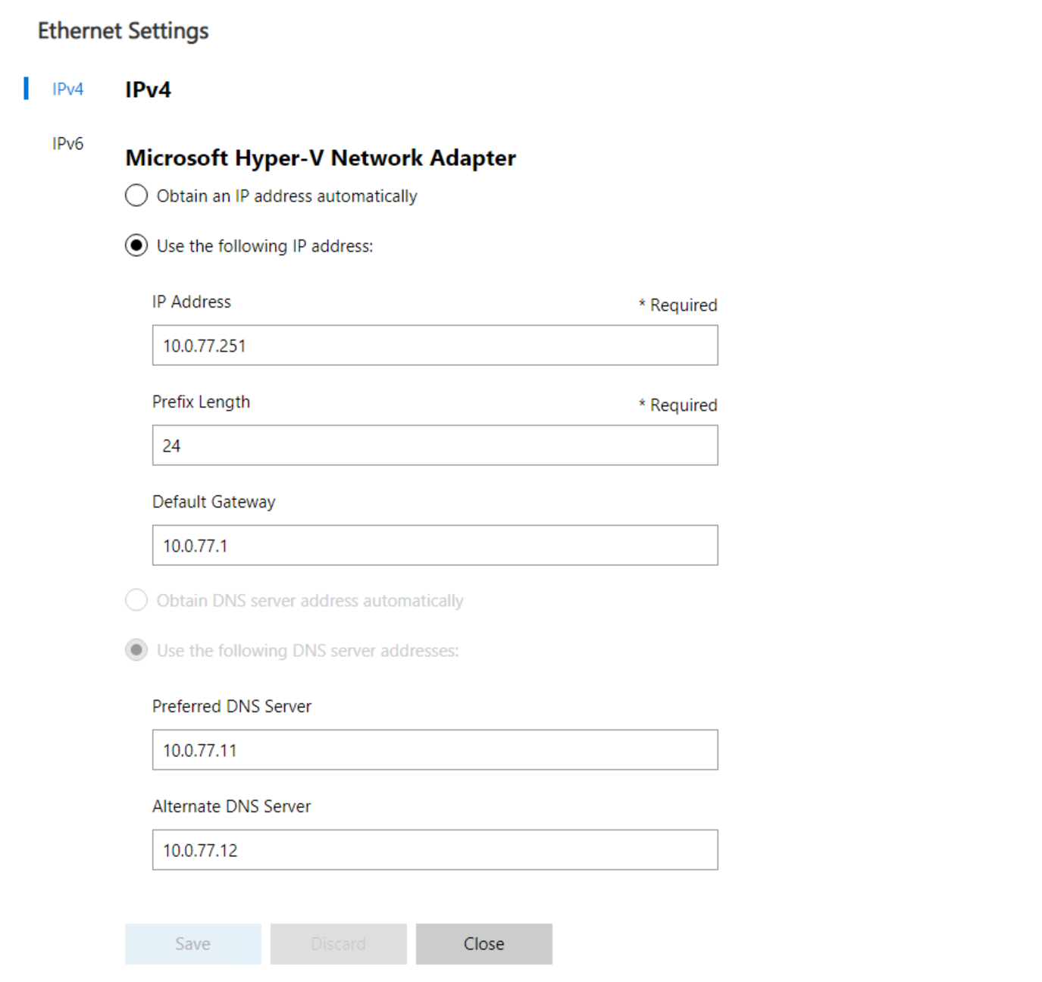
Server Management
Network

Slide 39

Server Management
Powershell

Slide 40
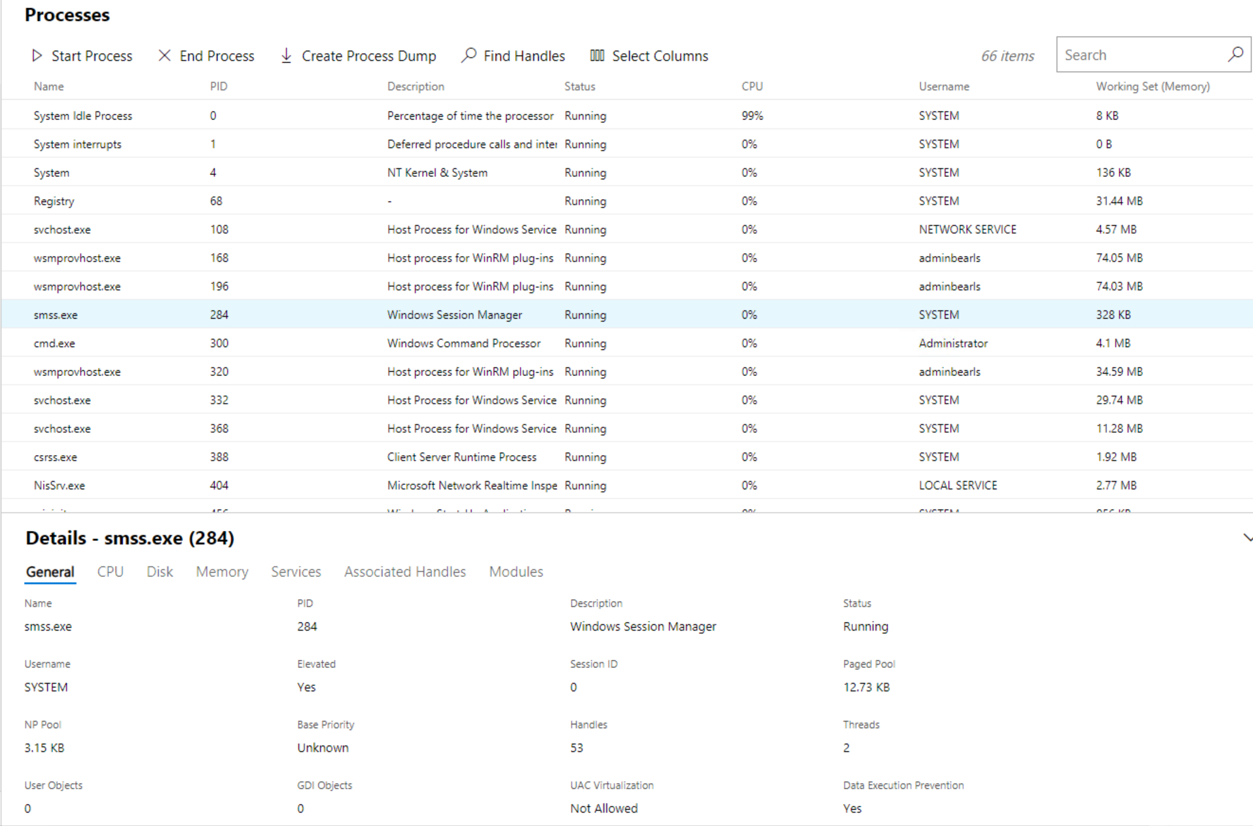
Server Management
Processes

Slide 41
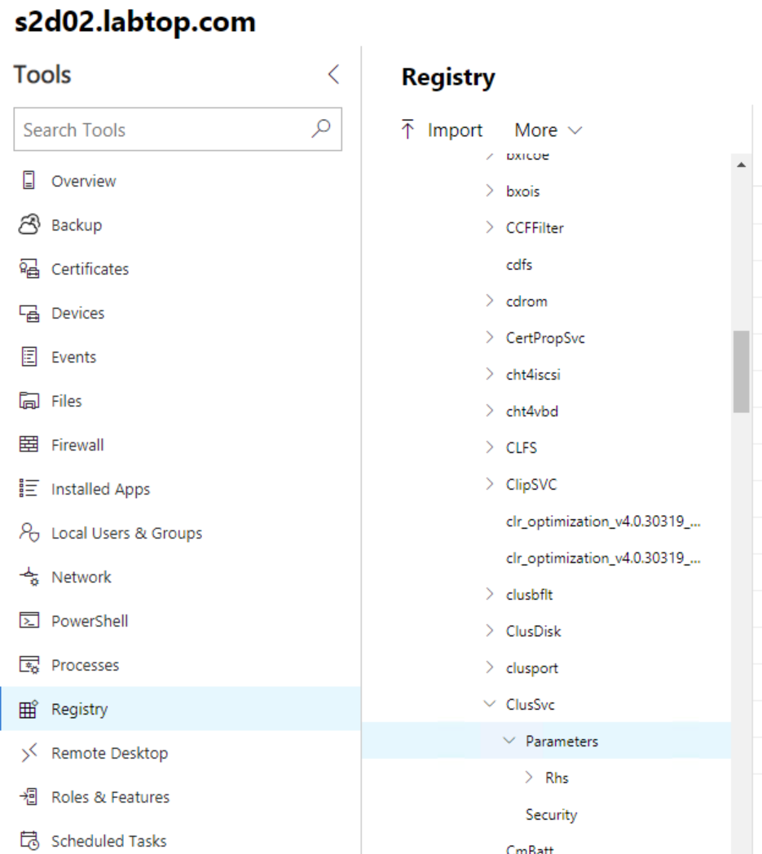
Server Management
Change a registry key
S2D cannot be installed on random hardware you build yourself anymore.
Have to change a registry key.

Slide 42
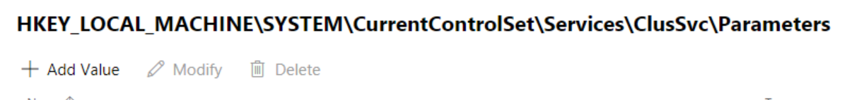
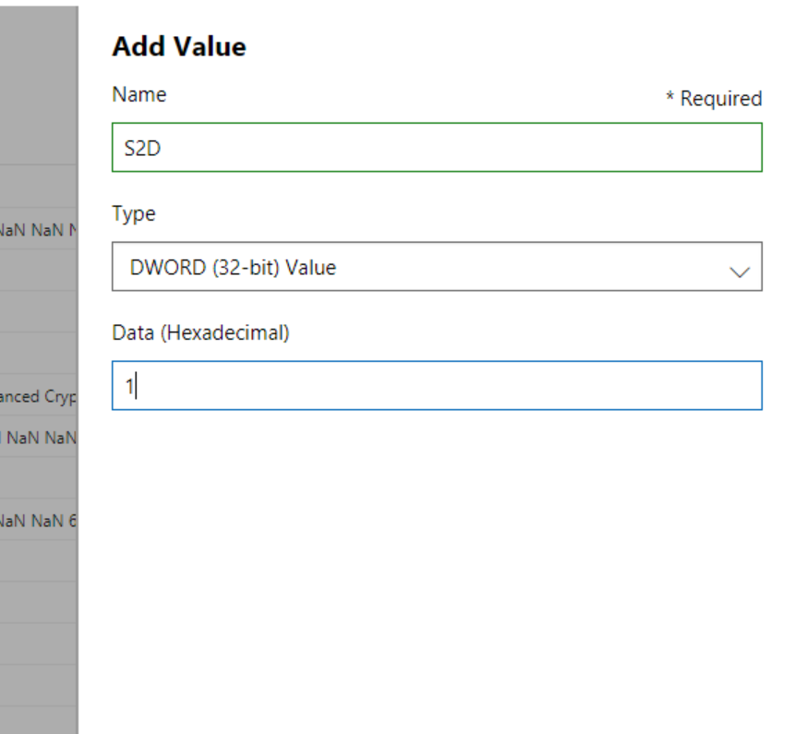
Server management
Change a registry key

Slide 43
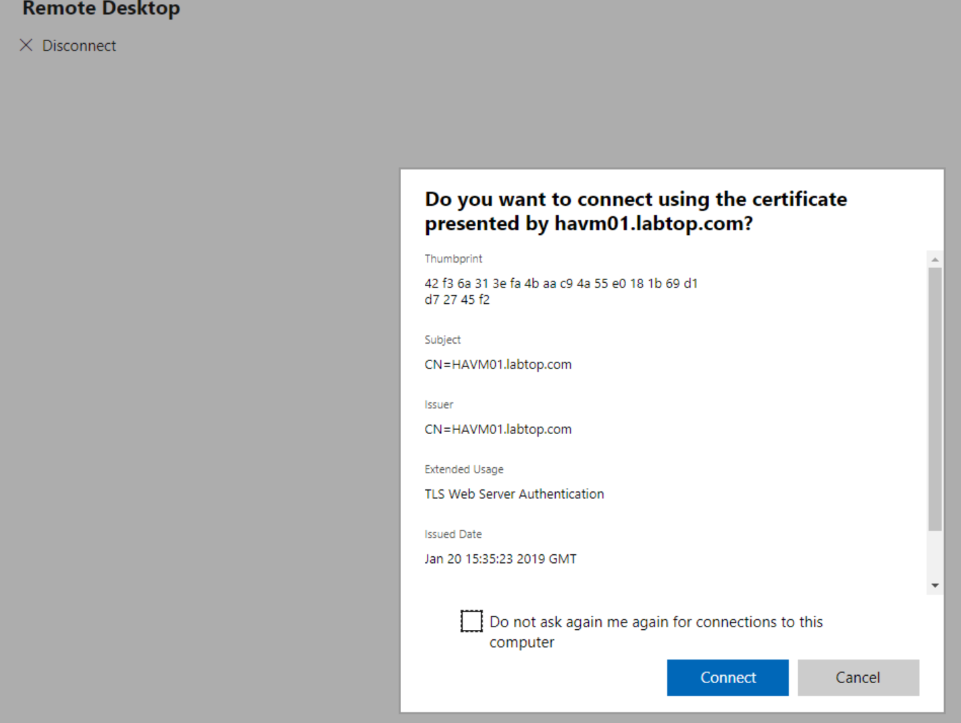
Server management
Remote Desktop

Slide 44
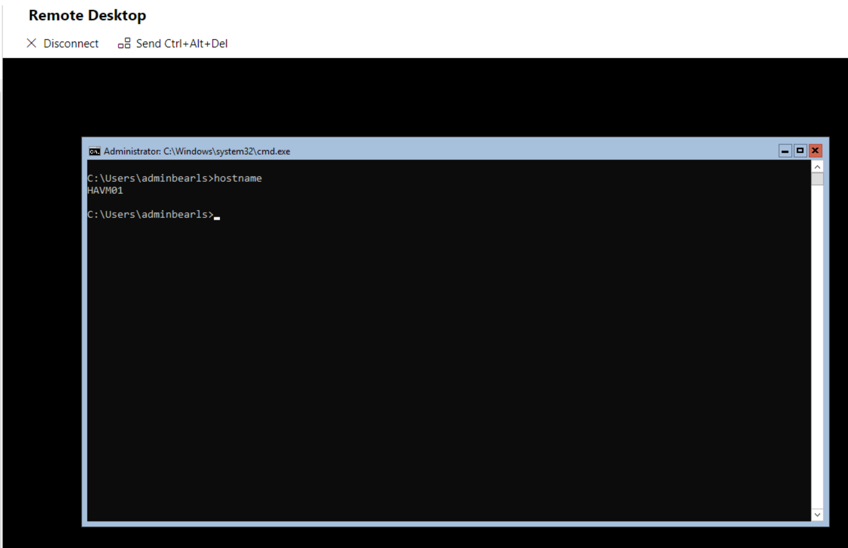
Server management
Remote Desktop

Slide 45
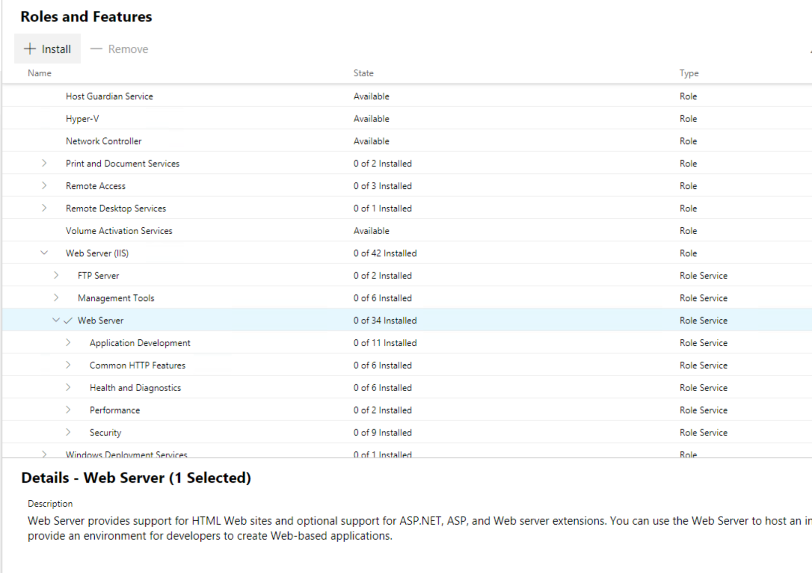
Server management
Roles & Features

Slide 46
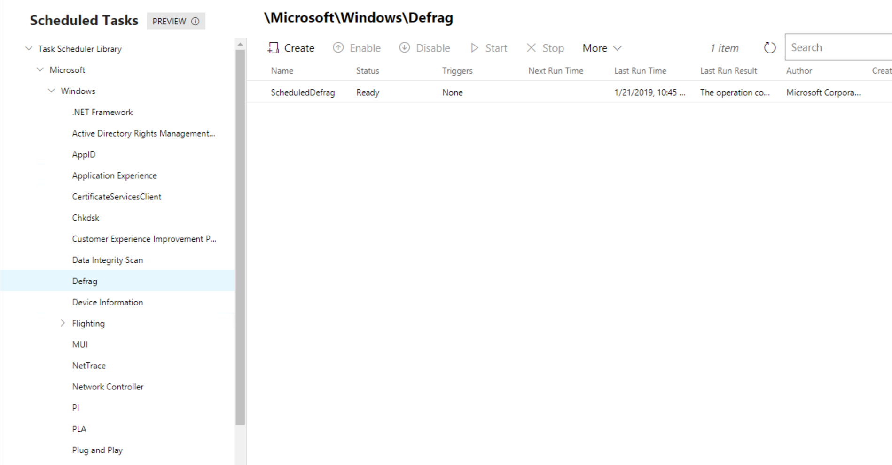
Server management
Scheduled Tasks

Slide 47
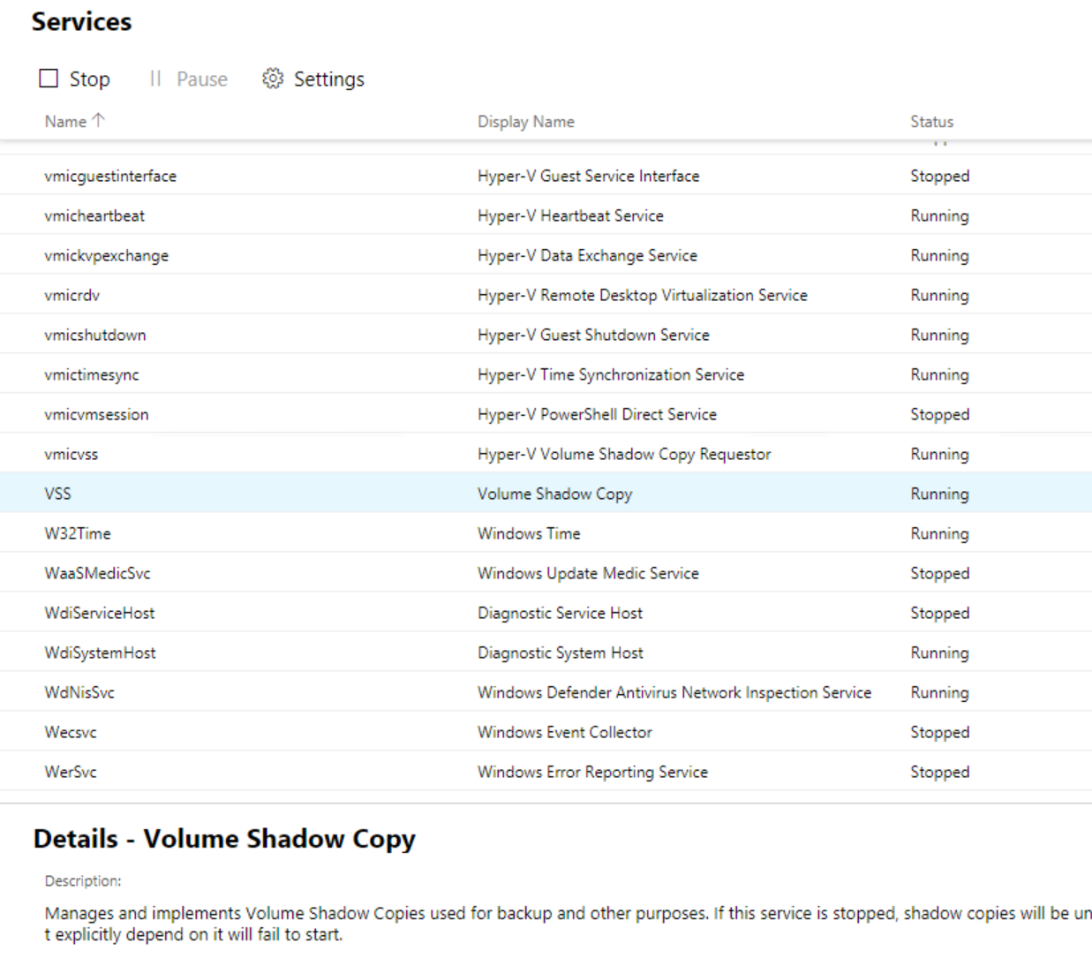
Server management
Services

Slide 48
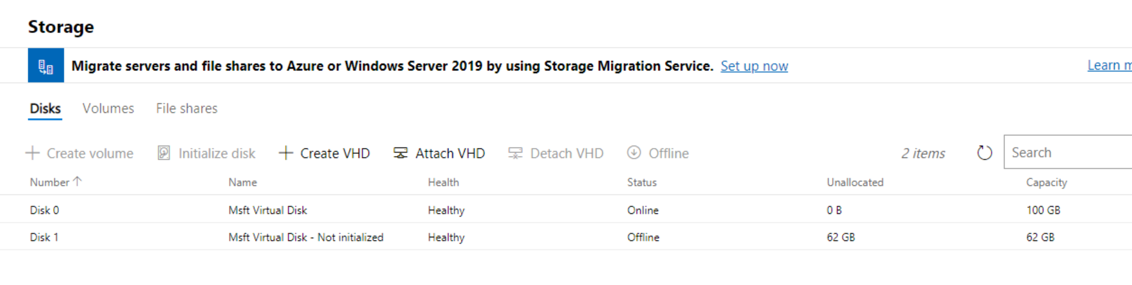
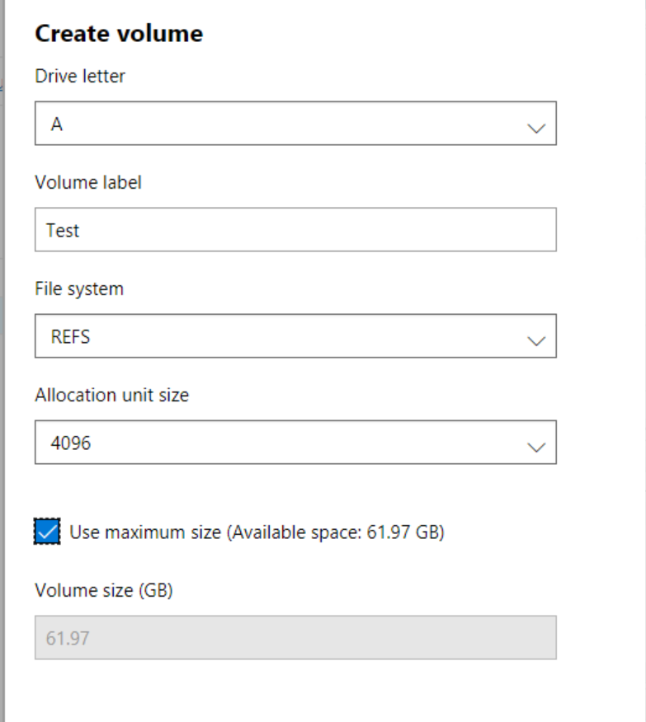
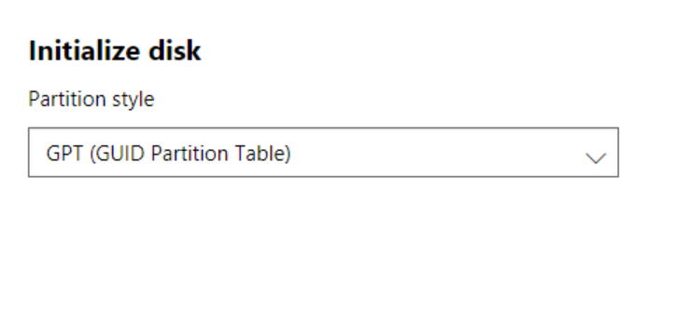
Server management
Storage

Slide 49
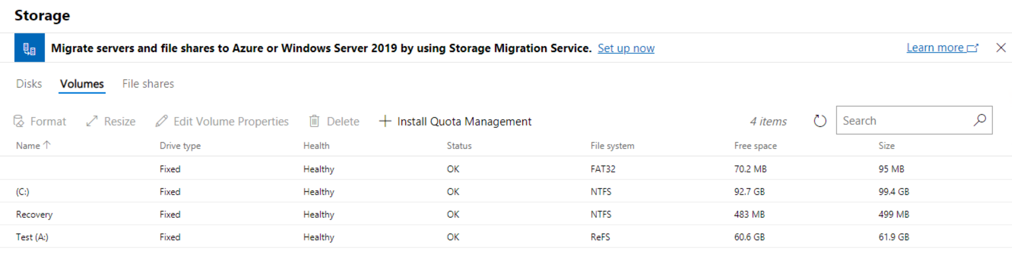
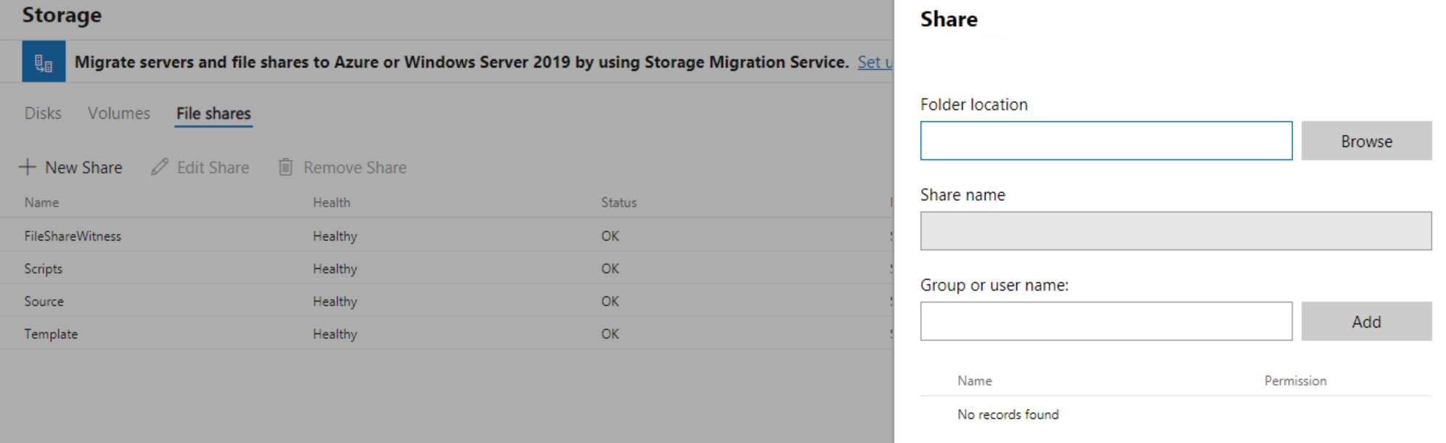
Server management
Storage

Slide 50
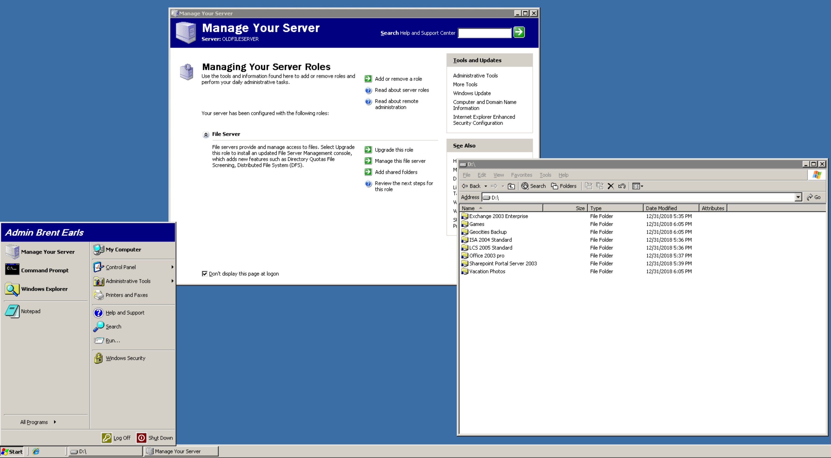
Server management
Storage Migration Service (2003 looks good in 4k)

Slide 51
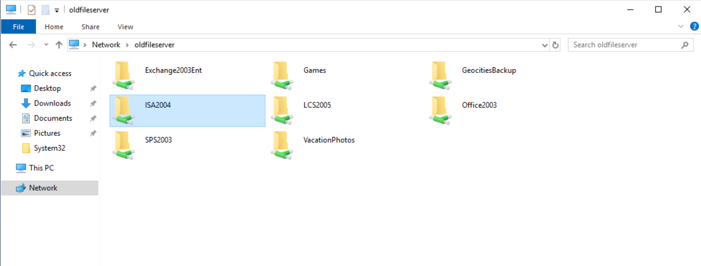

Server management
Storage Migration Service

Slide 52

Server management
Storage Migration Service

Slide 53

Server management
Storage Migration Service

Slide 54

Server management
Storage Migration Service

Slide 55

Server management
Storage Migration Service

Slide 56

Server management
Storage Migration Service

Slide 57

Server management
Storage Migration Service

Slide 58

Server management
Storage Migration Service

Slide 59

Server management
Storage Migration Service

Slide 60

Server management
Storage Migration Service

Slide 61

Server management
Storage Migration Service

Slide 62
Server management
Storage Migration Service

Slide 63

Server management
Storage Migration Service

Slide 64


Storage Migration Service
Resource Usage
On the Proxy/Destination server:
  This is a 4-core box
Source server:
  This is a 1 core box

Slide 65


Storage Migration Service
Resource Usage

Slide 66
Storage Migration Service
Scanned 289,938 files (290GB) in 7 minutes

Slide 67

Failover Cluster

Slide 68

Failover Cluster

Slide 69

Failover Cluster

Slide 70

Failover Cluster

Slide 71

Failover Cluster

Slide 72

Hyperconverged Cluster

Slide 73

Hyperconverged Cluster

Slide 74


Hyperconverged Cluster

