Slide 1
Windows Server 2019
What’s new, and what’s improved
December 14th, 2018

Slide 2
About Brent
Mirazon engineer since 2007
Chief Technology Officer
MCSE Cloud and Platform
MCSA Server 2016
MCITP-EA
MCSE 2003
VCAP-DCA, DCD 5
VCP 3, 4, 5, 5.5, 6.0

Slide 3
Agenda
Review
Where did it go?
Deployment Models
  LTSB/LTSC
  Semi-Annual Channel (not abbreviated)
Licensing
Desktop experience
Windows Admin Center (WAC)
What’s new
System Insights
Server Core app Features on Demand (FOD)
Windows Defender Advanced Threat Protection (ATP)
Storage Migration Service
Linux Containers on Windows
Kubernetes support
Encrypted networks
Low Extra Delay Background Transport
Persistent Memory support for Hyper-V VMs
Linux Subsystem for Windows

Slide 4
Agenda
What’s improved?
Security with SDN
Shielded Virtual Machine improvements
HTTP/2
Storage Spaces Direct improvements
Storage Replica improvements
Failover Clustering improvements
Container Improvements
Virtual networking performance
Windows Time Service
Software Defined Networking (SDN)
Remote Desktop Session Host

Slide 5
Where did it go?
Launched and then… didn’t?
Was released on October 2nd
Immediately they realized it COULD have the same bug as Win 10 1809 (ate some data)
Was removed October 10th
They fixed it (apparently)
Came back out November 13th
  If you’re a customer with VLSC access
  Not for trial downloads (someone missed that button?)
  Not available for partners (we’re always 13th class citizens)

Slide 6
Deployment Models
Long Term Servicing Branch (LTSB) Channel (LTSC)
Traditional server deployments.
Examples of LTSC
  Windows Server 2000*
  Windows Server 2003*
  Windows Server 2003 R2*
  Windows Server 2008*
  Windows Server 2008 R2*
  Windows Server 2012
  Windows Server 2012 R2
  Windows 10 1507
  Windows 10 1607
  Windows Server 2016
Mainstream support for 5 years
5 years of extended support
Most stable version of the OS (don’t laugh)
No major changes after release
  *Older versions released service packs that sometimes included additional functionality.

Slide 7
Deployment Models
Semi-Annual Channel (for some reason they don’t abbreviate this one)
“Cloud Cadence” server deployment
Examples of SAC Semi-Annual Channel
  Windows 10 1703
  Windows 10 1709
  Windows 10 1803
  Windows 10 1809
  Windows Server 1709
  Windows Server 1803
  Windows Server 1809
Support for 18 months. <Period for intentional emphasis
Quickly get new features (AKA: less testing)
Changes every 6 months
Functionality is added or removed with every release
For server, NO DESKTOP EXPERIENCE

Slide 8
Licensing
Basically identical to Server 2016
2-core packs
Minimum of 16 cores licensed per physical server
Differences in Standard and Datacenter
Functionality | Standard | Datacenter
Licensed OSes | Host + 2 VMs | Host + unlimited VMs
Scalability | No practical limit (same as datacenter) | No practical limit (same as standard)
Shielded VMs | No | Yes
SDN | No | Yes
Storage Replica | Limited | Full functionality
Storage Spaces Direct | No | Yes

Slide 9
Licensing
Which should I buy?!??!?!
Virtualizing?
  Probably Datacenter (if more than 7 VMs)
Not Virtualizing? Need previously mentioned features?
  Datacenter
Running VMware?
  Probably Datacenter (if more than 7 VMs)
Please get SA
Not-for-Profit?
  Tech Soup
Bankrupt?
  Linux (just not a mainstream supported option like IBM (Redhat) or Oracle (OEL), those cost a lot and make Microsoft look generous.

Slide 10
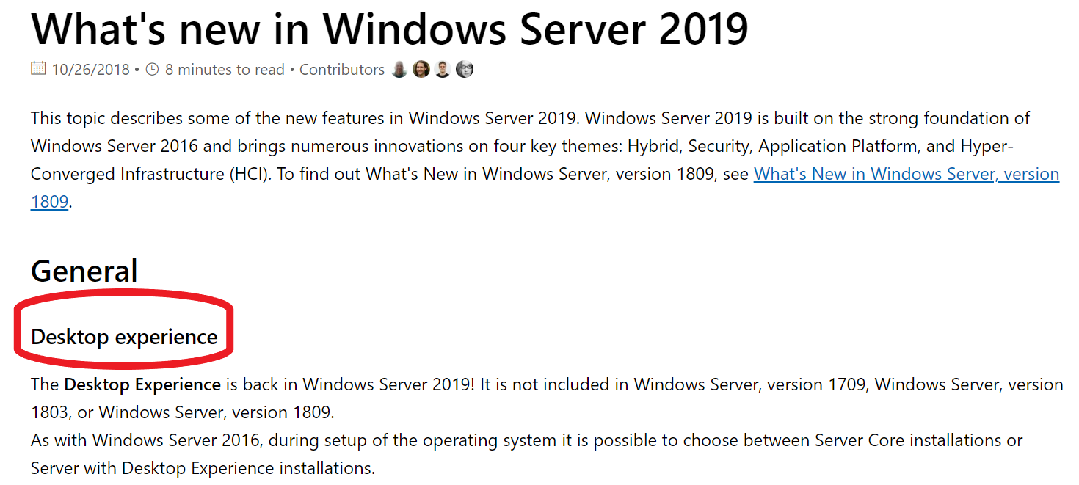
Desktop Experience
It’s still here!
That’s all they want you to know
It isn’t in Semi-Annual Channel, but is in LTSC
No, it still doesn’t support Edge
Yes, it does support most other things you need for RDS

Slide 11
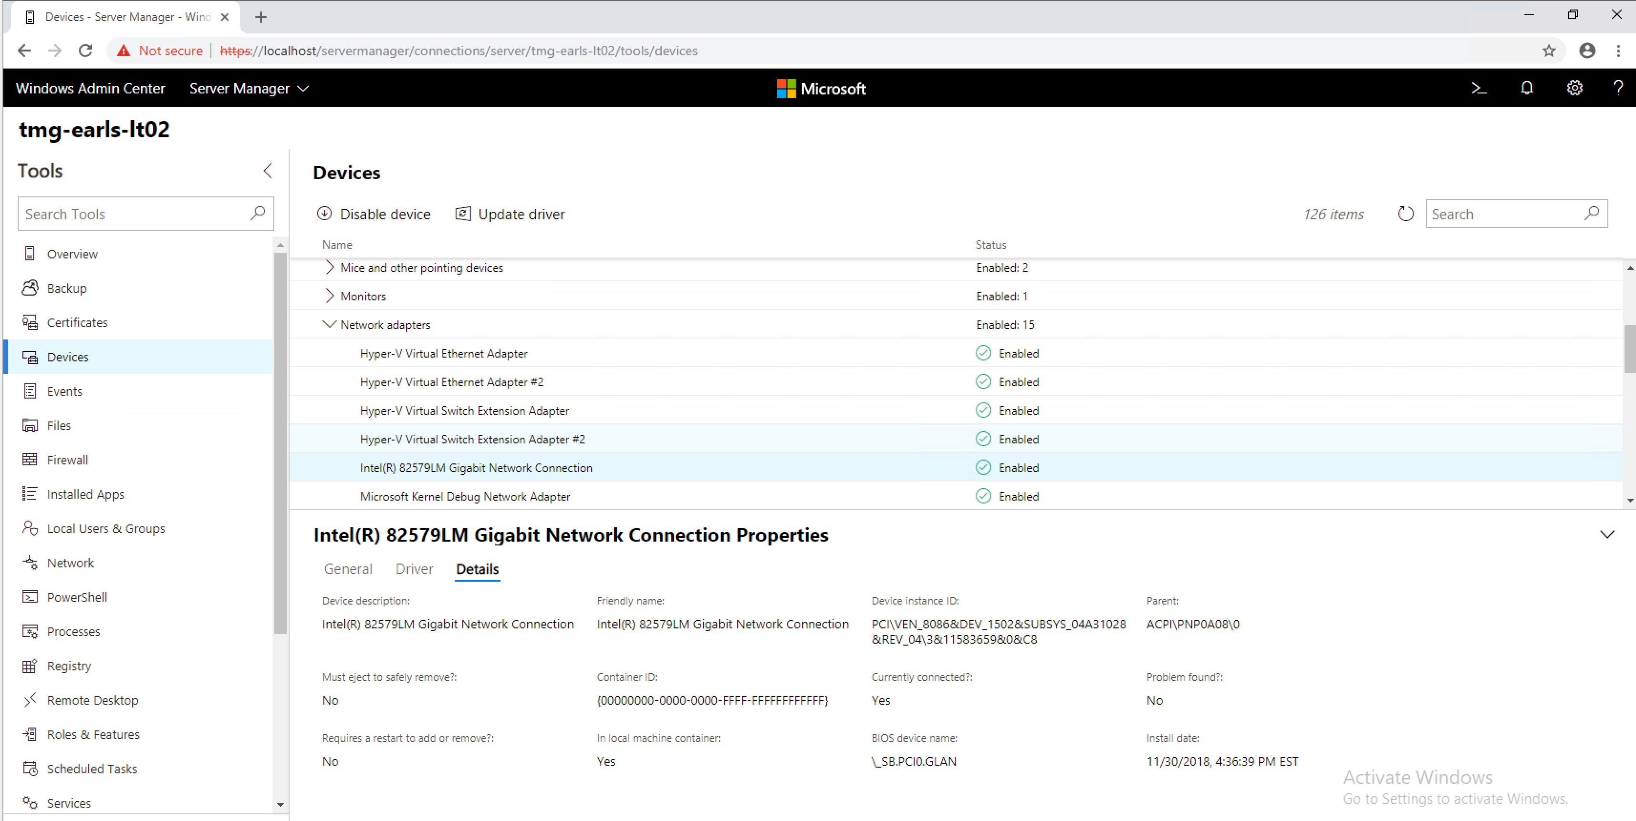
Windows Admin Center (WAC)
IT’S SO COOL!

Slide 12
What’s new?
System Insights
Predictive analytics for your on-premise servers
Data collected and stored locally on each server for up to a year
Machine learning charts trends and patterns LOCALLY (get your stinking paws off my data you damn dirty cloud)
Currently supports compute, networking and storage
Extensible framework (people can add stuff)
Accessible individually through WAC or globally through scripted PowerShell
By default runs every night at 3AM

Slide 13
What’s new?
System Insights
If you’re a data analysis person…
  “…We decided to use an auto-regressive forecasting model” “…This Model however requires three weeks of training data, so each capability uses a basic linear trend until three weeks of data are available”
  https://docs.microsoft.com/en-us/windows-server/manage/system-insights/understanding-capabilities
Can forecast up to 60 days in advance (if it has 6+ months of data)
Uses peaks for forecasting ex:
  Maximum storage use in a day
  Maximum 2-hour average for CPU and Networking
Can schedule scripts based on results: OK, Warning, Critical Error, None
Also dumps into Event Viewer with specific IDs

Slide 14
What’s Improved?
Windows Time Service
Precision Time Protocol (PTP) – NTP on steroids
Software timestamping – marks when a packet hits before processing (track timing more accurately
UTC leap second support – every couple years we tweak the clocks (US Gov and European Union require this now, somehow)

Slide 15
What’s Improved?
Remote Desktop Session Host
High availability licensing servers
Easier to manage licenses
  Update CALs in AD without direct AD access
Better GPU virtualization
  More performance and better isolation
WAC support
Windows Defender optimized for multi-user sessions
Web client supports SSO
Optimizations for deploying on Azure

Slide 16
What’s new?
Server Core app Features on Demand (FOD)
Provides a subset of desktop binaries for Server Core
Allows for greater app compatibility with Core
Which binaries?
  Microsoft Management Console (mmc.exe)
  Event Viewer (Eventvwr.msc)
  Performance Monitor (PerfMon.exe)
  Resource Monitor (Resmon.exe)
  Device Manager (Devmgmt.msc)
  File Explorer (Explorer.exe)
  Windows PowerShell (Powershell_ISE.exe)
  Failover Cluster Manager (CluAdmin.msc)
Afterwards, can also optionally add IE 11 or IIS Management Console

Slide 17
What’s new?
Windows Subsystem for Linux (WSL)
Allows running Linux Bash on windows
Lets normal Linux syntax interact with windows
Common tools included
Has been around for a while in Windows 10
Helps with that annoying dir/ls mental bug when you flip OSes

Slide 18
What’s Improved?
HTTP/2
Significantly faster than HTTP
  One persistent multiplexed session, simultaneous file access
Header compression (wasn’t allowed before)
Server push – server predicts and pre-sends data (like inlining) but can be cached
On by default in IIS with TLS connections

Slide 19
What’s Improved?
Shielded Virtual Machines
Branch Office improvements
  Failover Host Guardian Service
  Offline mode
Troubleshooting
  Enhanced Virtual Machine Connection and PS Direct re-enabled
  Can be disabled in guest
Linux support (select distros) for shielded VMs

Slide 20
What’s new?
Persistent Memory support for Hyper-V VMs
What’s persistent memory?
  Memory that persists (ha!) through a power cycle
  NVDIMM have been around a while
  Intel/Micron 3D Xpoint new guys
Became huge recently for in-memory databases
Can now pass it up to a VM through a .vhdpmem

Slide 21
What’s Improved?
Virtual Network Performance
Dynamic vRSS and VMMQ
  These features are huge performance boosts
  Required a lot of tuning before
  Most people didn’t do it
  Now it’s auto-magic
Receive Segment Coalescing in vSwitch
  Normally a NIC would do this
  Attaching a NIC to a vSwitch disabled it though
  Now it doesn’t

Slide 22
What’s new?
Low Extra Delay Background Transport
A way of utilizing all network bandwidth without impacting production
An update to BITS for updates (where you’ll immediately see it)
SCCM on 2019 can leverage it
Can be used for things other than updates
Monitors latency and backs off to keep it low

Slide 23
What’s new?
Windows Defender Advanced Threat Protection (ATP)
ATP Exploit Guard
  Attack Surface Reduction
    Rules to prevent common attacks
    Executable files, scripts in office or webmail, obfuscated scripts, unusual app behavior
  Controlled Folder Access
    Only authorized apps can access folders
    No malicious scripts, executables or DLL
    Specify specific folders locally or remote

Slide 24
What’s new?
Windows Defender Advanced Threat Protection (ATP)
ATP Exploit Guard
  Exploit Protection
    A lot of low level rules to prevent Apps from doing stuff they shouldn’t be
    Prevent ‘sensitive’ APIs from answering to anyone but legitimate callers
    Prevent an app from creating child processes
    Prevent an app from using Win32k system call table
    Randomize locations for virtual memory allocations
  Network Protection
    Expands Smart Screen to block outbound HTTP(s) traffic to low reputation sites/Ips

Slide 25
What’s new?
Storage Migration Service – SMS (yes, the SMS TLA is back)
Migrates selected data, shares, permissions from old server to new auto-magically
Can also take over identity (name and IP) of source
Source: all the way back to 2003
Nothing installed on source server
Destination: 2012 R2 – 2019 (2012 R2 and 2016 are slower)
Server 2019 orchestrates the move if it isn’t the destination
Doesn’t care about long file names
UI through WAC, PowerShell also available.

Slide 26
What’s new?
Storage Migration Service – Current restrictions
Within a domain
No clusters
No local groups
Up to 128 files simultaneously
No non-Windows file shares
No previous file versions are migrated
Same file system on both sides (NTFS to NTFS)
One-to-one server relationship
Support for ALL of that is planned in future SMS versions.

Slide 27
What’s Improved?
Storage Replica
Limited support on Standard Edition:
  One partnership
  One volume
  Less than 2 TB
Log improvements to greatly improve speed (it was already really fast)
Test failover
  Mounts writable snapshot on destination side

Slide 28
What’s Improved?
Storage Spaces Direct
Deduplication and compression on ReFS
Persistent memory support
Even faster – 13.7 million IOPs (storage process happening every .00000007 seconds)
Nested resiliency for 2-node hyper-converged infrastructure
USB witness for 2-node deployments
WAC monitoring and management
Built in performance history

Slide 29
What’s Improved?
Storage Spaces Direct
Up to 4 Pb per cluster
Mirror accelerated parity (2x faster than parity)
Drive latency outlier detection
Delimit volume allocation
  Must be 3-way mirror
  Must have more than 6 nodes

Slide 30
What’s Improved?
Failover Clustering
Cluster sets – grouping clusters
  Allows for live migration between clusters seamlessly
Azure-aware clusters
  Automatically detect they’re running in Azure
  Proactive failover and logging for Azure maintenance
  Easier deployment
Cross-domain cluster migration
  Dynamically migrate a cluster to a new domain
USB Witness
  File share witness can run on dumb things that it probably shouldn’t

Slide 31
What’s Improved?
Failover Clustering
Cluster infrastructure improvements
  CSV cache is now enabled
  Microsoft Distributed Transaction Coordinator now supported on CSV, and S2D. EX: SQL
  Enhanced partitioning and self-healing of clusters
Cluster Aware Updating now supports S2D (waits for resync)
File Share witness enhancements
  Less picky about where it can be (non domain shares)
  Explicitly blocks DFS shares (never was supported)

Slide 32
What’s Improved?
Failover Clustering
Cluster Hardening
  Intra-cluster comms over SMB use certificates now for full encryption of traffic
No longer use NTLM authentication
  Not used anymore
  Kerberos and Certificates exclusively
  No user interaction needed, it just happens
  Makes clusters more flexible

Slide 33
What’s new?
Linux Containers on Windows (LCOW) and Kubernetes
What are containers?
  OS virtualization
  Extremely small footprint
  Portable, replaceable, destroyable
    “cattle, not pets”
  Server 2016 supported windows containers
    Either traditional or Hyper-V isolated
    Supported Docker for management (the leader)

Slide 34
What’s new?
Linux Containers on Windows (LCOW)
Previously:
  Run a separate full Moby Linux VM on Hyper-V
  Runs its own docker daemon
  Containers run on that VM
  Large with overhead
Now:
  Run a tiny (<100 MB) LinuxKit distro
  Uses Windows docker daemon
Allows nearly seamless Linux and Windows container management at one place.

Slide 35
What’s new?
Kubernetes support
What the hell is Kubernetes? I thought they did docker?
  Docker is the platform and tool for making, distributing and running containers
  Kubernetes is the fancy orchestration on top
  Makes a lot of little containers function like a hivemind
  Kubernetes vs Docker Swarm
Think of it like a Hyper-V w/ Failover Cluster with System Center

Slide 36
What’s Improved?
Containers
Improved integrated identity
  Easier and more reliable
Better app compatibility
  Helps with containerizing applications
  Server Core image has more compatibility
  A new Windows image for things that need more APIs
Reduced size and higher performance
  Made the images smaller (again) so they’re faster

Slide 37
What’s new?
SDN: Encrypted networks
Uses Datagram Transport Layer Security (DTLS)
  Places certs on each host
  Prevents man-in-the-middle
Define certain subnets as encrypted
All packets that leave a VM are encrypted and delivered end-to-end to the other VMs encrypted
Provides a simple and clean solution for legacy apps
Gives that compliance checkbox
Anything going to another subnet is sent unencrypted auto-magically

Slide 38
What’s new?
SDN: Firewall Auditing
Flows from SDN ACL get recorded
Set per rule
Allows for extremely granular logging
Since SDN Firewalls are so specific, the logging can record on individual at:
  Subnet
  VM
  Individual NIC
For obvious overflow reasons, be careful

Slide 39
What’s new?
SDN: Other cool stuff
Virtual network peering
  Works like it does in Azure
  Nice for hosting, or mega corps
  Why do you care?
    Allows traffic to stay on backbone rather than exiting to “real” networking
    Can use User Defined Routes (UDR) to force certain traffic routing
Egress metering
  Works like Azure
  You too can nickel and dime people if you do hosting or department chargeback

Slide 40
What’s Improved?
SDN
SDN Gateways
  Huge performance improvement for GRE tunnels
    Up to 4x the performance
    Up to 1/6 the CPU usage
  IPsec performance improvements
    Up to double the performance
    Up to ½ the CPU usage
Deployment
  UI tool and WAC support makes this possible by humans

Slide 41
Questions?
You’ll probably have to come ask afterwards, because I’m almost certainly out of time.

