Slide 1
Core Operational Readiness for Office 365
Louisville Microsoft Users Group
Carroll Moon, CTO, CloudFit Software
November 30, 2018

Slide 2
Agenda
1 | Digital Transformation
2 | Monitoring and Major Incident Management
3 | Service Desk and Normal Incident Management
4 | Evergreen Management
5 | Questions

Slide 3
Digital Transformation

Slide 4
The Promise of the Cloud
Security
Evergreen
Costs
Co-Authoring
Anywhere, Any Device
Focus on Business Outcomes, Not Servers
…but is there more to the story?

Slide 5
Leadership and Strategies
Typically, there are two types of CIOs:
  IT Operations Background…view cloud as an extension of the datacenter…”economies of SCALE”
  Business or Applications Development Background…view cloud as a business enabler…”economies of SKILL”
BOTH are correct…make it an “and” rather than an “or”

Slide 6
A Simple View on Business Goals
Businesses exist to make profits
There are two ways to make profits:
  More revenue
  Lower costs

Slide 7
Six Simple Facts
Computing power is infinite and inexpensive
Storage is infinite and inexpensive
Physical Devices are powerful and inexpensive
Fast Networks are prevalent and inexpensive
Cloud enables scenarios for everyone
DevOps makes it all go faster

Slide 8
Winning in Business
The six bullets for Digital Transformation are available to everyone
Whichever business has the best ideas…
AND is the most effective at implementing the ideas (including agility)…
AND who is the best at integrating with the rest of the Portfolio…
…wins

Slide 9
Winning in Business
The six bullets for Digital Transformation are available to everyone
Whichever business has the best ideas…
AND is the most effective at implementing the ideas (including agility)…
AND who is the best at integrating with the rest of the Portfolio…
…wins
This session focuses here!

Slide 10
Monitoring and Major Incident Management

Slide 11
Service Management Communications are targeted
All tenants
1+ Environments
Subset of Capacity
Your Tenant

Slide 12
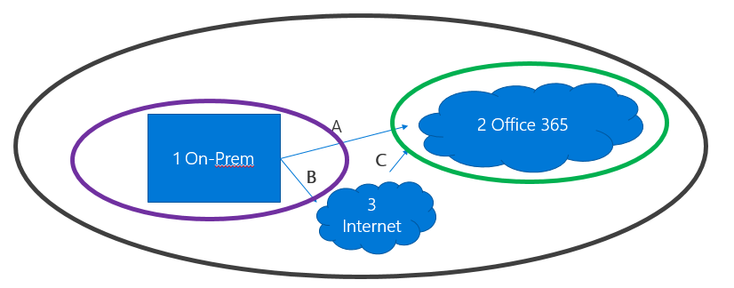
Start with Major Incident Scenarios
MI Scenario | End-to-End Alerts or User Calls? | Microsoft posts something for your tenant? | Notes
I | Yes | Yes | You are seeing impact. Microsoft has posted investigation. Workflow is likely: Notify leadership, Enable Service Desk, Follow the Service Incident

Slide 13
Start with Major Incident Scenarios
MI Scenario | End-to-End Alerts or User Calls? | Microsoft posts something for your tenant? | Notes
I | Yes | Yes | You are seeing impact. Microsoft has posted investigation. Workflow is likely: Notify leadership, Enable Service Desk, Follow the Service Incident
II | Yes | No | You are seeing impact. Microsoft has not posted anything. Workflow is likely: Notify leadership, Enable Service Desk, Initiate Incident Bridge, Troubleshoot for fault identification (customer, Microsoft, other)

Slide 14
Start with Major Incident Scenarios
MI Scenario | End-to-End Alerts or User Calls? | Microsoft posts something for your tenant? | Notes
I | Yes | Yes | You are seeing impact. Microsoft has posted investigation. Workflow is likely: Notify leadership, Enable Service Desk, Follow the Service Incident
II | Yes | No | You are seeing impact. Microsoft has not posted anything. Workflow is likely: Notify leadership, Enable Service Desk, Initiate Incident Bridge, Troubleshoot for fault identification (customer, Microsoft, other)
III | No | Yes | You are not seeing impact. Microsoft has posted. Workflow is likely: Email leadership, Enable Service Desk for high alert protocol. Could be a false positive, scoping false positive, real issue for a feature you do not [currently] care about, or a real issue for real users but not enough to trigger user calls or end-to-end monitoring

Slide 15
Office 365 Service Communications API
API
Leveraging the Office 365 Service Communications API

Slide 16
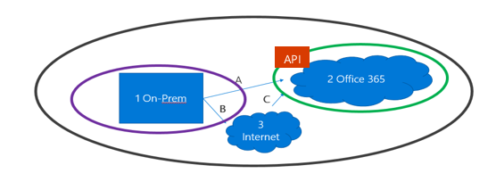
Progress to Monitoring Scenarios
Office 365 Mobile Admin App
Monitoring Scenario | What? | API Class | Admin UI
1 | Does Microsoft think that I need to know about a potential or confirmed Service Incident? | Service Incident | Service Health

Slide 17
Progress to Monitoring Scenarios
Office 365 Mobile Admin App
Monitoring Scenario | What? | API Class | Admin UI
1 | Does Microsoft think that I need to know about a potential or confirmed Service Incident? | Service Incident | Service Health
2 | Does Microsoft think that I need to take action to get healthy or to stay healthy? | Message %Prevent% | Message Center: Prevent or Fix Issues

Slide 18
Progress to Monitoring Scenarios
Office 365 Mobile Admin App
Monitoring Scenario | What? | API Class | Admin UI
1 | Does Microsoft think that I need to know about a potential or confirmed Service Incident? | Service Incident | Service Health
2 | Does Microsoft think that I need to take action to get healthy or to stay healthy? | Message %Prevent% | Message Center: Prevent or Fix Issues
3 | Does Microsoft think that I need to be aware of a planned Release? | Message %Change% | Message Center: Plan for Change

Slide 19
Progress to Monitoring Scenarios
Office 365 Mobile Admin App
Monitoring Scenario | What? | API Class | Admin UI
1 | Does Microsoft think that I need to know about a potential or confirmed Service Incident? | Service Incident | Service Health
2 | Does Microsoft think that I need to take action to get healthy or to stay healthy? | Message %Prevent% | Message Center: Prevent or Fix Issues
3 | Does Microsoft think that I need to be aware of a planned Release? | Message %Change% | Message Center: Plan for Change
4 | Does Microsoft think that I need to be aware of other Service Management information that is not 1-3? | Message %Informed% | Message Center: Stay Informed

Slide 20
End-to-End Capability Monitoring
This vector
Examples:
Exchange Online
Use existing tool to verify traffic to endpoint
Simple scripted login to Outlook Web Access or Exchange Web Services
Example User simulation: Login to Outlook, Maiflow Trend, LOB App, etc
Real User Monitoring

Slide 21
End-to-End Capability Monitoring
This vector
Examples:
Exchange Online | SharePoint Online
Use existing tool to verify traffic to endpoint | Use existing tool to verify traffic to endpoint
Simple scripted login to Outlook Web Access or Exchange Web Services | Simple scripted login to SharePoint Online
Example User simulation: Login to Outlook, Maiflow Trend, LOB App, etc | Example User simulation: Standard SharePoint features, Workflows, Critical Portals, etc
Real User Monitoring | Real User Monitoring

Slide 22
End-to-End Capability Monitoring
This vector
Examples:
Exchange Online | SharePoint Online | Skype for Business Online
Use existing tool to verify traffic to endpoint | Use existing tool to verify traffic to endpoint | Use existing tool to verify traffic to endpoint
Simple scripted login to Outlook Web Access or Exchange Web Services | Simple scripted login to SharePoint Online
Example User simulation: Login to Outlook, Maiflow Trend, LOB App, etc | Example User simulation: Standard SharePoint features, Workflows, Critical Portals, etc | Example User simulation: Login to Client, IM/Presence, Voice/Video, PSTN, etc
Real User Monitoring | Real User Monitoring | Real User Monitoring

Slide 23
End with Major Incident Scenarios
Codify + Streamline Workflows
MI Scenario | End-to-End Alerts or User Calls? | Microsoft posts something for your tenant? | Notes
I | Yes | Yes | You are seeing impact. Microsoft has posted investigation. Workflow is likely: Notify leadership, Enable Service Desk, Follow the Service Incident
II | Yes | No | You are seeing impact. Microsoft has not posted anything. Workflow is likely: Notify leadership, Enable Service Desk, Initiate Incident Bridge, Troubleshoot for fault identification (customer, Microsoft, other)
III | No | Yes | You are not seeing impact. Microsoft has posted. Workflow is likely: Email leadership, Enable Service Desk for high alert protocol. Could be a false positive, scoping false positive, real issue for a feature you do not [currently] care about, or a real issue for real users but not enough to trigger user calls or end-to-end monitoring

Slide 24
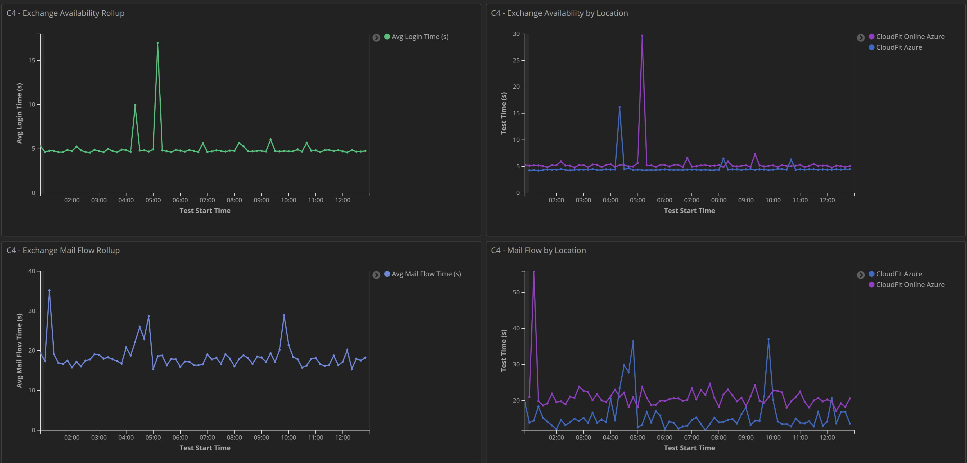
CloudFit Software Example

Slide 25
Service Desk and Normal Incident Management

Slide 26
The Customary Enterprise Service Desk
User→Tier 1 (log the call, follow a script)
Tier 1→Tier 2 (follow a script with increased permissions)
Tier 2→Tier 3 (go off-script to resolve the issue. eventually push knowledge down to lower tiers)
Tier 3→Microsoft (start with wizards)

Slide 27
The Customary Enterprise Service Desk
User→Tier 1 (log the call, follow a script)
Tier 1→Tier 2 (follow a script with increased permissions)
Tier 2→Tier 3 (go off-script to resolve the issue. eventually push knowledge down to lower tiers)
Tier 3→Microsoft (start with wizards)
Why not just give the wizards to tier 1 and/or tier 2?
For that matter, if appropriate, why not give the wizards to the end-user prior to their calling the help desk?

Slide 28
Just a few examples...

Slide 29
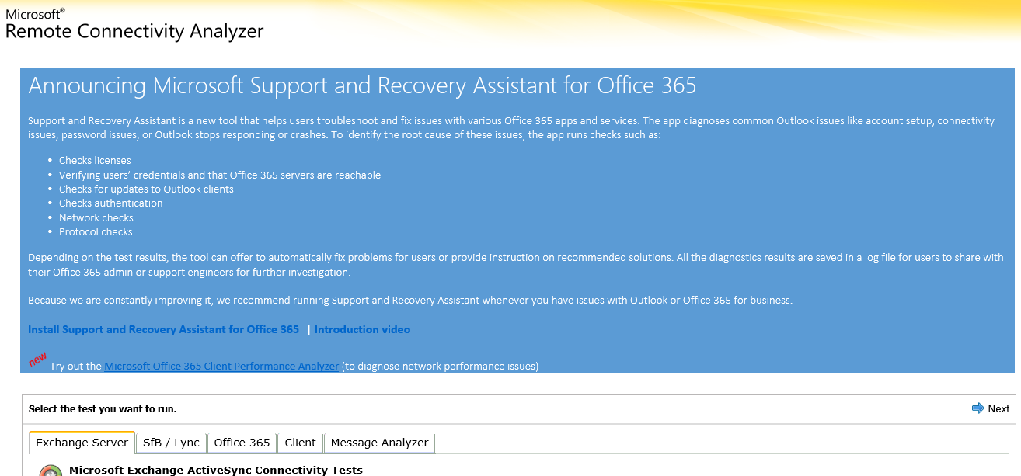
Remote Connectivity Analyzer
SaRA tool
User-Experience Tests
https://testconnectivity.microsoft.com/

Slide 30
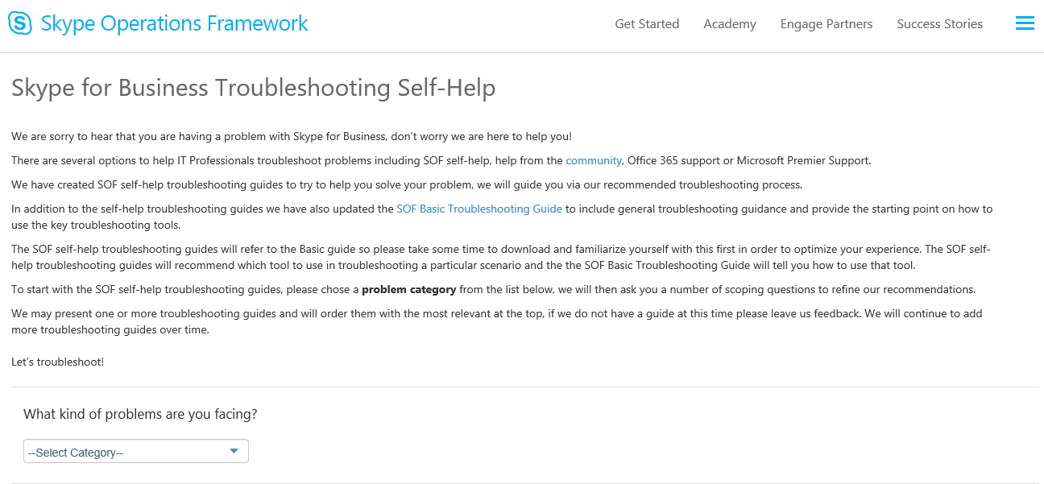
Skype Troubleshooter
https://www.skypeoperationsframework.com/TroubleshootGuide

Slide 31
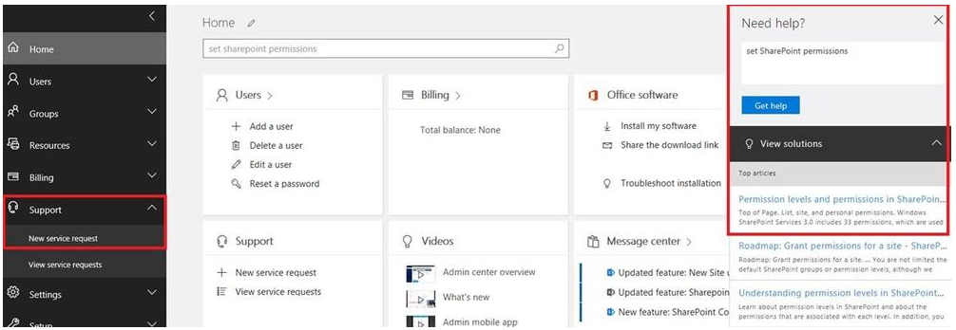
Admin Portal

Slide 32
Evergreen Management

Slide 33
Office 365 Service Communications API integrate with your Change/Release tools
API
Leveraging the Office 365 Service Communications API

Slide 34
Change and Release Communications
Office 365 Mobile Admin App
Monitoring Scenario | What? | API Class | Admin UI
1 | Does Microsoft think that I need to know about a potential or confirmed Service Incident? | Service Incident | Service Health
2 | Does Microsoft think that I need to take action to get healthy or to stay healthy? | Message %Prevent% | Message Center: Prevent or Fix Issues
3 | Does Microsoft think that I need to be aware of a planned Release? | Message %Change% | Message Center: Plan for Change
4 | Does Microsoft think that I need to be aware of other Service Management information that is not 1-3? | Message %Informed% | Message Center: Stay Informed
3
4

Slide 35
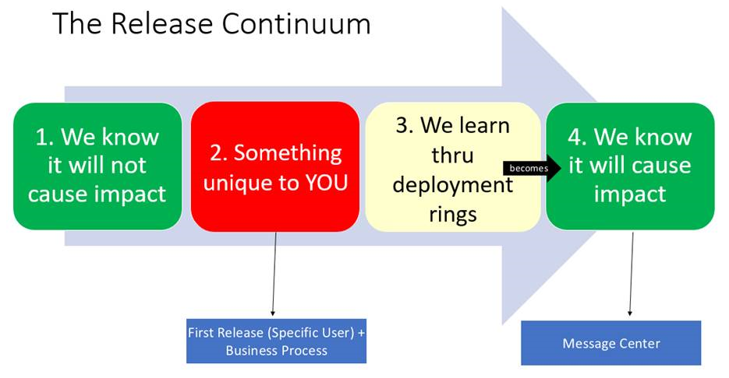

Slide 36
First Release
Tenant-Level
Specific-User
First Release

Slide 37
First Release
Tenant-Level
Specific-User ← very important
  Real users
  Likely existing super-users

Slide 38
Service Owners / IT Must Triage
Assign accountability
Triage
  roadmap.office.com
  blogs.office.com
  Triage Message Center’s “Plan for Change” and “Stay Informed” communications
  Office 365 Technical Community

Slide 39
Establish a Triage Workflow with Super-Users
~Monthly
  Triage roadmap.office.com
  Triage blogs.office.com
  Triage Message Center’s “Plan for Change” and “Stay Informed” communications
Two Topics for each Release
  How might this break your department or cause Service Desk calls?
  How can your department use this feature to be more productive, etc?
Exception Processes
  If the super-users do see adverse impact, how do they escalate to the project team immediately without needless red tape?
  If you meet monthly and there is a need to meet out-of-band, what is the procedure for that?
Measuring Impact

Slide 40
Questions

