Slide 1
Project Management:
Managing Expectations
Dealing with Delusions
One Stakeholder at a time
  Bert Walther, PMP®
  Executive Project Manager

Slide 2
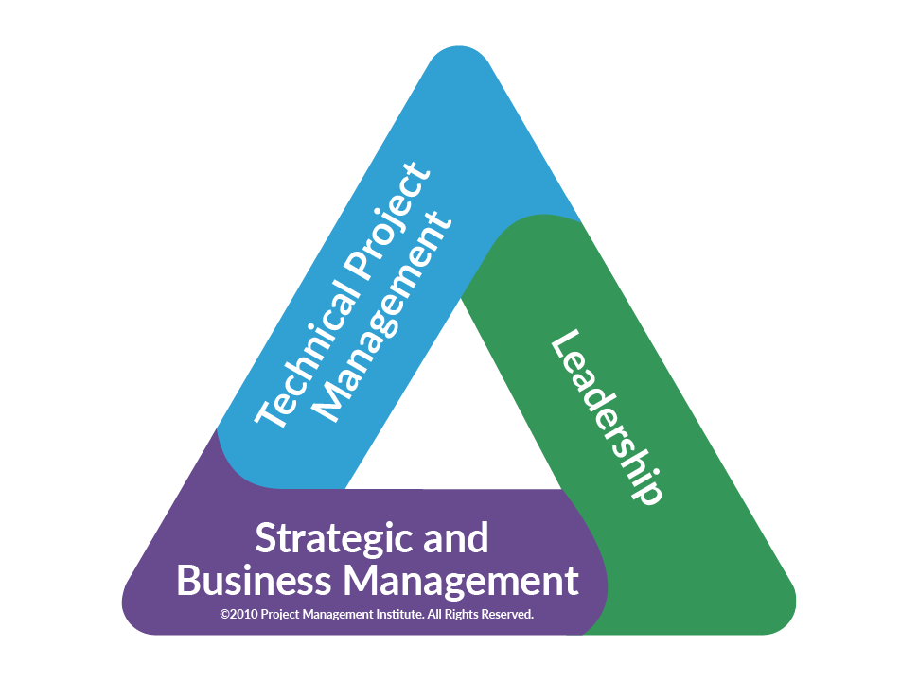
Notes:
Solarity as an REP = PMI Registered Education Providers
How many managers
How many front line
How many customer facing
How many enjoy technology more than people

Slide 3



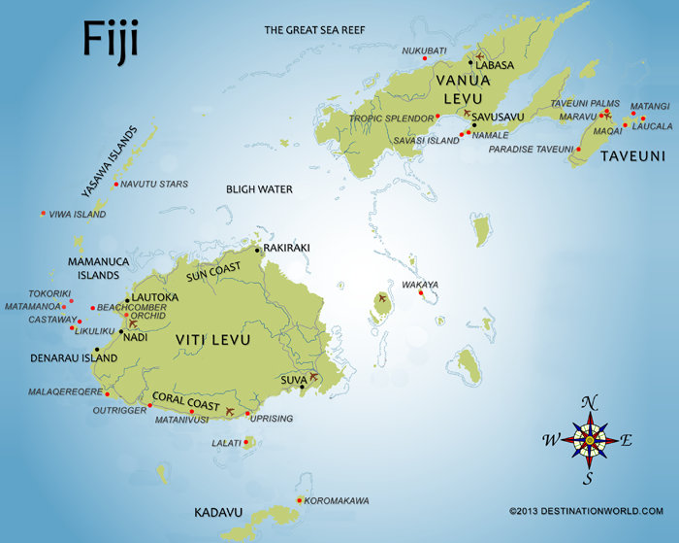
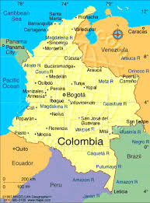



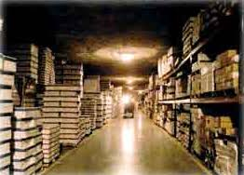

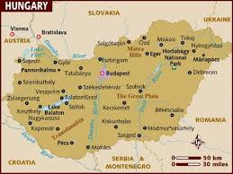
Helping people, organizations, and communities THRIVE!”
Notes:
SE Ohio Fiji - Construction
Asbury College (University Columbia – Construction/Electrical (ESL)
Hungary - ESL
Bible major with an emphasis in History
This qualified me to remember to pray for food
KUSI – X-rays
ComUSA Event Planning – Physical Cleaning
Recruiter for Manpower – Pim :: Network [Hiring/HR]
Help Desk Manager – Pusher :: HD Mgmt.; Accidental Project Management
Solarity :: Project Manager – PMP [KY Wired]

Slide 4
Personal Guiding Principles: Cultivating
The ability to conceive and articulate the appropriate questions
The ability to quickly assimilate needed data from masses of irrelevant information...
The ability to understand human nature and lead accordingly.
The ability to conceptualize and reorganize information into new patterns.
The ability to articulate and develop ideas with an eye toward application.
The ability to think inductively, deductively and dialectically. Familiarity with the different modes of thought (including quantitative, historical, scientific, and aesthetic.)
The ability to attack problems heuristically.
The ability to see connections among disciplines, ideas and cultures.
The ability to identify needed personal traits and turn them into habits.
The ability to establish, maintain, and improve lasting relationships.
The ability to pursue lifelong learning
The ability to discern truth and error regardless of the source or the delivery.
The ability to discern true from right and the discipline to do right.
https://joshkaufman.net/what-must-an-educated-person-know/
Notes:
Life Long Learning

Slide 5
At Solarity, we’ve developed an integrated approach to our business consulting and training services which we call our “Integrated Practices Management Model.” The Solarity Project Management Practice was used in various capacities over these LFUCG projects as we discussed in the presentation.
What is a Solarity Practice?
A Solarity practice is a consistent, quality delivery of a Solarity service or business operations. Our model is designed to integrate these quality practices to achieve our mission while aligning with our values.
Solarity Practice Components
  Guiding Principles
  Processes
  Templates
  Tools
  Metrics
  Wellness Checks
  Continuous Improvement
We’ve established an operational platform through our Practices Management Office (PMO) not to be confused with what is normally associated with a conventional Project Management Office (PMO). Solarity’s PMO assures the quality delivery of our business consulting and training services in line with our Integrated Practices Management Model.
Learn more about Solarity’s services in Consulting – Training – Community Broadband or email us at info@solarity.com
Notes:
Resonate

Slide 6

Since 2014, Solarity has partnered with the City of Lexington, to ensure successful outcomes for over 15 projects, from implementing new systems and upgrading critical business software to directing work on high-profile, public-facing projects like GigforLex, all the while working to promote organizational maturity.
We needed to instill Project Management best practices into our core IT team.
- Aldona Valicenti, Chief Information Officer
Notes:
1610 Peoplesoft Upgrade Project Bud 1610-2 LFUCG Business Process Mapping and Test Script Project
17030 LexCall 311 Salesforce P2 - LFUCG Brian
18009 Avaya Project Phase 1 Discovery - LFUCG Alex
LFUCG Portfolio Christy
PMP Training Classes
OCM Training Class
CPPM Training Class Cultivate a PM culture

Slide 7
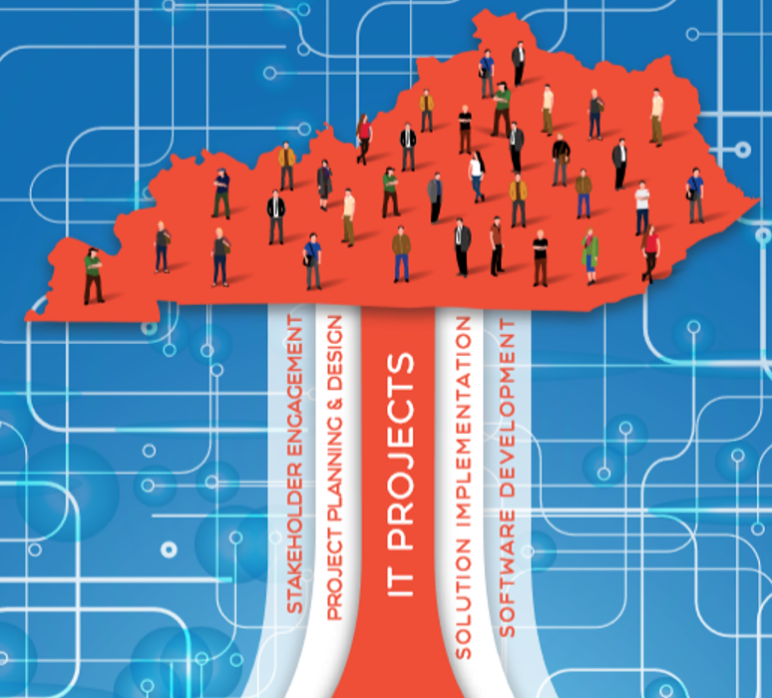
Objectives and Success Criteria
Ensure IT Infrastructure is Reliable and Secure
Improve IT Efficiency and Effectiveness
Increase Enterprise Security
Increase System and Solution Standardization
Increase Process Automation
Enhance IT Customer Service & Outcomes
Notes:
& Guiding Principles

Slide 8
Cornerstone Project: Windows 10 Upgrade
In spring of 2016, Microsoft announced an upgrade from previous OSs with no licensing cost if installed before July 29, 2016. This initiated a project to upgrade Lexington-Fayette Urban County Government’s desktop environment to Windows 10. LFUCG contracted with Solarity to provide project business consulting to ensure successful completion of the project by the deadline set by Microsoft. Through this project, 1,604 machines were updated by the deadline, resulting in significant license savings. (> $300k)
This project allowed the organization to prioritize, scope, schedule, and provide budget for:
Purchase and Implementation of a new Service Desk Ticketing System
Identification & Remediation of existing Access Databases in the Enterprise
Document and Improve the Annual Lease Computer Project
Facilitate the move of on premise Exchange to the Microsoft Cloud
Provide assistance identifying opportunities for Leadership Development, Process Improvement, and Professional Development
Notes:
Cornerstone Project ^> Servers/Applications
Q; How many of you know the number of Access DBs in your environment
Q: How much would you pay to know? Write that number on your business card a give it to Cory

Slide 9
Capstone Program: Information Security
Lexington’s city leaders wished to make IT and Security a priority and contracted with Solarity to provide program management business consulting services to manage the various projects and investment needed to modernize the city’s information security platform. The effort has provided benefits in:
Security and Risk Management
Legacy System Modernization
Elimination of Technical Debt
Data Management and Analytics
Audit and Compliance Activities
Notes:
Different types of programs
Capstone Program
Data Mgmt.
Vendor Mgmt.
CISO
Security
Infrastructure
Systems
Applications
Workstation
Policy
Security Awareness

Slide 10
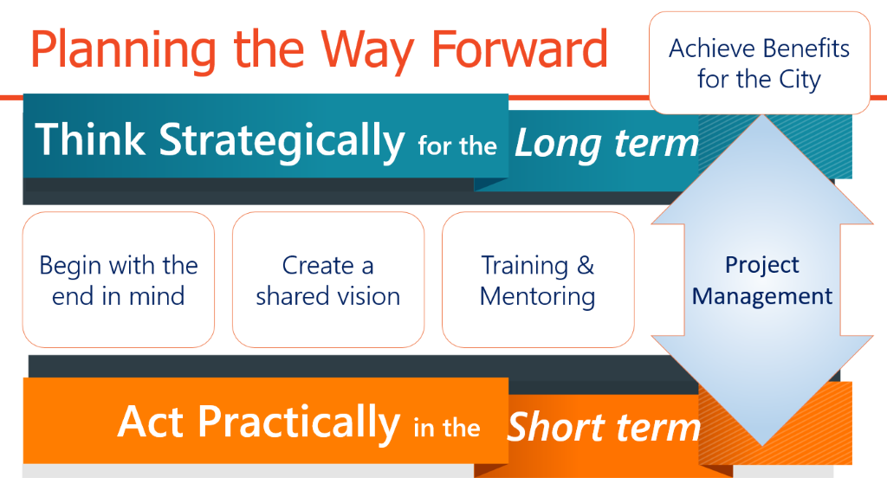
Notes:
Proven methods for driving Scope Management in key Enterprise Projects and Programs

Slide 11
Stakeholder Management
Who wants change? Who wants to change?
ex·pec·ta·tion : ekspekˈtāSH(ə)n/ noun
  a belief that someone will or should achieve something.
de·lu·sion : dəˈlo͞oZHən/ noun
  an idiosyncratic belief or impression that is firmly maintained despite being contradicted by what is generally accepted as reality or rational argument.
re·quire·ment : rəˈkwī(ə)rmənt/ noun
  a thing that is needed or wanted.
  a thing that is compulsory; a necessary condition.
de·liv·er·a·ble : dəˈliv(ə)rəb(ə)l/ noun
  a thing able to be provided, especially as a product of a development process.
Managing expectations and dealing with delusions
Notes:
Stakeholders / Sponsor = RELATIONSHIPS
Quality
Wellness
Relationship
Continuous Improvement
Focus
75% - 90% communication
200 stakeholders = 19,900
MBWA v. Management by Sky Mall Magazine
User Stories ---- Acceptance Criteria
ALWAYS have an agenda for a meeting
PPT -> Mobile phone
“We don’t see things as they are. We see things as we are.” -- Anais Nin, Author and Diarist

Slide 12
As it turns out, a Murder Board, while effective for choosing projects, is not a tool or technique for Stakeholder Management.
Well, at least not officially…

Slide 13
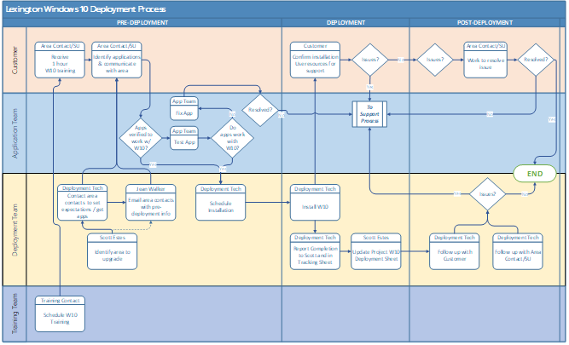


Un-intended Messages:
We’re upping our communication!
So…
Up yours!
“Stories create community, enable us to see through the eyes of other people, and open us to the claims of others.”
– Peter Forbes, photographer and author
Notes:
Communications

Slide 14
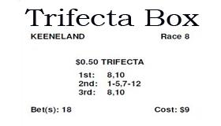
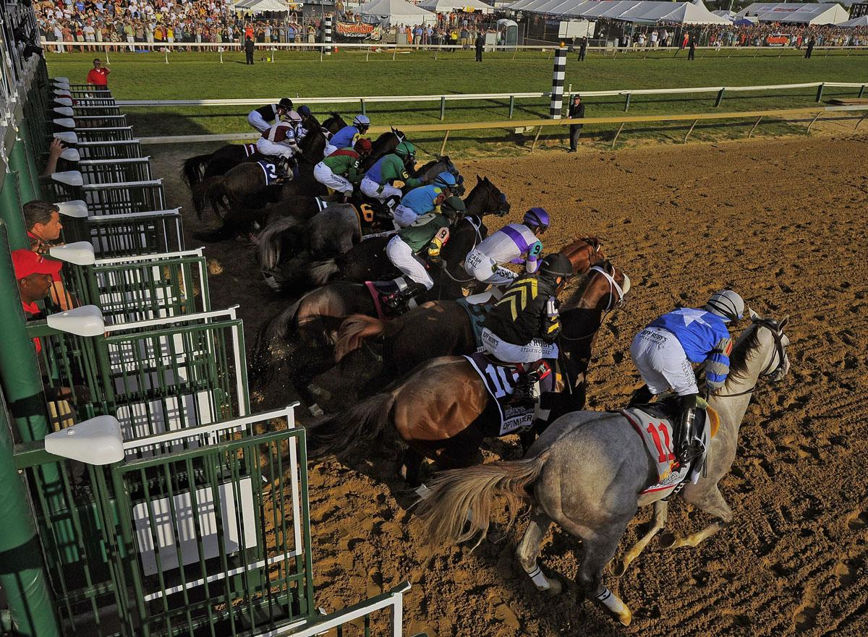
Tech Trifecta
1st: Mindset
2nd: Skillset
3rd: Toolset
Notes:
Humana Resources
Hiring
Mindset: SEE - How you see, perceive and view the world around you – your beliefs and way of thinking that determine your behaviour and outlook, how you’ll interpret and respond to situations. WORLD VIEW
Skillset: ACT - How you act and behave based on your capabilities, knowledge and understanding as well as your motivation to put your abilities to use – ie. your mindset
Toolset: What mechanisms you use to develop your skills and achieve your objectives – these can be any number of methods, techniques, models, approaches and frameworks that create value in your chosen field.
The Leadership Team is open and honest and demonstrates a high level of trust by ensuring….
The right people are in the right seats and understand their roles and responsibilities
They have the right knowledge and access to the right systems and are engaged in the right work the right way
They are implementing the right solutions with quality customer service
This is managed through monitoring the right measurements for the right results

Slide 15
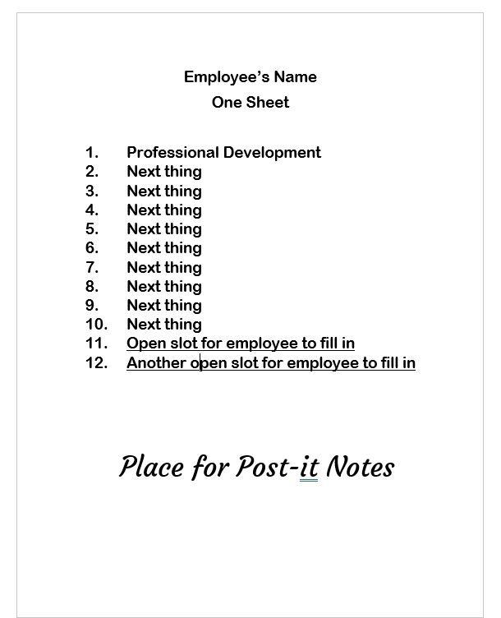
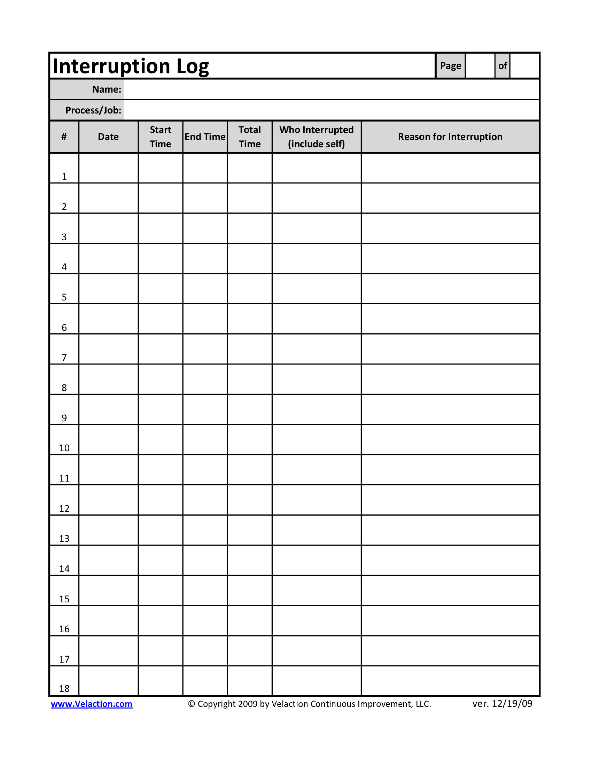
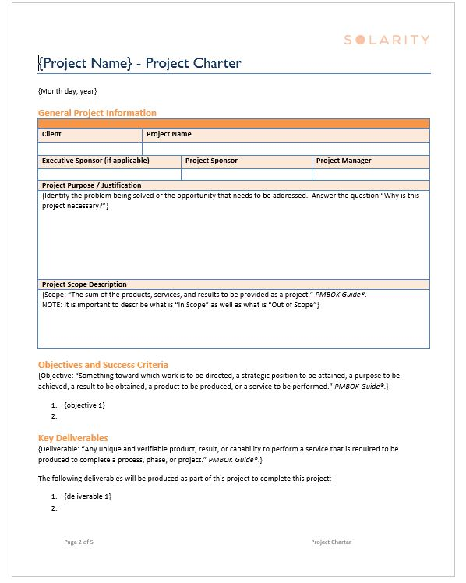

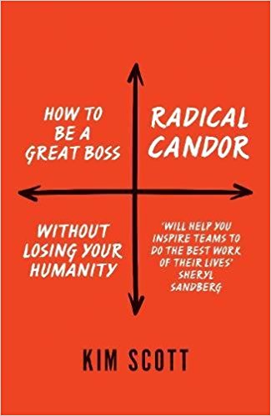
Just one more thing
Objectives & Success Criteria
Key Deliverables
High-Level Requirements
Agreement on Scope
Constraints
Assumptions
What 3 things do I do to get back on track?
Notes:
Care Personally
Challenge Directly
Sweet Spot – Radical Candor – Kim Scott

Slide 16

“We live out the mission of helping people, organizations, and communities THRIVE!”
Notes:
New Perspectives
On
Familiar Challenges

Slide 17
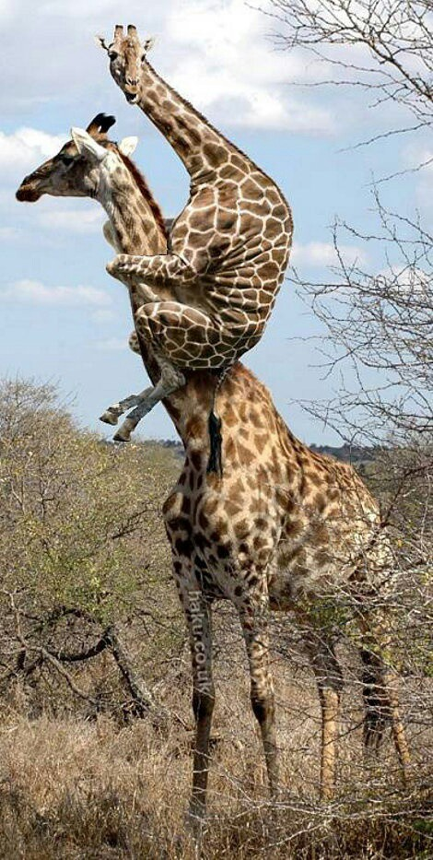
Overcoming our legacy
If I have not seen as far as others, it is because giants were standing on my shoulders.
Source: Public Knowledge - Hal Abelson; also quoted in Vortex dynamics in thin films of amorphous Mo77Ge23, 1998, p. 6
Notes:
Exchange 5.5 -> O365 in the Cloud
People are our greatest legacy system
Caricature of ourselves

Slide 18
Cornerstone Project: Windows 10 Upgrade
In spring of 2016, Microsoft announced an upgrade from previous OSs with no licensing cost if installed before July 29, 2016. This initiated a project to upgrade Lexington-Fayette Urban County Government’s desktop environment to Windows 10. LFUCG contracted with Solarity to provide project business consulting to ensure successful completion of the project by the deadline set by Microsoft. Through this project, 1,604 machines were updated by the deadline, resulting in significant license savings. (> $300k)
This project allowed the organization to prioritize, scope, schedule, and provide budget for:
Purchase and Implementation of a new Service Desk Ticketing System
Identification & Remediation of existing Access Databases in the Enterprise
Document and Improve the Annual Lease Computer Project
Facilitate the move of on premise Exchange to the Microsoft Cloud
Provide assistance identifying opportunities for Leadership Development, Process Improvement, and Professional Development

Slide 19



Success
Making IT look too easy
Success by personal heroism
Superhero Syndrome

Slide 20
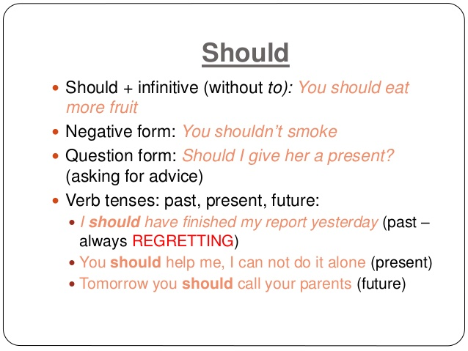
If we are not careful… we could should all over ourselves
What’s important is not just to implement the technology; what is important is to develop the processes, integrations, and support necessary to improve business the through the technology implementation.
Notes:
Arctic Wolf – Security is configured not purchased – securing the Human

Slide 21

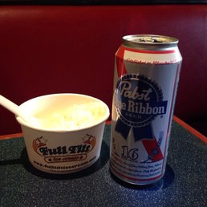
Lessons Learned: Life Lesson #19
Root Beer + Ice Cream = Good!
Beer + Ice Cream = BAD!
Notes:
How do you stop the attachment that shouldn’t have been emailed
The day you walk in and your data center is a walk-in easy bake oven
How to handle your “John Falstaff”

Slide 22

Questions?

Slide 23
Books
Zapp! The Lightning of Empowerment: How to Improve Quality, Productivity, and Employee Satisfaction by William Byham
The Contrarian's Guide to Leadership by Steven B. Sample
THE PERSONAL MBA MASTER THE ART OF BUSINESS by Josh Kaufman
Patrick Lencioni Books (https://www.tablegroup.com/books
The Five Dysfunctions of a Team
The Five Temptations of a CEO: A Leadership Fable
Death by Meeting: A Leadership Fable...About Solving the Most Painful Problem in Business
The Four Obsessions of an Extraordinary Executive: A Leadership Fable
Silos, Politics and Turf Wars: A Leadership Fable About Destroying the Barriers That Turn Colleagues Into Competitors

Slide 24
Thank you!
Bert Walther, PMP®
Executive Project Manager
m: 859-553-5915
e: bert@solarity.com

