Slide 1


PowerShell
PowerShell goodness 2017
Jeremy Sublett
Composable Systems, LLC

Slide 2
Topics
Basics
  Syntax, Terminology, Variables, Environment Variables
Advanced Basics
  Filtering, Functions, WMI, Event Log, Workflow
Web access for the REST of us
Rollin’ in My 5.0
Mr. Administration
Bonus Points

Slide 3
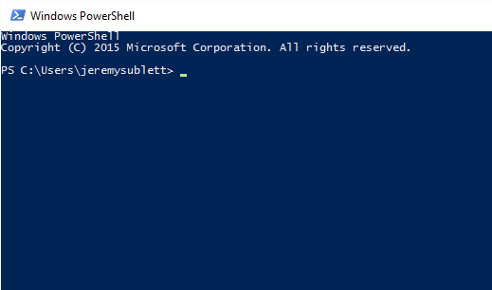
Hello PowerShell
Accessing PowerShell…
  Start menu
  Cmd
  Application-specific PowerShell loaders
Notes:
Open PowerShell from various ways. Talk about versions…

Slide 4
Basics
Getting around the environment
Piping
Variables
Filtering
Notes:
Open the ISE and work with the script file

Slide 5
Basics
Environment Variables
Get-ChildItem Env:

Slide 6

Advanced Basics
Functions
Looping
JSON

Slide 7
Admin
About Jeffrey Snover
  Inventor of PowerShell
  GUI on a server… not a fan
  In charge of Windows Server and Systems Center
  Nano Server – small footprint, command line only

Slide 8
Admin
Rename-Computer MyNewComputerName

Slide 9
Admin
Restart-Computer
Restart-Computer –ComputerName SomeOtherServer
Stop-Computer

Slide 10
Admin
Add-Computer –DomainName MyCompany.corp

Slide 11
Admin
Get-NetIPConfiguration
Get-NetIPAddress
New-NetIPConfiguration
Set-DNSClientServerAddress
Test-NetConnection smtp.com -Port 25

Slide 12
Admin
Get-Service | Where-Object {$_.status -eq "Stopped"}

Slide 13
Admin
Get-HotFix

Slide 14
Admin
$pass = ConvertTo-SecureString –String "Pa55w0rd" –AsPlainText -Force
New-ADUser –Name John.Doe –AccountPassword $pass

Slide 15
Workflow
Multi-Server Management
Single task to manage complex processes, with status always available
Automated failure recovery
Connect/disconnect/restart – persistable, resumable
Parallel or sequential execution
Can use Visual Studio declarative workflows (XAML)

Slide 16
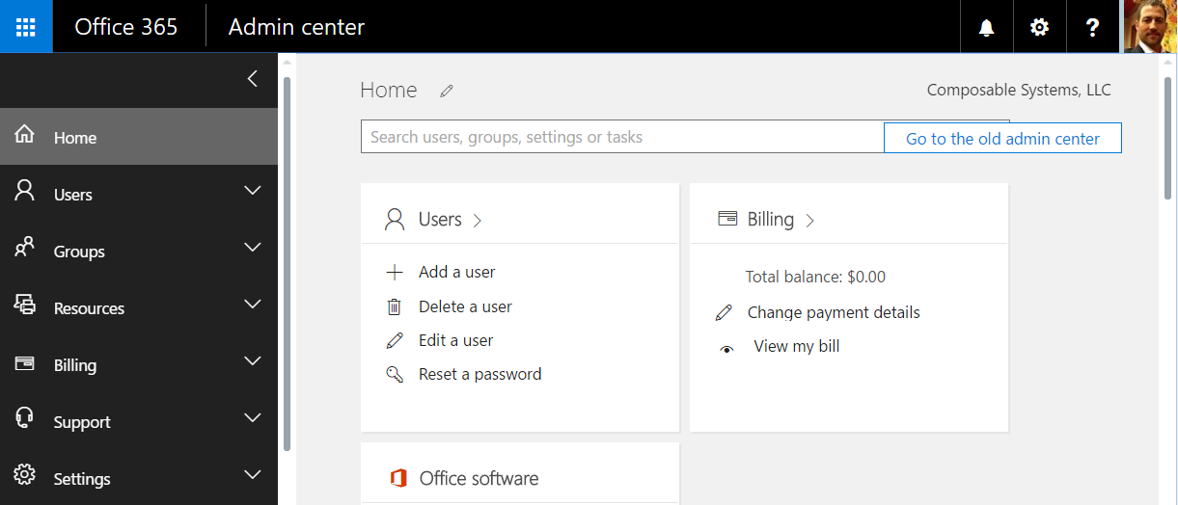
Office 365
Install Windows Azure Active Directory Module
Connect with your Office 365 credentials
Connect-MsolService
Get-MsolUser | Select-Object FirstName, Title, IsLicensed
Get-MsolCompanyInformation
Get-MsolRole
Get-MsolAccountSku

Slide 17
SharePoint and SQL Server
#adding a new site collection
$siteColl = New-SPSite -URL "http://csdev/sites/demo1" -OwnerAlias JSE6410\Jeremy -Template "STS#1" -Name "Demo 1"
#creating a document library
$csv = Import-Csv c:\PowerShellDemo\symbols.csv
$csv | foreach { Get-Quote $_.Symbol }
#creating a bunch of doc libraries - based on data in SQL
$vendors = Invoke-Sqlcmd -Database AdventureWorks -Query "Select top 10 * from Purchasing.Vendor"
$vendors | foreach { $siteColl.RootWeb.Lists.Add($_.AccountNumber,$_.AccountNumber,$listTemplate) }
#cleanup
$siteColl.Dispose()
#removing
Remove-SPSite -Identity "http://csdev/sites/demo1" -Confirm:$false

Slide 18
Web, REST APIs and JSON
  Interacting with web content
  Invoke-WebRequest -Method Get -Uri http://microsoft.com
  APIs: Posting, Getting and Handling JSON data
  Invoke-WebRequest vs. Invoke-RestMethod
  Invoke-RestMethod -Method Get -Uri {api_endpoint}

Slide 19

PowerShell 5.0
Version?
  $PSVersionTable.PSVersion
Classes
Enumerations
Desktop and Core versions
ConvertFrom-String auto data extraction improvements
Zip/archive file support
PackageManagement (to replace OneGet)
Script tracing and debugging improvements
Cryptography cmdlets
New-Guid

Slide 20
PowerShell 5.0
Class Computer
{
[String]$Name
[String]$Location
[Int]$RamGb
GetLoginActivity()
{
#...
}
}
$c = [Computer]::new()

Slide 21
PowerShell 5.0
Compress-Archive -Path C:\Stuff -DestinationPath archive.zip
Compress-Archive -Path C:\Stuff2\*.txt -Update -DestinationPath archive.zip
Expand-Archive -Path archive.zip -DestinationPath C:\Destination

Slide 22
Important Commands
Get-Command
Get-Help
Get-Member
Select-Object
Foreach-Object (Foreach or %)
Where-Object (Where or ?)
Write-Host
Write-Output
Export-CSV
Out-Grid

Slide 23
Questions
Jeremy Sublett
jsublett@composablesystems.com

