Slide 1
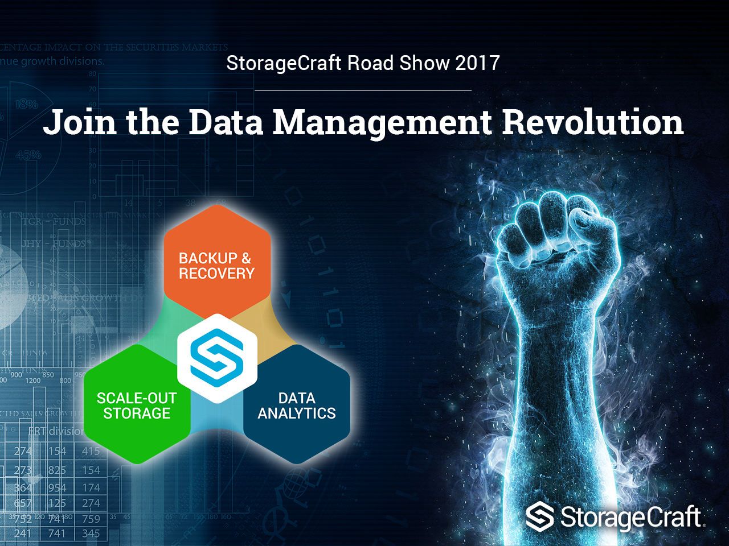
Outcome-Based
Disaster Recovery & Business Continuance

Slide 2
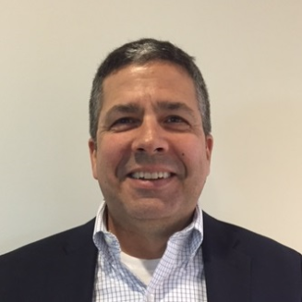



StorageCraft Midwest team: midwest@storagecraft.com
Eric Hentschel Territory Account Manager
614-440-5823
eric.hentschel@storagecraft.com
Matt Kern Sales Engineer
614-325-6880
matt.kern@storagecraft.com

Slide 3
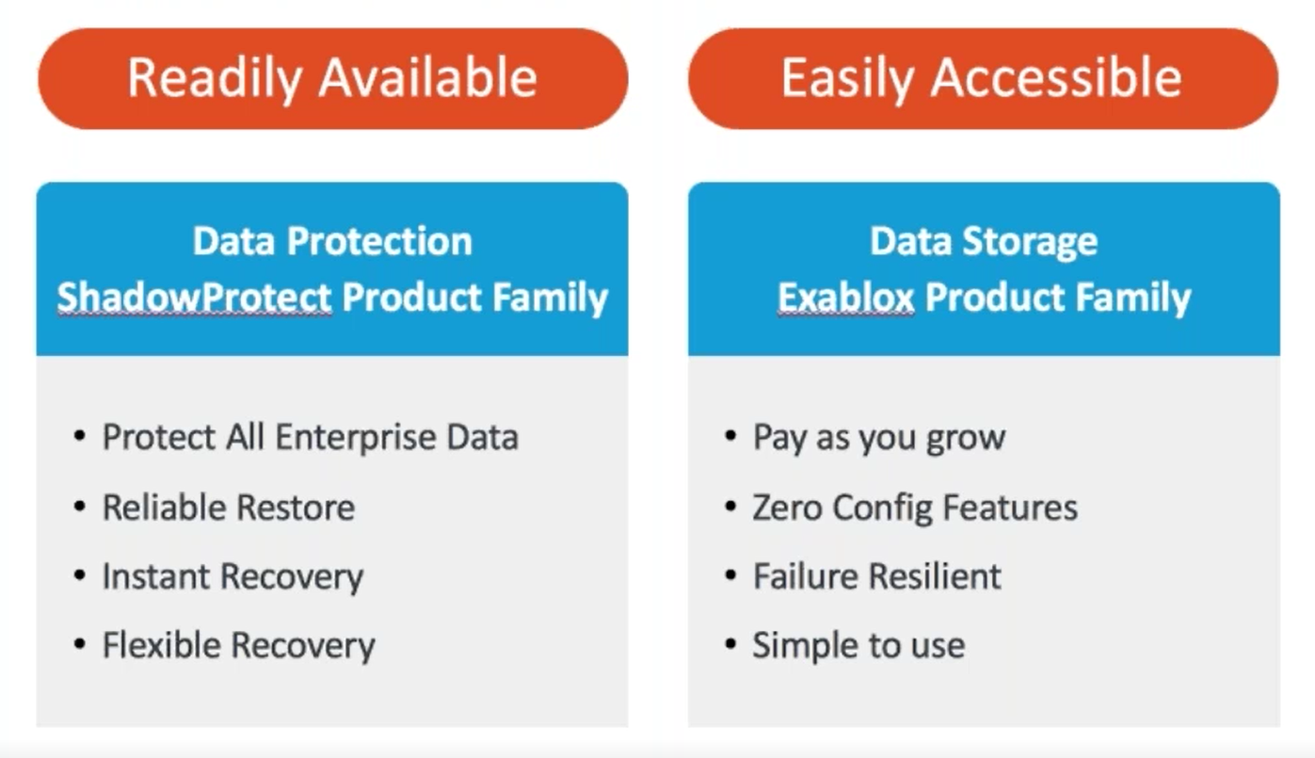
StorageCraft Solutions
Notes:
PRESENTER’S NOTES
Adding Oneblox storage solves the problem of scale that so many of our partners have been trying to solve and provides a platform for continued innovation. We’re going to take short break
<advance>

Slide 4


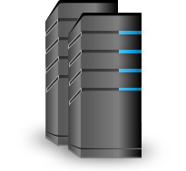











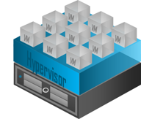


Data Storage & Protection
with Intelligent Recovery
G Suite
PHYSICAL SERVERS
BDR
FTPS or SFTP
TABLETS-LAPTOPS
DESKTOPS
iFTP
ShadowStream
PUBLIC CLOUD
Connectors
VIRTUAL
ENVIRONMENTS
OFFSITE
Notes:
PRESENTER’S NOTES
Finally. What about this data explosion? How do we manage that? Well, intelligently, hopefully. Yes some might say that Copy Data is a necessary evil. It will continue to grow and requires storage. Eventually that storage repository you are storing that Copy Data on is going to reach capacity. This can create a whole new set of problems. For those of you who have wondered ‘Why Exablox?’ here is the answer. Pay as you grow, zero configuration, object storage, with global de-dupe, compression and the ability to scale out. As we learned earlier, Fork Lift upgrades are a thing of the past. <advance>

Slide 5
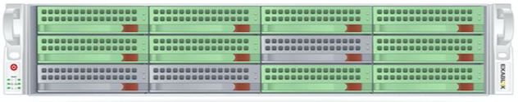
Exablox NAS Appliance
\\OneBlox\Public\Backup
On the fly drive and node expansion
Up to 7 nodes in a ring (21 soon); 224TB Useable (over 1PB soon)

Slide 6
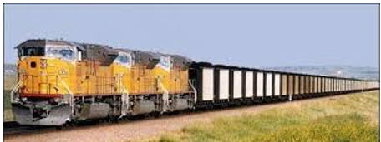

Exablox NAS Appliance
How Does Object-based storage Help?
3 copies to protect Data vs Disks (bit rot)
Cost efficient Drives to ease ROI of three copies
Pooled Resources to ease Management
Namespace grows on-the-fly to ease management
Data redistributes on-the-fly to ease management
Drive rebuilds of actual data only to ease overhead
Compression – Deduplication – Encryption – Snapshots
HDD and AFA versions
No more RAID groups to buy at a premium/drive
No more procurement involvement for additional capacity
No more RAID groups to manage
No more RAID rebuilds to wait-out

Slide 7
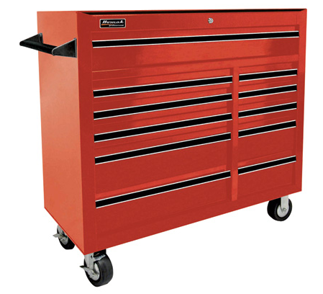


What do I mean by: Outcome-Based
Disaster Recovery & Business Continuance

Slide 8


CHANGES
More file-based mobile devices with critical information
More SaaS applications to streamline business operations
The ever-changing Security landscape
Notes:
PRESENTER’S NOTES
What kind of pressures do these organizations face that would threaten to drive them out of existence? <advance>

Slide 9
CHANGES
Darwin: Size, Strength, Intelligence, does not matter
Ability to Adapt to Change
Notes:
PRESENTER’S NOTES
Companies that are not adapting and adopting up solutions that address the digital revolution won’t survive in this market.
A CNBC study predicts that this pressure will drive 40% of the current S&P 500 out of existence within ten years. This seems difficult to really comprehend but I’ll give you and example: We all know the Kodak Corporation. In 1998, Kodak had 170,000 employees and sold 85% of all photo paper worldwide. All medical X-rays used Kodak film. Camera's, both commercial and industrial, security camera's- imaging of all sorts. Within just a few years, their business model disappeared and they went bankrupt. How many of you in 1998 thought that in 3 years you would never take pictures on film again?<advance>
Data Source: Lori Iounnou, “A decade to mass extinction event in S&P 500,” CNBC, June 4, 2014, www.cnbc.com/2014/06/04/15-years-to-extinction-sp-500-companies.html.

Slide 10
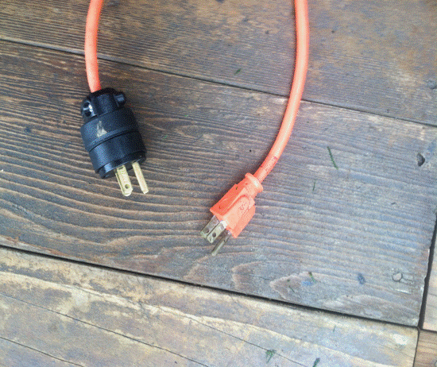

REALITIES
Security will not Stop…
Catastrophic Act of God or a Malicious Employee
HW /SW failure or Corrupt data being replicated
Oops! I guess I really needed that file
Smart people from doing dumb things!

Slide 11

REALITIES
Regardless of your Security Posture,
Data Center Redundancies,
and Storage Resilience,
You need Backup with a Recovery Plan

Slide 12

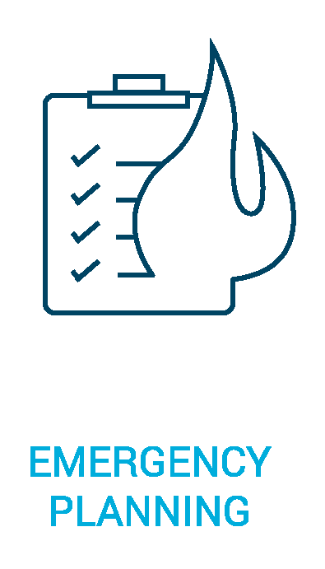
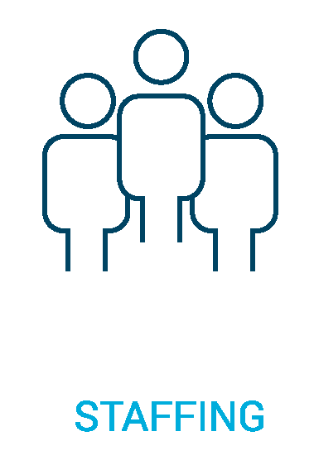
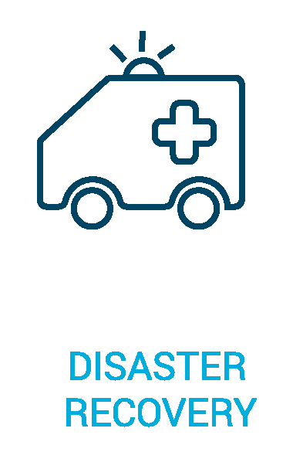
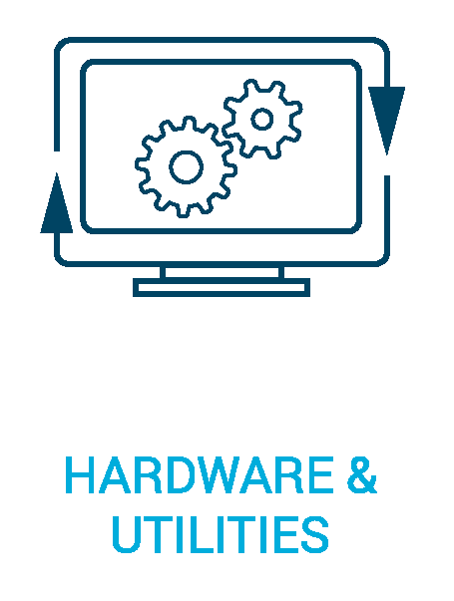
Business Continuity
Disaster Recovery is to Business Continuity
as Backup is to Disaster Recovery

Slide 13
Step One
Buy-in from the entire organization
If BoD or Owners do not buy-in, No proper funding
If IT does not buy-in, no proper execution
If employees do not buy-in, it won’t matter
Keep your resume updated

Slide 14
Step Two
Simplify as much as possible
Servers should be standard and easy to replace
Networks should be configured with DR in mind
Storage should be Easy to install, Configure, and Manage
Backup/Recovery should be the same Plus Easy to Recover

Slide 15
Step Three
Use an On-Line BC/DR Plan System
Employees – Used to communicate with employees
Locations – Information on secondary sites should be detailed
Teams – DR team information and their tasks
Assets – List of major assets and critical information such as suppliers, insurance, and maintenance schedules
Contacts – Major suppliers and customers should be documented
Contact Groups – Manage contacts by groups
Insurance – Details of insurance policies and contact information
Tasks – list of step by step tasks for all disaster types

Slide 16
Step Four
All Data is not Created Equal; you need to Sort your People, Pets, & Pigs
We expect loss with Pig ranching and might just make Ham and Bacon
We know Pets will pass but we try
We will go to the ends of the earth to preserve People
Sort your applications/data the same way

Slide 17
Backup Security is a Key
Backup target not part of the production domain
Do not Map Drives to backup target
Use a “Boot from Backup” (VirtualBoot) for immediate recovery on-site or in the Cloud
With pre-staged restore, set time lag to 4+ hours to keep viruses off the recovery Volumes
Use a solution that doesn’t replicate Ransomware

Slide 18
Other Best Practices
Approach BC/DR as Standard Operating Procedure; Not an after-thought
Implement & Proactively Train on Detailed BC/DR plans
(Perfect) Practice Makes Perfect

Slide 19
Get Started
On-line Plan
Application
SLA
Test
Repeat

Slide 20
Work with
A partner and vendor that understands…
  Why you are in business
  it is about the outcome
  Your SLA Requirements
  That you need to prove your recover-ability with automated testing

Slide 21

Thank
You!

