Slide 1
The Microsoft UC Experience
Skype for Business & Office 365 & You!
Daryl Hunter, Chief R&D Officer

Slide 2
Quick Agenda
Skype for Business
Licensing Basics
Deployment Options
Demo
Wrap Up / Q&A

Slide 3

About Daryl
(Or DW to friends like you)
Chief R&D Officer
Practice Lead: Unified Communications
Solutions Architect
Lync & Skype, Office 365, Networking, Exchange
Cloud / Hybrid

Slide 4
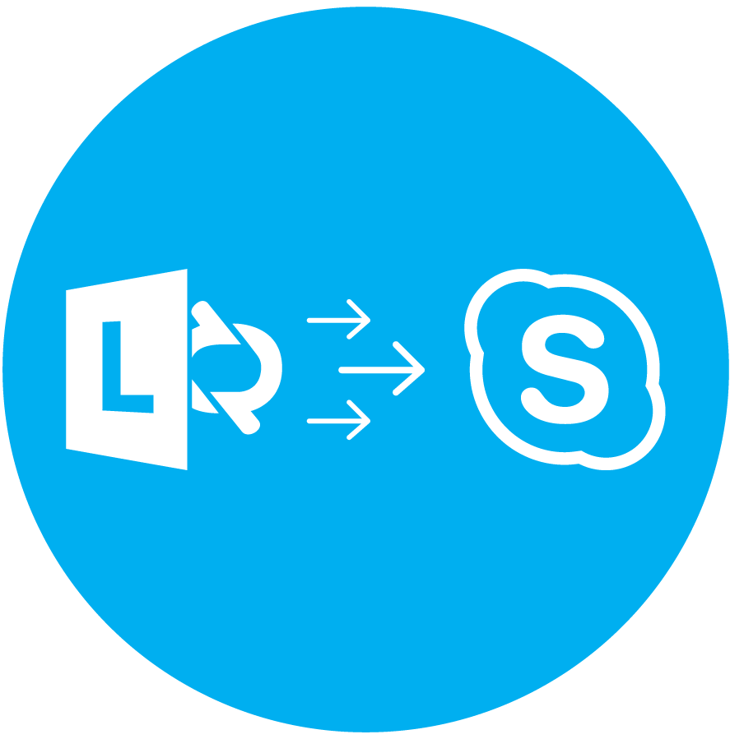
History Lesson – Microsoft UC
The Long Road to Skype for Business
Standalone – NetMeeting
Exchange 2000 Instant Messaging
LCS 2003
LCS 2005 (then SP1)
OCS 2007
OCS 2007 R2
Lync 2010
Lync 2013
Skype for Business 2015

Slide 5
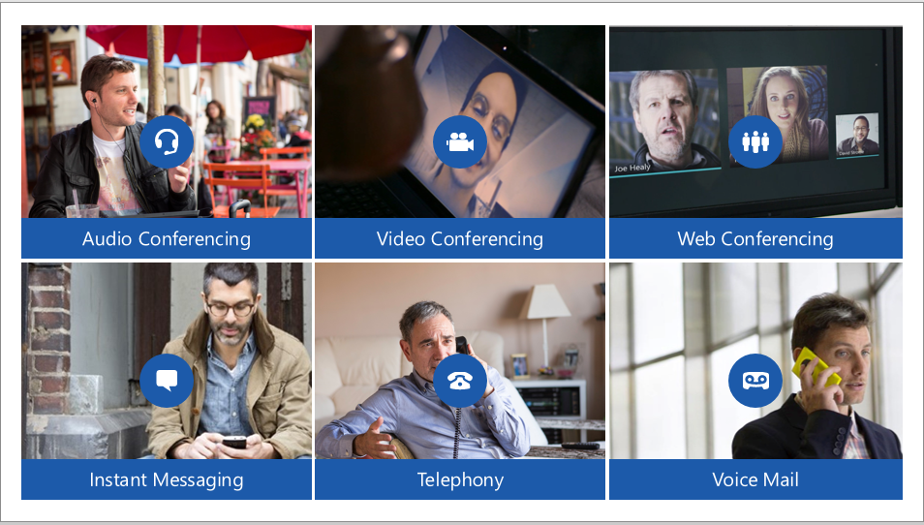
Skype for Business
It’s more than IM – It’s full UC

Slide 6
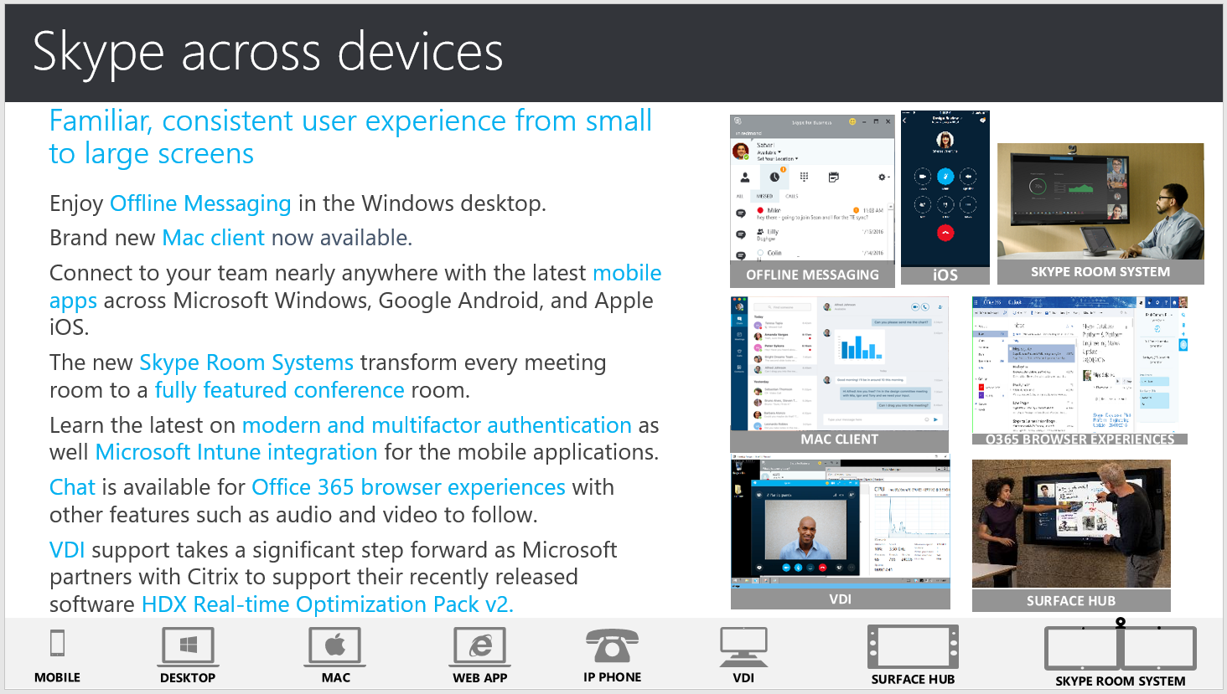
Skype for Business
Multi Device // Familiar Experience

Slide 7
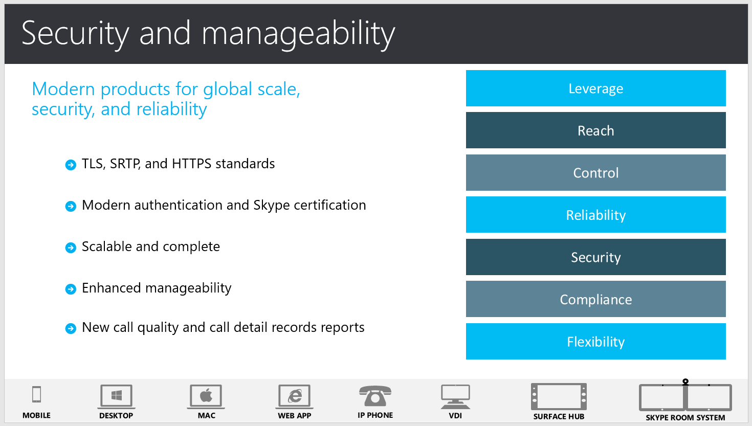
Skype for Business
Secure Administration, Scalability, Reliability

Slide 8
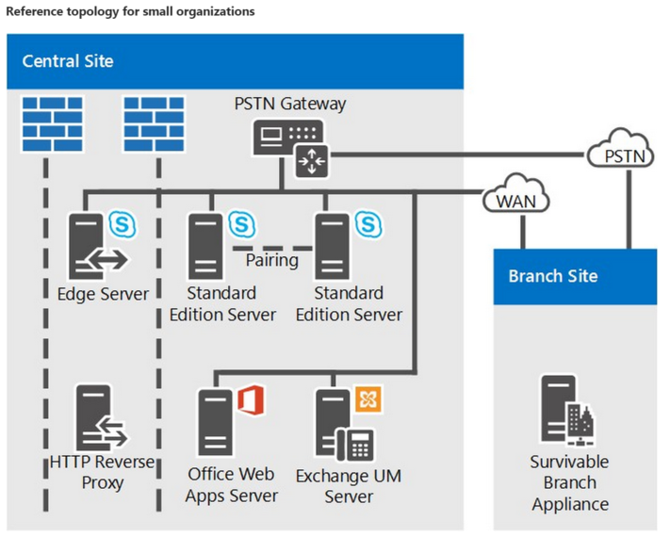
Skype for Business
Reference Architecture – On-Premises // Small

Slide 9
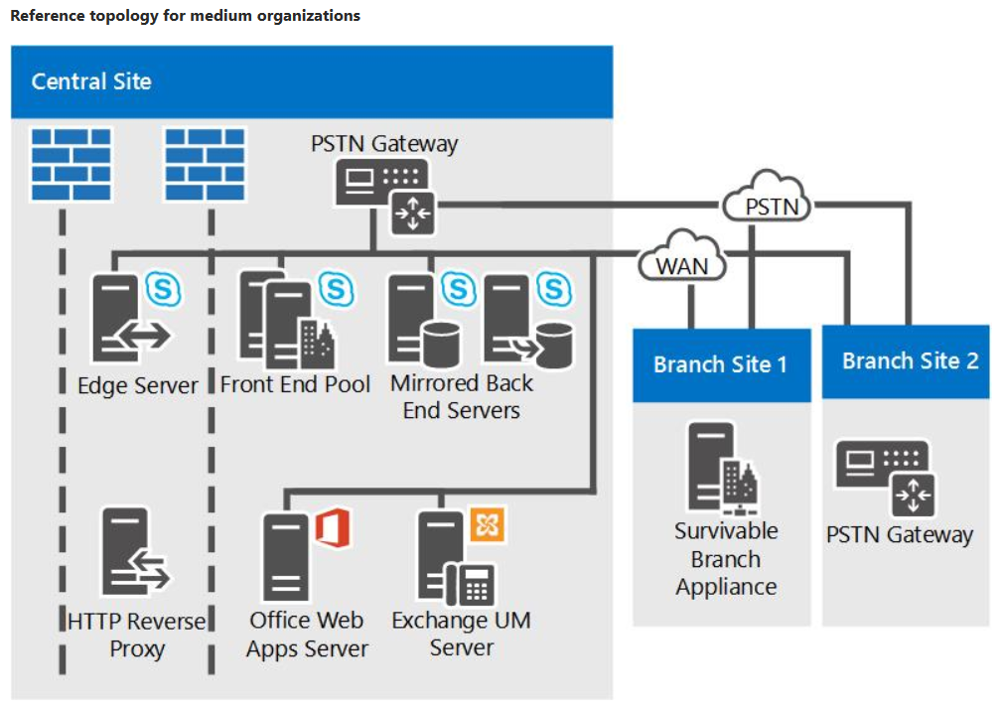
Skype for Business
Reference Architecture – On-Premises // Medium

Slide 10
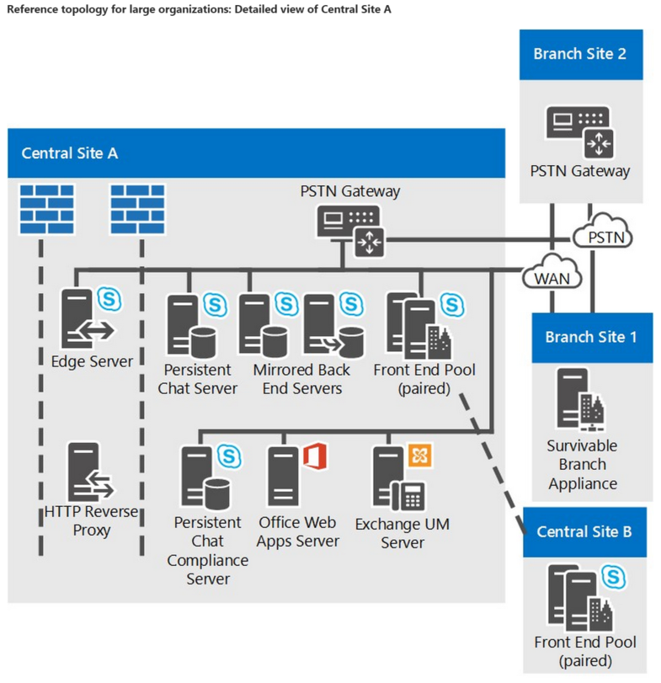
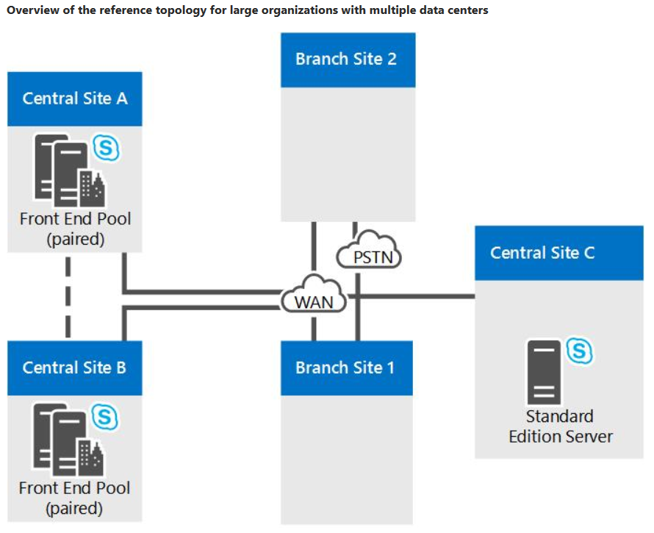
Skype for Business
Reference Architecture – On-Premises // Large

Slide 11
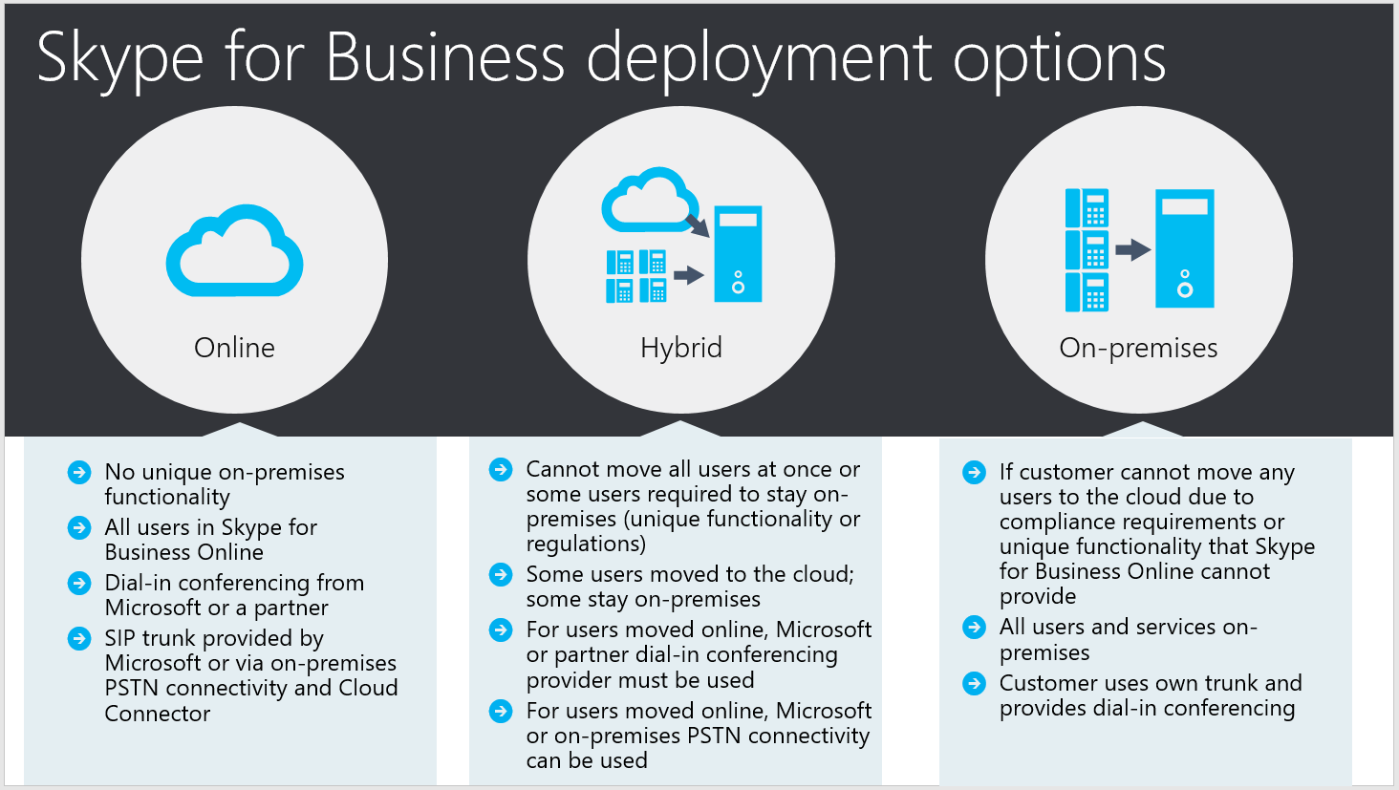
Skype for Business
But DW, What about Hybrid / Online?

Slide 12
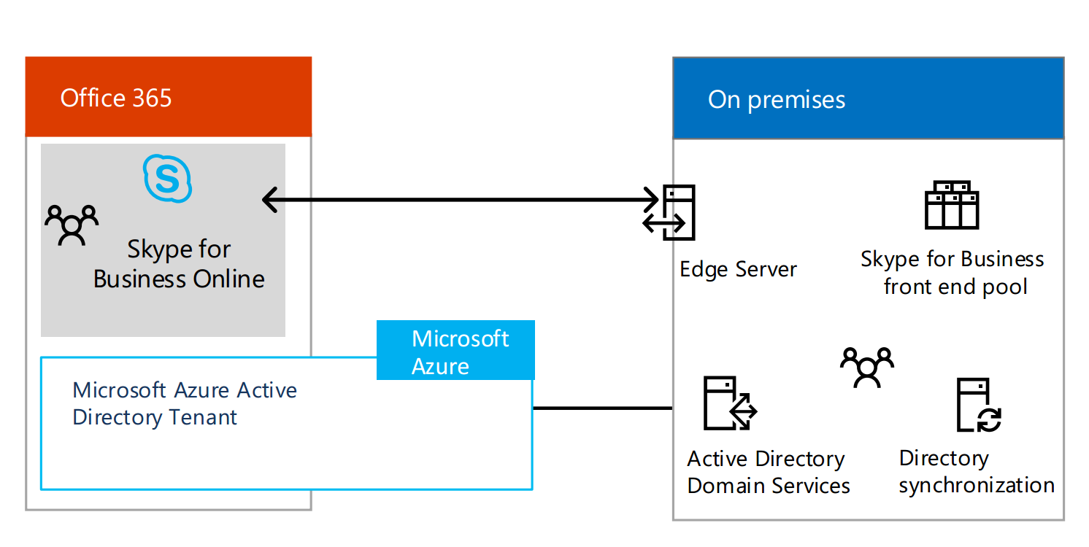
Skype for Business
Reference Architecture – Online // Hybrid

Slide 13
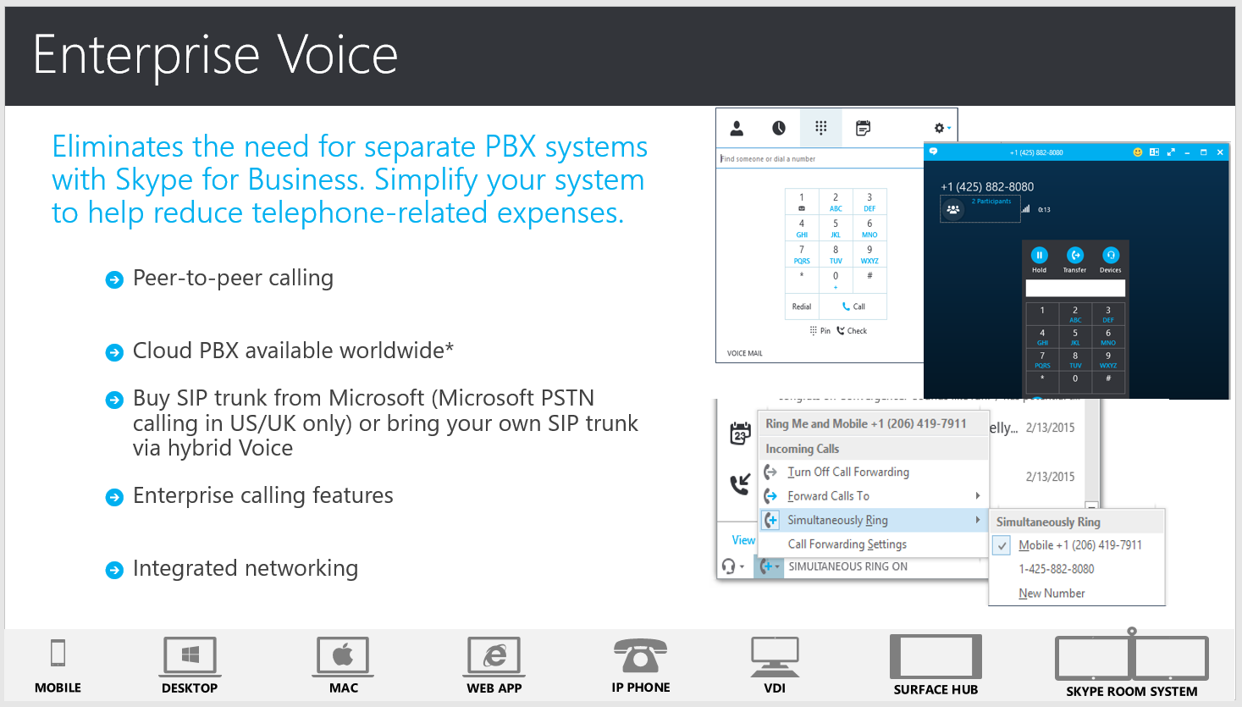
Skype for Business
Can I do Skype for Business Online – With Full Voice?

Slide 14
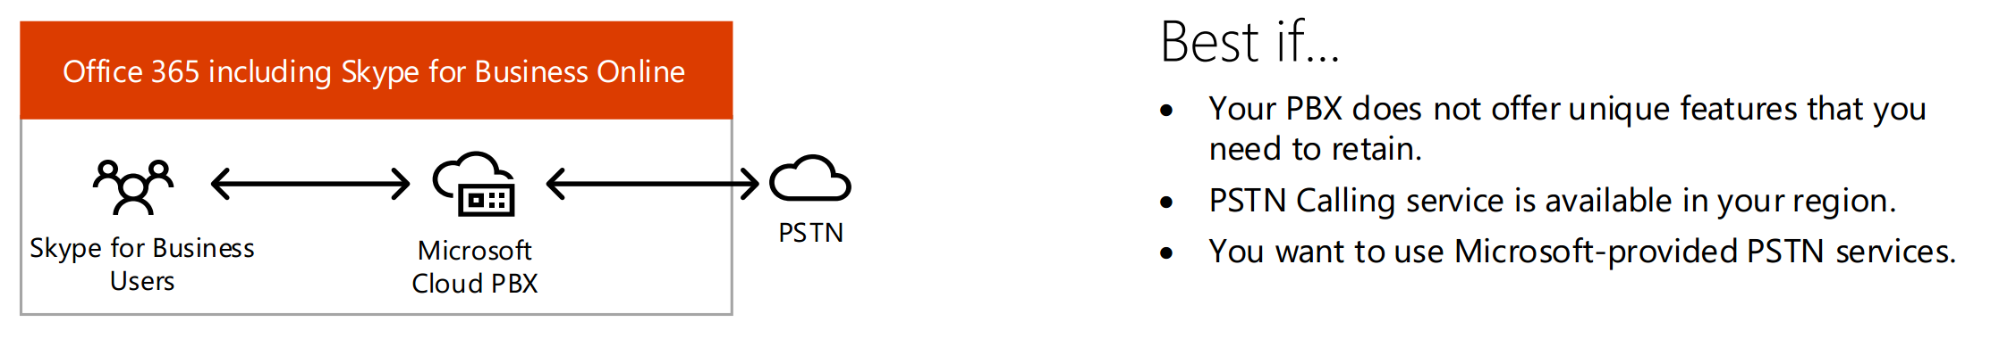
Skype for Business
Reference Architecture – Full Skype Online

Slide 15
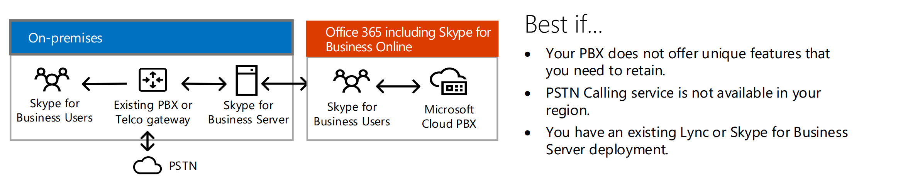
Skype for Business
Reference Architecture – Online // Hybrid

Slide 16
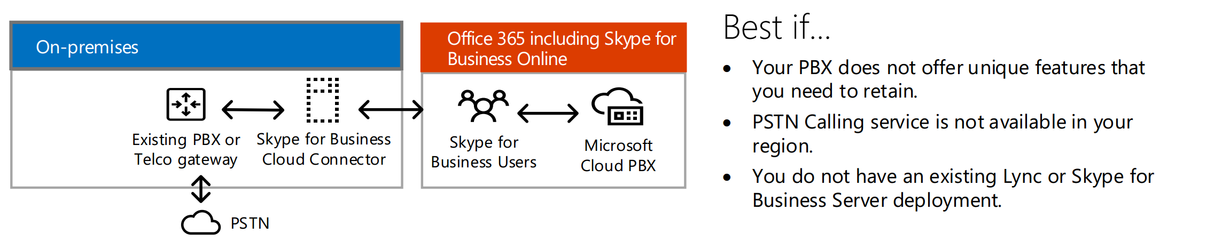
Skype for Business
Reference Architecture – Online // Cloud Connected (CCE)

Slide 17
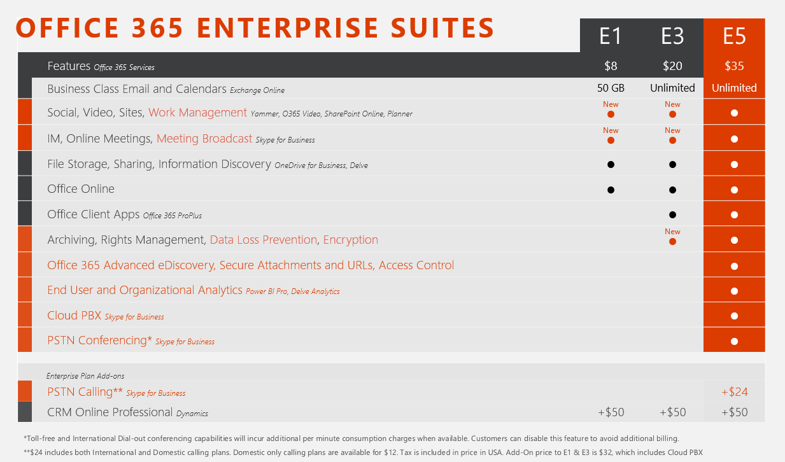
Skype for Business
Office 365 Licensing Models

Slide 18
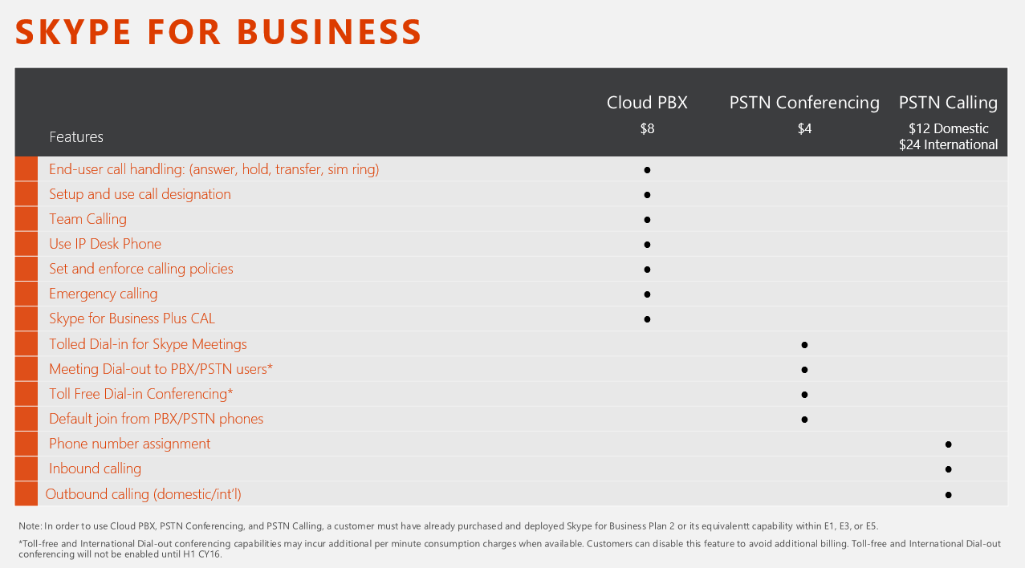
Skype for Business
Office 365 Licensing Models

Slide 19
Demo Time
Skype for Business
Office 365 Tenant / Licensing
Cloud PBX
Auto Attendant
Call Queue
Some “Screen Shots” of a migration

Slide 20
Wrap Up / Q&A
Thanks for participating!
Email / S4B: daryl.hunter@mirazon.com
Tweets: @darylhunter

