Slide 1
Disaster Recovery as a Service

Slide 2
Lets understand what we are talking about

Slide 3

Definitions
With all the acronyms floating around out there. Let’s get to a base understanding of what we are talking about today.
Business Continuity (BC):
  The capability of the organization to continue delivery of products or services at an acceptable predefined level following a disruptive incident. (Source: ISO 22301:2012)
Disaster Recovery (DR):
  Involves a set of policies and procedures to enable the recovery or continuation of vital technology infrastructure and systems following a natural or human-induced disaster (Source: Wikipedia)
“As a Service” (XaaS):
  The as a service we hear about everywhere is simplified by saying that “X” meaning “anything or everything” as a service to mean remotely installed, managed or accessed. Removes the subscriber from SOME responsibility.
Notes:
So we understand the perspective of this conversation today…

Slide 4

…But First
If Pinocchio says “My Nose Will Grow Now”, it would cause a paradox.
Notes:
In what may be the most interesting thing you hear today, consider the Pinocchio Paradox
Let… me explain, as we all know, Pinocchio’s nose grows only when he tells a lie.
So if he were to say “my nose will grow now”
- if his nose does grow that would mean he wasn’t lying,
- so if he wasn’t lying, his nose wouldn’t grow
- this would mean his statement would be a lie, so his nose would grow
- however, then the statement wouldn’t be a lie, so his nose wouldn’t grow…
Basically, his nose would have to grow to make Pinocchio’s statement not a lie, but then it can’t grow since it isn't a lie.

Slide 5




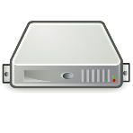

Types of Disasters
Operational
Natural Disaster
Human Error
Facilities
Infrastructure
Application
What disasters are you planning for?
Notes:
Is there a right or wrong type of disaster to build a DR plan around? NO
Unfortunately most people we talk with think and plan only for the natural disasters however, statistically, those are the ones that happen least of all. Anyone care to guess what the most common type of disaster occurrence is?
Human Error
How many have a spare tire?
How many test the air pressure?
How many have redundant edge network devices (Firewalls)
How many have redundant network infrastructure
How many have redundant SAN’s (controllers will suffice)
How many have redundant Compute nodes (N+1)
How many have redundant ISP’s
How many have a DR strategy in place
How many regularly test their DR strategy?
How many use are Peak 10 production cloud, colocation or DRaaS customers
Everyone sitting, our sales reps will be by to see you

Slide 6
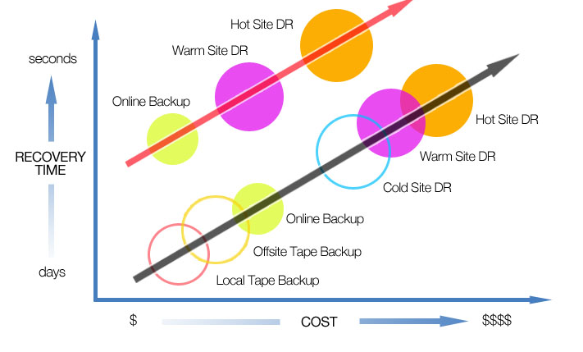
RTO vs. Budget
Notes:
This slide looks a lot more cognitive after a few drinks but the message here is the more “Critical” your data and systems are, the more you will spend to lessen the impact or loss in the event of one of those disasters we spoke of on the previous slide.
Recovery time in days costs less than recovery time in seconds.
There are different types of DR solutions for different workloads, it is a process to identify which is which.

Slide 7
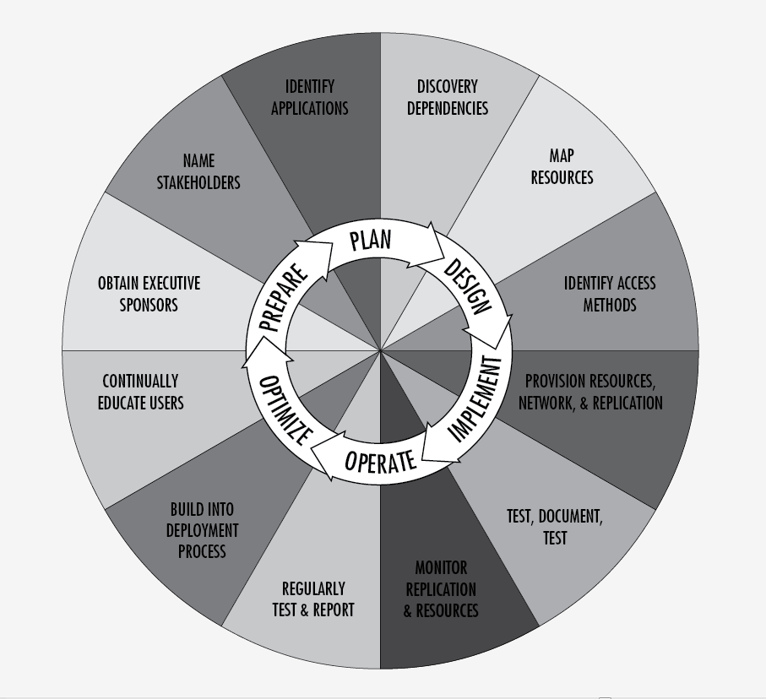
DR Methodology
DR Methodology
Prepare
Plan
Design
Implement
Operate
Optimize
Notes:
This his how we view DR methodology… it is a circle with no end.
Rinse and Repeat not Set it and forget it.
Each business unit or application has a place on this chart.

Slide 8
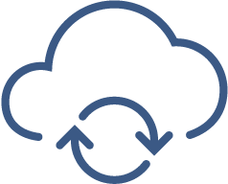
BC/DR is a Business Decision
Number 1 Rule:
The quickest, most efficient method in accomplishing EPIC failure with your DR plan is to lack any top management support.
Notes:
Make no mistake… Having no “C” level“ buy-in will quickly reveal the visual illustration of wasting your time.
I was in the airport a few weeks ago and saw a middle-aged man standing at the bottom of a motionless escallator. I could tell by the look on his face he wasn‘t sure what was going on. Intreagued, I asked him if everything was OK. Towhich he responded, yes, I am just waiting.
So instead of climbing the motionless people mover a.k.a stairs; he was infact wasting time by waiting. I dont know the full story. Maybe he had time to kill, maybe he had Escalaphobia (a fear of escalators which stems from a fear of heights) but to any logical person, he simply was wasting time.
Spending time building a BC/DR plan without an executive sponsor is akin to standing at the bottom of the escalator waitng for the staris to start moving.
Business Continuity / Disaster Recovery is a BUSINESS decision, not an IT decision.

Slide 9

Identify Critical DR Needs
Do you have the time and expertise to identify your DR needs?
Start with a Business Impact Analysis (BIA)
What are your most Critical Applications?
Ask the Business Unit Owners?
How do you differentiate between what is critical to one person and what is critical to the business?
Notes:
Great, that is all great but how do I begin.
If your answer to any of these is WTF (Wednesday, Thursday, Friday) ☺ get help.
It is 100% fine to admit you need outside expertise to get this right.
This is where that top level support is leveraged.
The way to start this process is to ask your executives/owners “what does an hour of downtime cost the business” If they can answer it, awesome. If they cannot, Awesome. If they ignore you… update your resume.
That was a response to a customer who didn’t have a DR plan, his resume was updated every 6 months.

Slide 10

BC/DR planning is more than a checkbox
…..it’s hard.
Notes:
To be clear, some companies DR plan can be a checkbox. For most of us, we must not only have a plan but we must test that plan regularly.

Slide 11
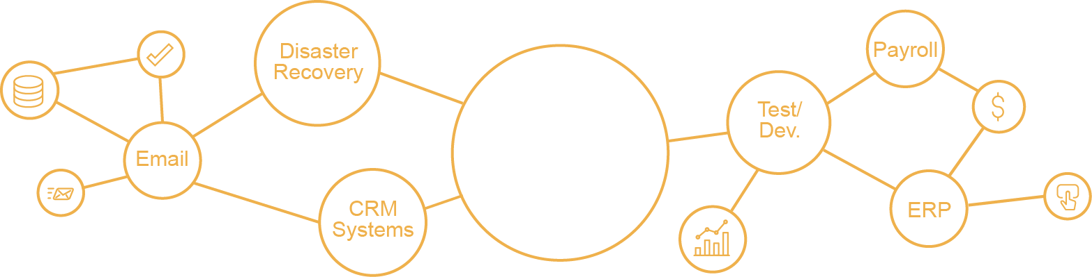
Workloads Matter – Infrastructure Matters
Customer
Workload
On Premise
own hardware
own data center
Colocation
own hardware
service provider data center
Public Cloud
shared infrastructure
pay as you go object storage
Private Cloud
dedicated infrastructure as a service
Recovery Cloud
DR infrastructure as a service
Managed Services
Managed Services
Consulting Services
Notes:
The conversation around workloads today is critical.
The flexibility your company needs extends beyond the provider you choose.
Your applications are uniquely dependent and your DR plan must also allow for those unique needs.
Workloads today come from many places, how they act together in production must also be how they act in your disaster recovery solution. Ensuring your DR solutions provider has experience with this level of diversity is key.

Slide 12
BC or DR… or Both

Slide 13

BC/DR Planning
Start Here
Start small but start
Conduct an internal BIA
Meet with all the business stakeholders
Communicate the process at regular intervals
Properly set expectations
Document, document, document
Need help Get help !

Slide 14

Business Continuity
Continuation
Protect the function of the business
Don’t forget about your people
Don’t hide from your customers
Include DR planning for all prod. Systems old and new
RTO for BC is after the disaster
Keep regulations in mind (HIPAA, PCI etc.)

Slide 15


Disaster Recovery
DR Protection
Traditionally tied to the IT infrastructure
Plans for RPO and RTO are decided by business owners
Set realistic expectatoins
Ask the tough questions (How much does downtime “cost”
Group systems by application mapping
Groups will replicate as a unit (VPG)

Slide 16
Multiple Tiers, Multiple Options
Premium
Choose the tier based on budget, infrastructure, and business requirements. Or, choose multiple tiers to create a tailored plan.
Most Critical
Prime
Essentials
Least Critical

Slide 17
Highest Tier for the Most Critical or Most Difficult
Highest performance, scale, & testing flexibility
Large Database
Strategic Testing
Mission-Critical Workloads
Data Analytics
Predictable Performance
ERP
Risk Management
Notes:
Strategic testing for application, line of business, and full failover.
Some charge customers for testing
Some require dedicated infrastructure due to application

Slide 18
Critical Workloads for Critical Recovery
Comprehensive solution with testing & disaster usage included
Most Business Applications
Planned Testing
Business Critical Workloads
Balanced Price
DR Coach
Email
High Touch

Slide 19
Standard Tier for Non-Critical Workloads
Low entry price with continuous data protection
“Check the Box”
Infrequent Testing
Less-Critical Workloads
Budget
Inexpensive protection of workloads
Branch Office
DRaaS First-Timers
Notes:
New management recognizes gap and needs a plan fast without creating massive hurdles financially.
Start-ups

Slide 20
Multi-tiered Recovery Cloud
“Meet the need without breaking the bank.”
Budget
DR Maturity
Infrastructure Scale & Performance
Business Requirements
Test Design
Partner Requirements
Risk

Slide 21


DRaaS the “As a Service”
DR Service Providers often offer additional services to compliment and complete their offerings.
Design
Build
Migrate
Operate
Governance
Colocation, IaaS, DRaaS, Managed Services

Slide 22
What is As a Service
Consulting Services | Business Impact Analysis | BC/DR Planning
Application evaluation | Protection Group Planning | Network Assessments
Network Planning | Implementation Services | Replication Management
Replication Monitoring | Testing Assistance | Recovery Assistance
Compute | Storage | Networking
Licensing | Scalability | Reliability

Slide 23






So what is As a Service?
Covers customers from implementation phase to steady state and beyond:
Implementation
Steady State
TDM Services
Total Quality Management
Data Center Operations Services
DR Testing & Validation Services
Customer Environment Setup
Migration Services
Database Analysis
DR Planning Services

Slide 24
Time and Money Impact

Slide 25

DR Lessons Learned
DR Plans aren’t always comprehensive
  Know your interdependencies
  Plan for the unexpected
You recover as you test
DR Testing is a Program
You must plan for your staff not being available
  Can anyone execute your plan
  Have you had all shifts execute the plan
Many plans are good for recovering but don’t plan on the return home
You have to continually update your plan as your infrastructure makes changes
  Have an “Always Ready” recovery program/plan
  Ensure DR is a part of Change Management
Not everything needs to be up immediately but eventually everything needs to be up

Slide 26

Best Practices for a DR Strategy (Obvious)
Perform a Business Impact Analysis (BIA)
Have a Formalized and Written DR Plan
Test the DR plan
Backup is NOT DR (it can be a part of)
Have a Communication Plan
Get Executive buy-in to the DR Plan
Understand what an hour / day of downtime will cost the business
  Monetary and Non-monetary

Slide 27

Best Practices for a DR Strategy
First and foremost, Protect the data, not the systems
DR should be part of the Application Lifecycle
Different disasters call for different plans
  Site Failure
  Server Failure
  Application Failure
What is your rollback plan?
Start small and GET STARTED!
Notes:
So the first bullet point may sound a bit contradictory to the previous slide. Since the blessing of virtualization (CLOUD), the systems are a means to the end. Data is King. The technologies we have now make the systems a part of the data such as a .vmdk file.
Make sure you don’t forget that hopefully, your production environment will once again thrive. How do you get your systems/data back to production since the disaster?
Most importantly, start small. Don’t try to boil the ocean. There are tons of things to do so don’t try to get to 100% before starting or you will be behind before you start.

Slide 28

Tales of a Solutions Architect
Be Pessimistic, not Optimistic
Realistic RTOs
A single datacenter does not make a DR plan
Management Buy-in
Religiously Test your Plan
Get Started NOW!
Notes:
Assume your DR plan will fail so test the hell out of it.
Make sure your “C” suite understands realistic RTO’s
Redundancy is awesome and best practice… redundancy is not DR. DR is geo-diverse.
”C” must say “Si” ask for a executive sponsor to see it above to a board of directors or owners.
Test your tests.
What are you waiting for?

Slide 29

Selecting the Right DR Partner
Compliance and Security
Hybrid IT
Is testing included and will the Partner participate?
Can you call and talk with someone?
Is DR a core service offering?
Examine the Partner’s infrastructure and SLAs

Slide 30

Other Things to Consider
Encryption of data at-rest
Licensing Challenges
  Virtual vs. Physical Licensing
  Production License extend to DR environment?
  Can I license on virtual environments?
How much bandwidth do you need to replicate?
How will you handle IP Address changes?
Network architecture changes
  MPLS Circuits
Phone System
Firewall and Security rule changes
Remote access for users, is it allowed and if so, how?

Slide 31
Thank You!

