Slide 1


PowerShell
To the Command Line and Beyond
Jeremy Sublett
Composable Systems, LLC

Slide 2
Topics
Basics
  Syntax, Terminology, Variables, Environment Variables
Advanced Basics
  Filtering, Functions, WMI, Event Log, Workflow
  Packages
  Scheduling scripts
Interacting with Office365
Accessing SQL Data
Working with REST APIs and JSON Data

Slide 3
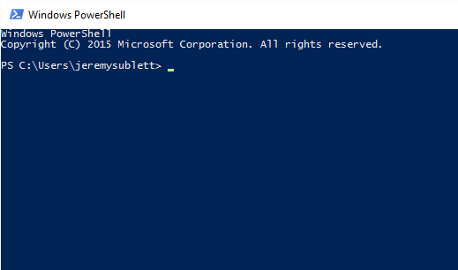
Hello PowerShell
Accessing PowerShell…
  Start menu
  Cmd
  Application-specific PowerShell loaders
Demo
Notes:
Open PowerShell from various ways. Talk about versions…

Slide 4
Basics
Getting around the environment
Piping
Variables
Filtering
Environment Variables
Demo
Notes:
Open the ISE and work with the script file

Slide 5

Advanced Basics
Functions
Looping
WMI
Event Log
Packages with OneGet
Modules
Demo

Slide 6
OneGet
Package management
Allows installation of packages from different repositories
  Scripts
  Desktop apps
  …
Get-Command -Module PackageManagement

Slide 7
Modules
Script Modules
.psm1 files
Import-Module

Slide 8
Running Scripts
Executing from a .bat file
Task Scheduler
Azure-hosted

Slide 9
Workflow
Multi-Server Management
Single task to manage complex processes, with status always available
Automated failure recovery
Connect/disconnect/restart – persistable, resumable
Parallel or sequential execution
Can use Visual Studio declarative workflows (XAML)

Slide 10
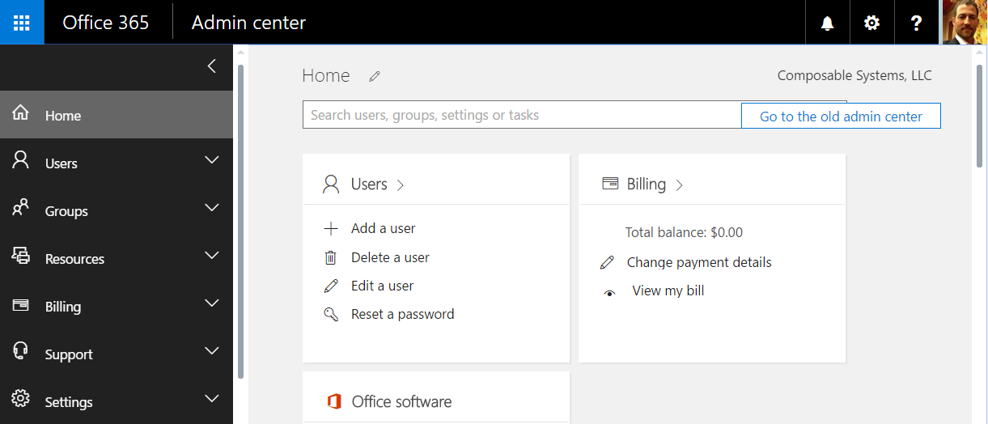
Office 365
Install Windows Azure Active Directory Module
Connect with your Office 365 credentials
Connect-MsolService
Get-MsolUser | Select-Object FirstName, Title, IsLicensed
Get-MsolCompanyInformation
Get-MsolRole
Get-MsolAccountSku
Demo

Slide 11
SQL
SQL Queries
DML
Server Management
SQLPS
Invoke-Sqlcmd

Slide 12
SharePoint
#adding a new site collection
$siteColl = New-SPSite -URL "http://csdev/sites/demo1" -OwnerAlias JSE6410\Jeremy -Template "STS#1" -Name "Demo 1"
#creating a document library
$csv = Import-Csv c:\PowerShellDemo\symbols.csv
$csv | foreach { Get-Quote $_.Symbol }
#creating a bunch of doc libraries - based on data in SQL
$vendors = Invoke-Sqlcmd -Database AdventureWorks -Query "Select top 10 * from Purchasing.Vendor"
$vendors | foreach { $siteColl.RootWeb.Lists.Add($_.AccountNumber,$_.AccountNumber,$listTemplate) }
#cleanup
$siteColl.Dispose()
#removing
Remove-SPSite -Identity "http://csdev/sites/demo1" -Confirm:$false

Slide 13
Web, REST APIs and JSON
  Interacting with web content
  Invoke-WebRequest -Method Get -Uri http://microsoft.com
  APIs: Posting, Getting and Handling JSON data
  Invoke-WebRequest vs. Invoke-RestMethod
  Invoke-RestMethod -Method Get -Uri {api_endpoint}
  ConvertFrom-Json
  ConvertTo-Json

Slide 14
Important Commands
Get-Command
Get-Help
Get-Member
Select-Object
Foreach-Object (Foreach or %)
Where-Object (Where or ?)
Write-Host
Export-CSV
Out-Grid

Slide 15
Questions
Jeremy Sublett
jsublett@composablesystems.com

