Slide 1
Windows Server 2016
New Features & Enhancements
October 6, 2016
mirazon.com

Slide 2
Brent
Mirazon engineer since 2007
Currently storage and virtualization practice lead
MCITP-EA
MCSE 2003
Hyper-V 2008 SME with Microsoft
VCAP-DCA, DCD 5
Brent.earls@Mirazon.com
Mirazon.com/author/brentearls

Slide 3
Disclaimer!
Beta software (Technical Preview 5)! Some of it is still Alpha
Microsoft’s documentation is currently seriously lacking
LOT of new features (similar to when 2008 came out)
Features are STILL being added as of Tech Preview 5

Slide 4
Agenda
Licensing change
Nano servers
Containers
Active Directory
Failover Clustering
Hyper-V
Remote Desktop Services
File and Storage Services
Storage Replica
Deduplication Improvements
PowerShell 5.0
Windows networking
mirazon.com

Slide 5
Licensing Change
Per Core
Previously per socket, now per core
Won’t change cost if you have 16 or fewer cores on a server
For more than 16, now might have to buy an extra license
Ex: a server with 2 processors, each at 8 cores will be the same cost
Ex: a server with 2 processors, each at 16 cores will now cost double

Slide 6
Nano Servers
Very small server – configured, up and running server: 450 MB (answer to VMware touting their “32 MB hypervisor”)
Can be installed in a VM, or on physical servers (either way you’re just making a VHD and pointing a boot config to it)
Can run the following roles and features: Hyper-V, Failover Clustering, File Server, DNS (not AD), IIS
Managed exclusively remotely

Slide 7
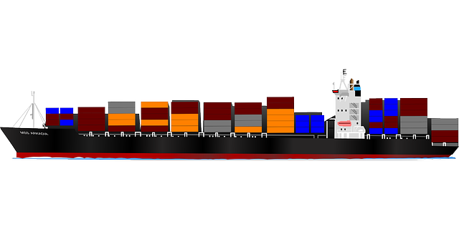
Containers
Allow for compartmentalization of applications into their own unique space
Allows multiple applications to run on a single host yet be isolated
Allows applications to be transportable
Allows resources to be limited per application

Slide 8
Active Directory
Privileged access management – Allows for extra security in a time based (checkout) method for privileged credentials.
Azure AD Join – Allow more devices to “join the domain” more easily and get better access to resources. In the cloud, of course.
Microsoft Passport – It’s back!!! Except… not really. Allows for user login using biometrics and randomly generated numbers.
FRS is deprecated again, again, again

Slide 9
Failover Clustering
Cluster Operating System Rolling Upgrade
Workgroup and Multi-Domain Clusters
Virtual Machine Resiliency
Diagnostic Improvements in Failover Clustering
Cloud Witness
Site-Aware Failover Clusters

Slide 10
Hyper-V
Hot add and remove for network adapters and memory
Integration services delivered through Windows Update / WSUS
Production checkpoints - VSS
Storage quality of service (QoS) – Scale-Out File Server mins and maxes assigned at the virtual disk level
PowerShell Direct

Slide 11
Hyper-V
Linux Secure Boot – Like Windows secure boot, requires modern OS
Nested virtualization – Run a hypervisor inside of a hypervisor
Networking features – Further optimizations, RDMA with virtual switches and switch embedded teaming, VMMQ (improves throughput over VMQ), QoS with software–defined networks
Storage quality of service (QoS) – Requires Scale-Out file server. Allows for minimums an maximums per virtual disk

Slide 12
Hyper-V
Shielded virtual machines
make it harder for malicious admins or malware to test/inspect/modify virtual machines
Data and state is encrypted
Admins can’t see video output or disks
Only run on healthy hosts
Virtual machine configuration file format – Easier to read and more resilient to corruption
Virtual machine configuration version – Doesn’t automatically upgrade so you can move back if necessary

Slide 13
Remote Desktop Services
Persistent desktop assignment
Pen remoting support – No longer treated like a mouse, recognized as a pen and supported as such
Windows MultiPoint Services
Better OpenGL and OpenCL support for VDI

Slide 14
File and Storage Services
Storage Spaces Direct
Storage Replica
Deduplication improvements
REFS!
Storage Quality of Service (Scale-Out File Server)

Slide 15
Windows Networking
Flexible encapsulation technologies - VxLAN, NVGRE
Converged NIC – Single NIC for Management, RDMA storage, tenant traffic
Switch embedded teaming – SDN based NIC teaming.
Hyper-V virtual switch no extensible and supports routing, isolation, traffic shaping
New functionality for existing protocols – DHCP, IPAM, DNS, DNS DoS protection

Slide 16
Thank You / Questions?
http://www.mirazon.com/category/windows-server-2016/
https://technet.microsoft.com/en-us/library/dn765472.aspx
https://azure.microsoft.com/en-us/blog/containers-docker-windows-and-trends/
https://www.youtube.com/channel/UCrhJmfAGQ5K81XQ8_od1iTg/featured
mirazon.com

