Slide 1
Veeam Backup & Replication v9:
Making the Most of the Upgrade
March 25, 2016
mirazon.com

Slide 2
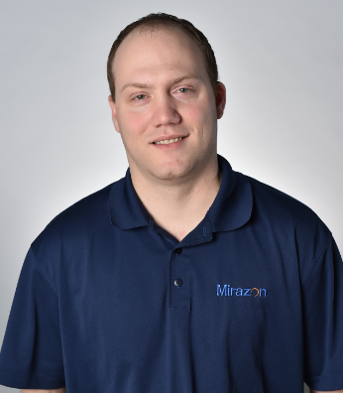

Jason Thomas Andy Barhorst
Mirazon Engineer
Veeam Certified Engineer (VMCE8)
11 years in virtualization/server support
Veeam Sr. Systems Engineer
Veeam Certified Engineer (VMCE8)
VMware Certified Professional
Past-life… a Veeam customer!
mirazon.com

Slide 3
What’s New in Veeam Backup & Replication v9?
Making Your Backups More Seamless
Scale-out backup repository
BitLooker
Direct NFS Backups
Standalone console
ROBO enhancements
Veeam Explorer
Veeam Cloud Connect

Slide 4
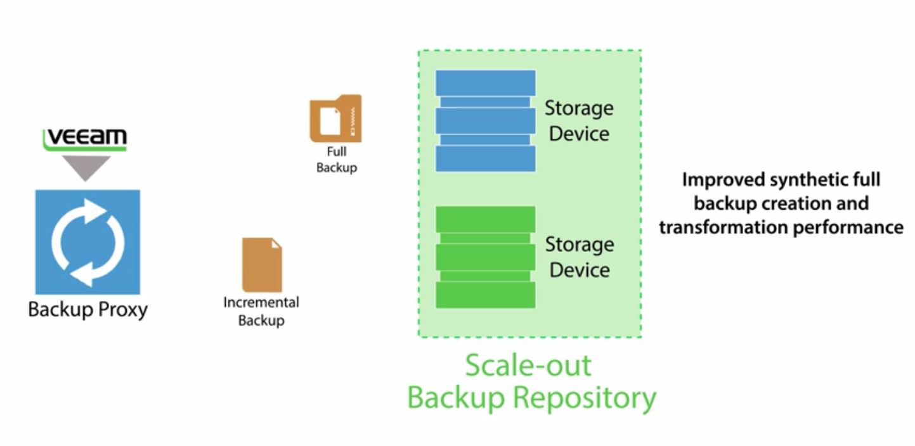
Scale-Out Backup Repository
Simplify Backup Job Management & Spend Less on Storage
What is it?
Use cases
Licensing limitations
Limitations for certain types of jobs

Slide 5
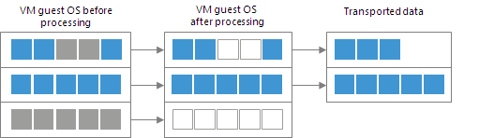
BitLooker
Clean Up Your Backups
Excludes deleted file blocks
Excludes swap & hibernation files
Excludes user-specified files & folders
Not enabled by default in existing Veeam

Slide 6
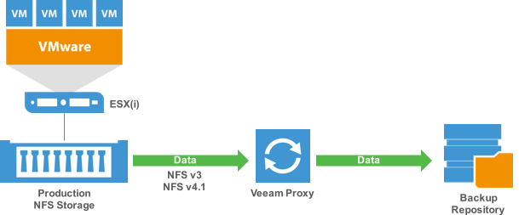
Direct NFS Backups
Veeam proprietary NFS client
Allows backing up directly from VMWare NFS volumes
Supports NFS v3 & v4.1

Slide 7
Standalone Console
Finally!
You won’t have to physically log into the server anymore
Remote PowerShell access
Write locks

Slide 8
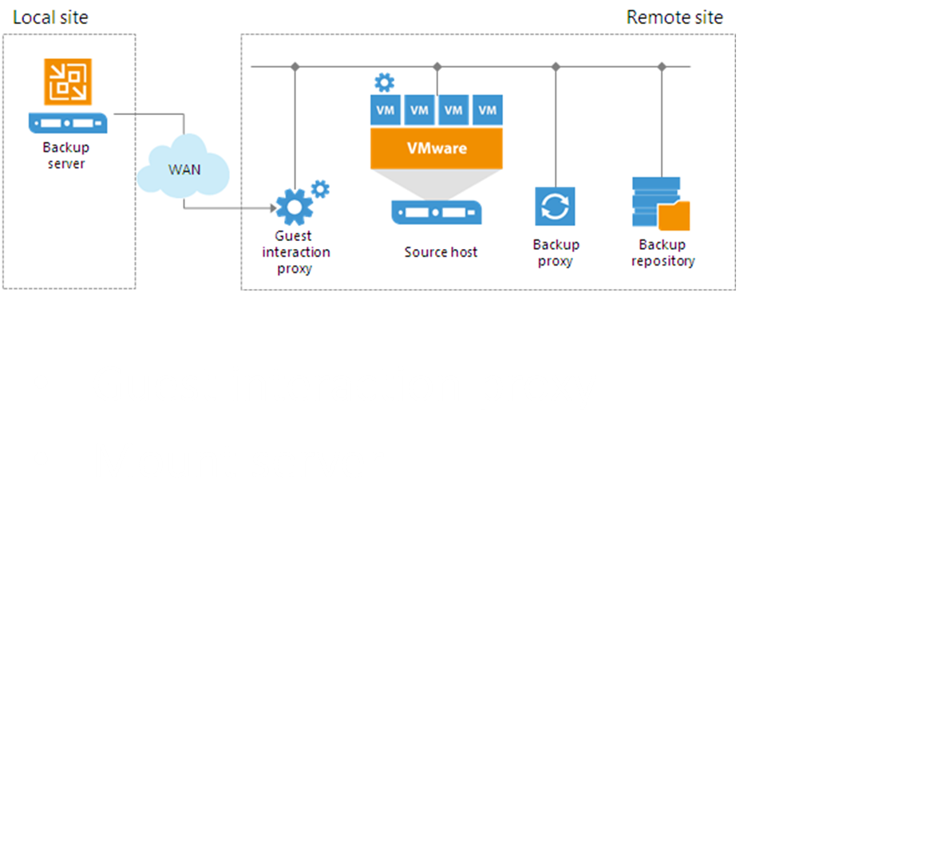
ROBO enhancements

Slide 9



Veeam Explorer Updates
Making Recovery Even Easier
Explorer for Oracle
  Just like SQL
New functionality for AD Explorer
  GPO
  DNS records
Exchange 2016 Support
  Export reporting
    Security concerns
    Export size estimation
Notes:
Ask people to speak up if they have Oracle to see if they want it discussed more?

Slide 10


Veeam Explorer
Continued
SQL Server
  Table-level recovery
  Object-level recovery
    Procedures, functions, views
  Remote staging
SharePoint
  Full site restore
  List and item permission restore

Slide 11
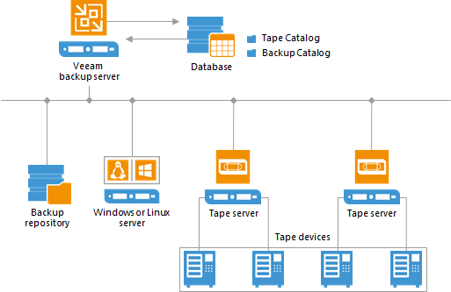
Tape Enhancements
GFS Media Pools
Backup file for every VM, instead of all in one
- Enables quick recall of individual VM’s
Parallel processing

Slide 12
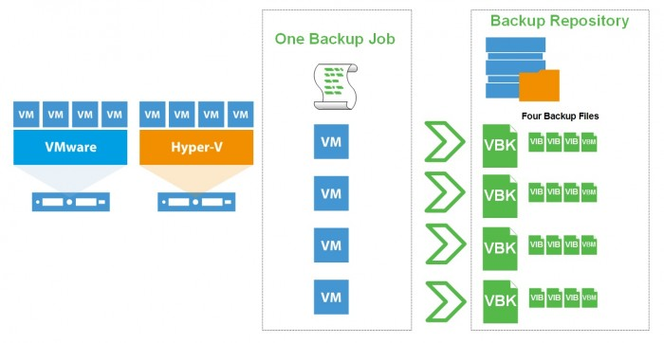
Dedupe Improvements
Compatible appliances
Windows Server dedupe
Per-VM backup files chains
Active-Fulls with Backup Copy Job

Slide 13
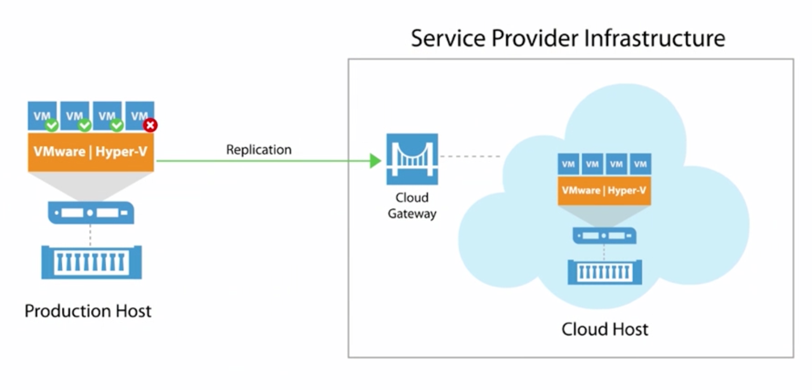
Veeam Cloud Connect
Cloud Backups & Replicas for VMs
Now supports replication
  Partial & Full site failover

Slide 14
Thank You / Questions?
Andy Barhorst: andy.barhorst@veeam.com
Jason Thomas: jason.thomas@mirazon.com
502-240-0404
mirazon.com

Slide 15
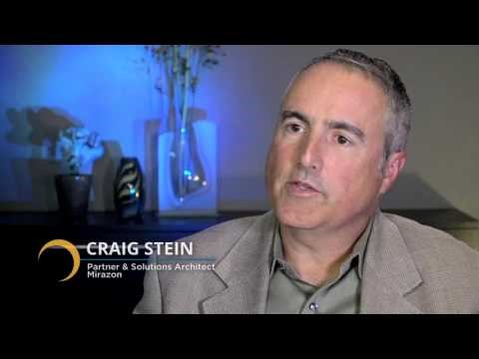
Why Mirazon Chooses Veeam

