Slide 1
The Microsoft UC Experience: The 2016 New-Car-Smell Edition
Skype for Business & Office 365 & You!
Daryl Hunter, Solutions Architect – R&D
Unified Communications Practice Lead
mirazon.com

Slide 2


Quick Agenda
What We’re Covering Today
Skype for Business
Office 365 basics
New Features
Demo (or at least pics)
Wrap Up/Q&A

Slide 3

About Daryl
(Or DW to friends like you)
Solutions Architect
Practice Lead: Unified Communications
R&D: Products, Services, Internal IP, Community
Skype & Lync, Office 365, Networking, Exchange
Cloud / Hybrid

Slide 4
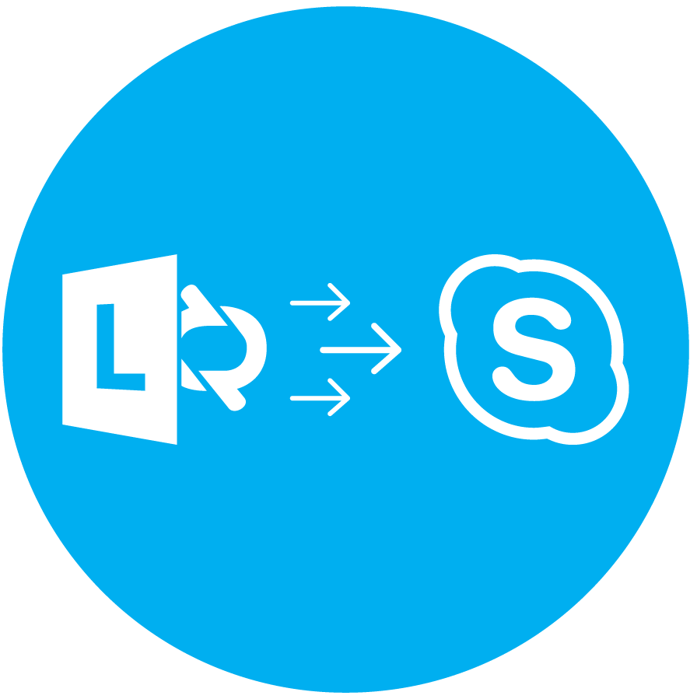
History Lesson – Microsoft UC
Where Is Skype for Business Coming From?
Standalone – NetMeeting
Exchange 2000 Instant Messaging
LCS 2003
LCS 2005 (then SP1)
OCS 2007
OCS 2007 R2
Lync 2010
Lync 2013
Skype for Business 2015

Slide 5
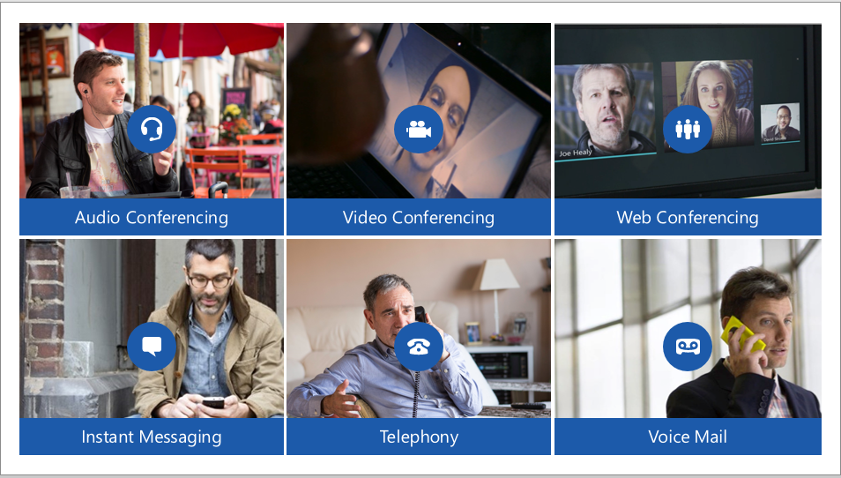
Skype for Business
It’s More than IM

Slide 6

How Skype for Business Helps You Work
The Benefits
Control costs
Improve productivity
Support the mobile workforce
Federation – B2B & Public
Maintain regulatory compliance

Slide 7
Some HADR Discussion
Uptime!
Standard Edition
  No HA – Zero
  DR Only – Pool Pairing
Enterprise Edition
  HA Pools – 3+ Members for Best Practices Fabric Design
  SQL Server Backend Required
  Pools should not cross/span physical sites
  DR – Pool Pairing
Server License Cost is same – Depends on Architecture / Implementation

Slide 8

Some Cost Discussion
Dolla dolla bills, y’all
Skype for Business 2015 Server itself – with SA
  Upgrade Rights
  Virtualization Rights
Skype for Business 2015 CALs – with SA too ☺
  Standard – IM/P
  Enterprise – Conferencing
  Plus – Dialtone
Lync 201x/SfB Client (PC or Mac)
  Included with Office 201x Pro/Plus
Exchange Enterprise CAL for UM

Slide 9
Moving Parts
What Goes Into a Skype for Business Architecture?
Public IPs, Public & Private DNS
Firewall Rules
Reverse Proxy for Webservices
SfB 2015 Topology/Server(s)
SBC – if Enterprise Voice
Exchange UM – if Enterprise Voice
Handsets and Headsets – if Enterprise Voice – or if you just want a better audio experience.

Slide 10
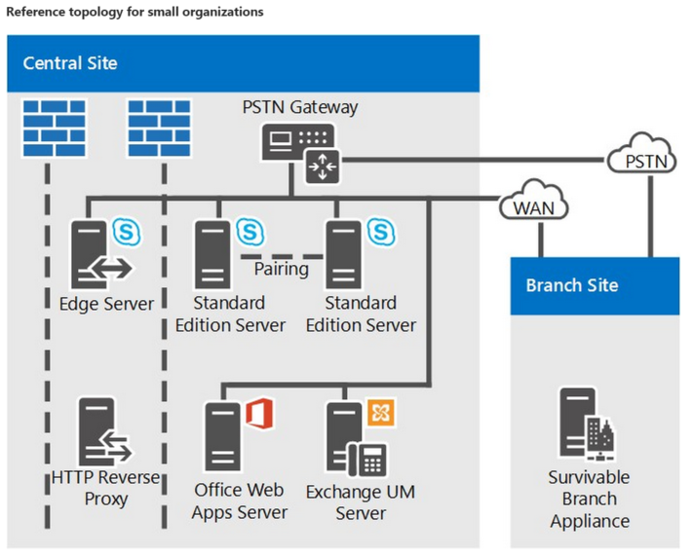
Reference Architectures
How It All Works

Slide 11
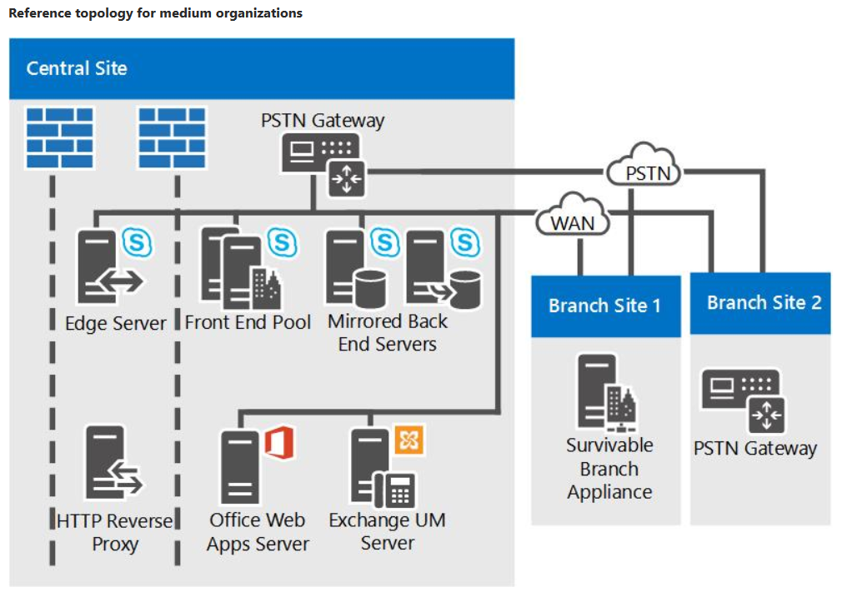
Reference Architectures
How It All Works

Slide 12
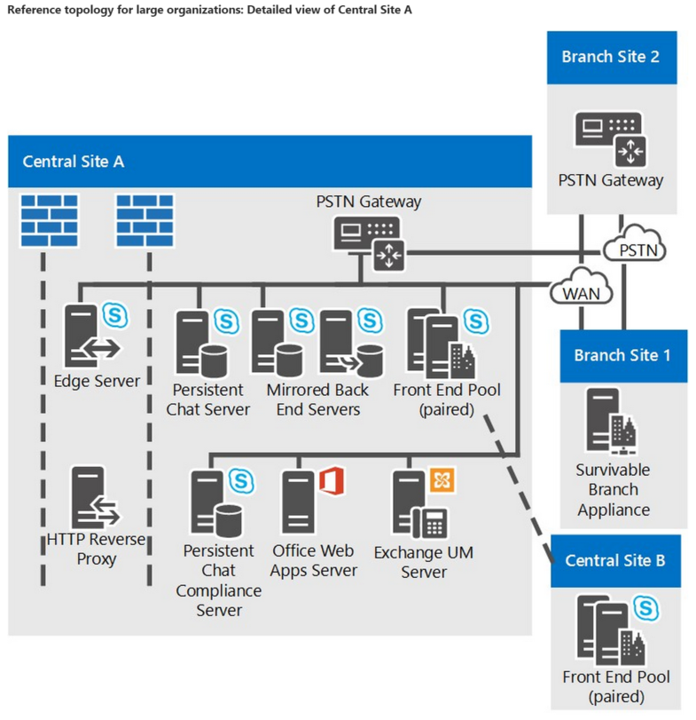
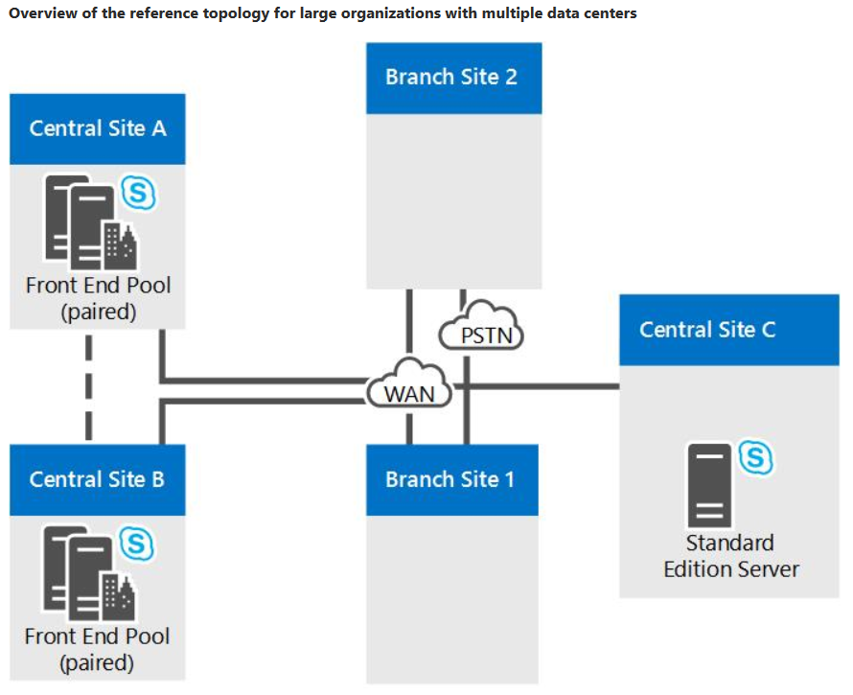
Reference Architectures
How It All Works

Slide 13

Shifting Topics
Before We Move On…
Let’s wrap up Skype for Business On-premises
Anything to talk about or discuss that we haven’t gotten to yet related to SfB?

Slide 14
Office 365 -- Interop
Connecting to Skype for Business
Interop
  ADFS – Uptime Dependencies
  Directory Sync / Password Sync
  Hybrid Exchange is awesome & flexible and you should explore
  You MUST have some method of SSO for Lync/SfB and Office 365 Interoperability for UM

Slide 15

Office 365 -- Interop
The Options are…
SfB 2015 On-Premises & Exchange Online (O365)
  Fully compatible
SfB 2015 On-Premises & Exchange Hybrid (On-Premises & EXO Plan 2)
  Fully compatible
Exchange Online (O365) and On-Premises PBX
  “It works” but may not be supported
  PBX + SBC + O365 Tenant with EXO Plan 2

Slide 16
Lync 2013 –> Skype for Business
The 2015 Transition
April 2015 – Client Availability – Lync 2013 “reskinned”
May 2015 – Server Availability – Weekend before Ignite
Office 2016 – “Native” SfB Client // New Mac Client Announced!
New Features!
  Can Upgrade Pools, or Transition side-by-side
  New Server Role: VIS / Video Interoperability Server (Cisco for Now)
  SfB Client: Undockable Call Monitor
  Further Enhanced Consumer Skype Interoperability
  Cloud PBX (Dialtone in SfB Online – Trial available Now)
  Skype Meeting Broadcast (SfB Online) – Up to 10,000 Attenders
  Azure ExpressRoute Coming for CloudPBX / On-Premises Connectivity
  Office 365 E3 / E4 / E5 Changes (Announced at WPC)

Slide 17
Skype for Business 2016
The 2016 Further Enhancements
New Native Mac SfB Client – In Preview (this week) – Summer 2016
  Q3 GA as of 4/22/2016 – Multiple “drops” between now and then
Skype Meeting Broadcast (SfB Online) – Up to 10,000 Attenders
PSTN Conferencing (SfB Online) – 60+ Countries in March, 100 in June.
Cloud PBX /w on-premises Dialtone
  Hybrid with Skype - Today
  Cloud Connector Edition (min-topology) – April
PSTN Calling (full SfB Online Dialtone)
Unified Messaging in Azure (Education only? Still TBD)
Enterprise Connect 2016 Announcements
  Auto Attendants for Cloud Voice – April 2016
  Project Rigel – 2H2016 – Skype in Meeting Rooms
  PSTN Calling – UK Preview in May
  Cloud Video: Polycom – 2H2016
  Management & Analytics (from EventZero) – 2H2016

Slide 18
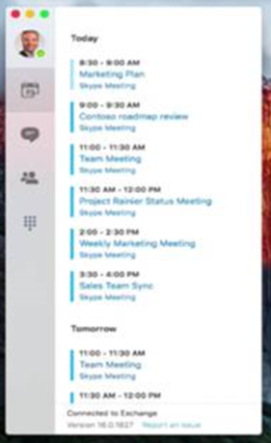
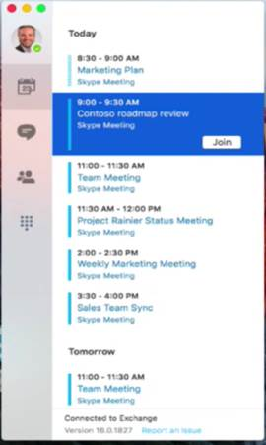
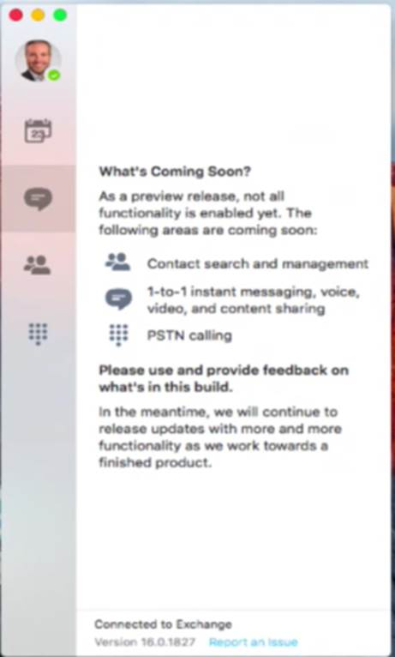
Mac Client: Skype for Business
Unicorns…

Slide 19
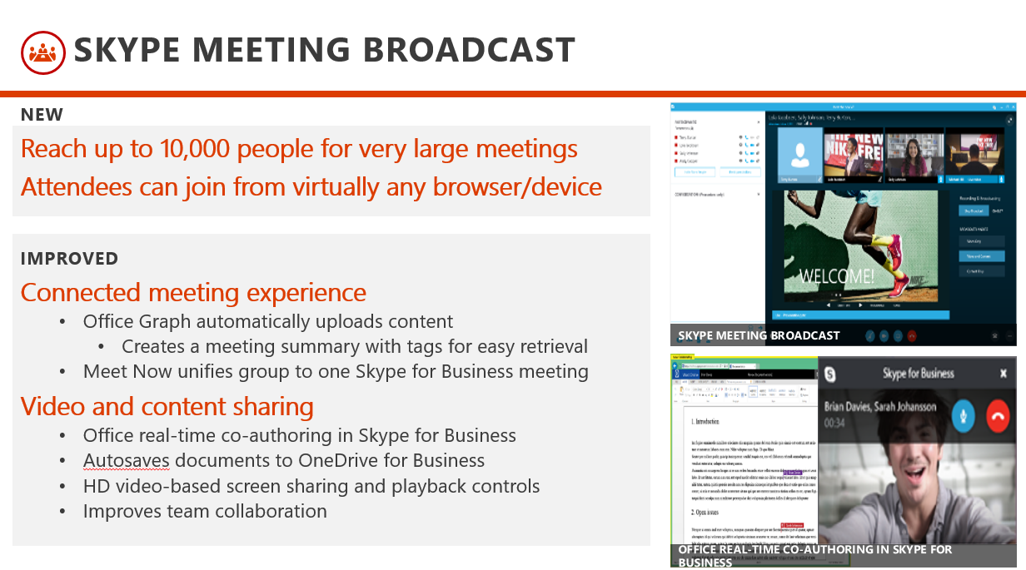
Broadcast Meetings
Skype for Business Online only

Slide 20
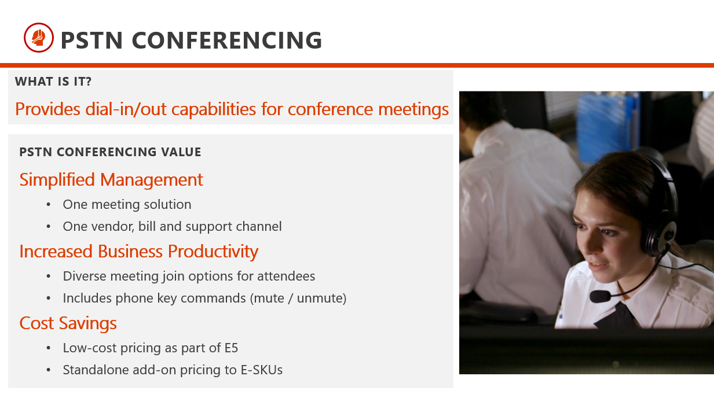
PSTN Conferencing
Not 100% new – now native/enhanced

Slide 21
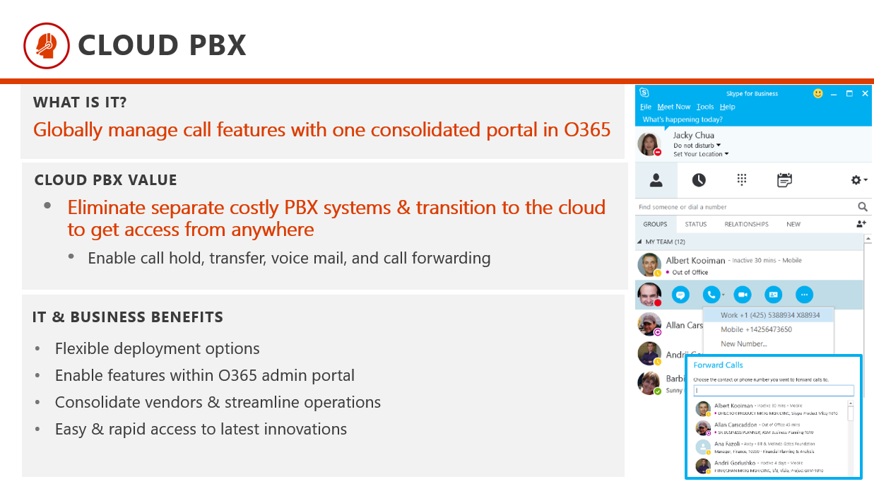
Cloud PBX
Online call control – limited but part of 2016/2017 roadmap

Slide 22
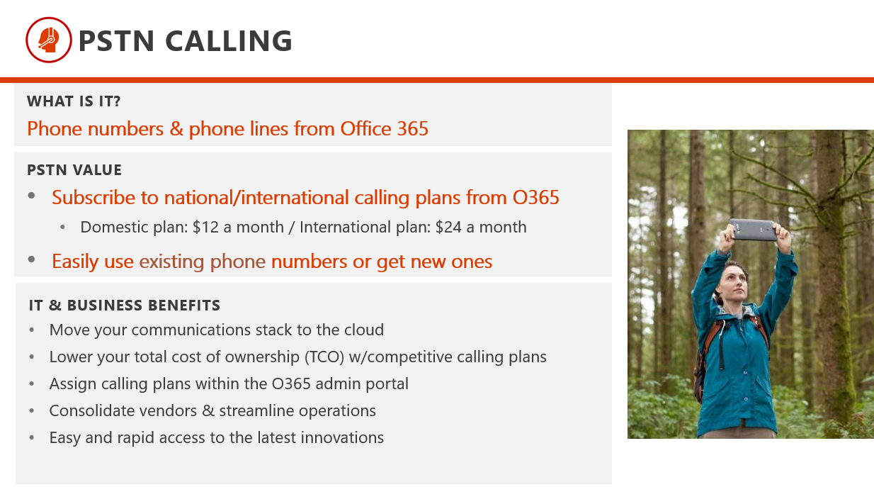
PSTN Calling
Microsoft is your telco – net-new #s or port your own #s

Slide 23
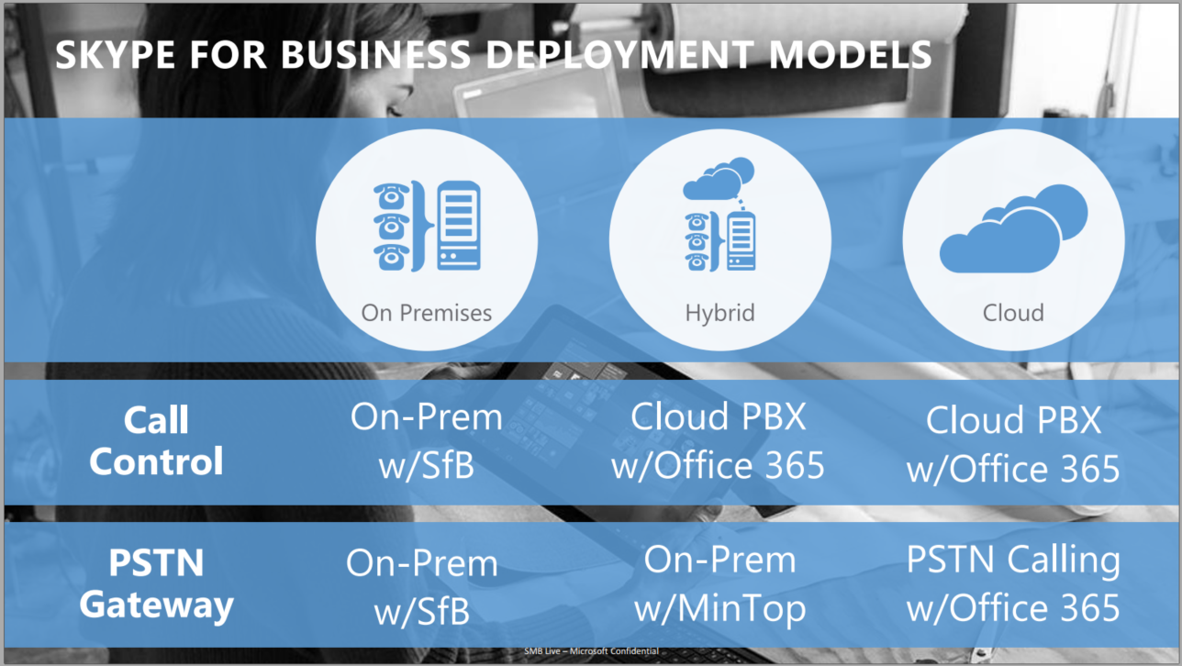
More on CloudPBX
Okay, Cloud Voice – how do I get there?

Slide 24
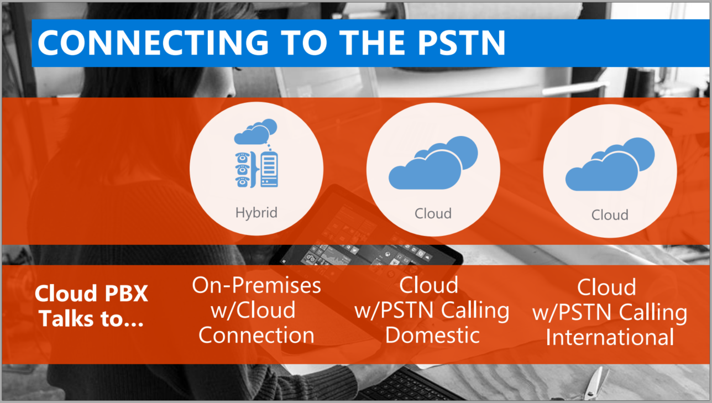
More on CloudPBX
Okay, Cloud Voice – how do I get there?

Slide 25
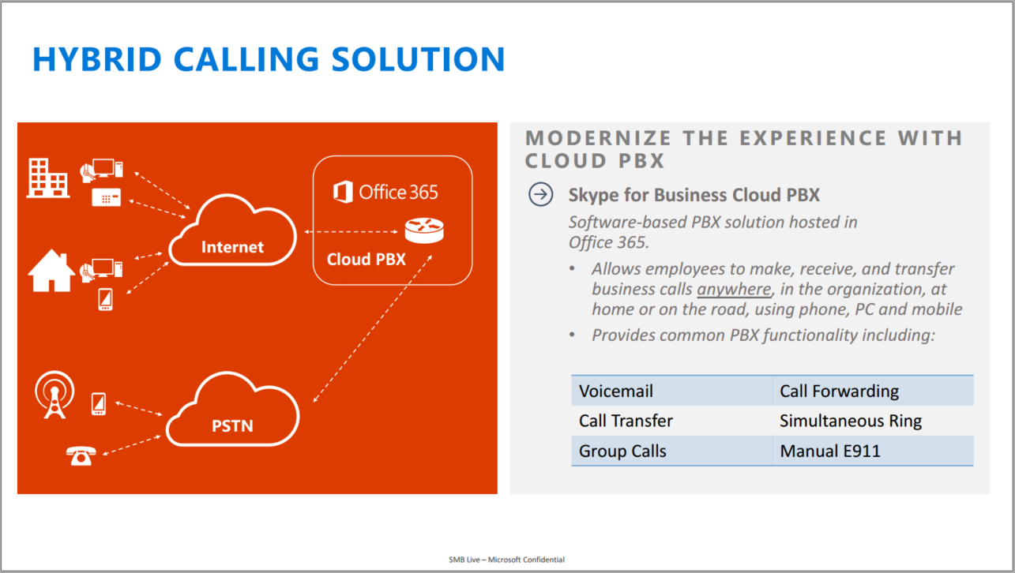
More on CloudPBX
Okay, Cloud Voice – how do I get there?

Slide 26
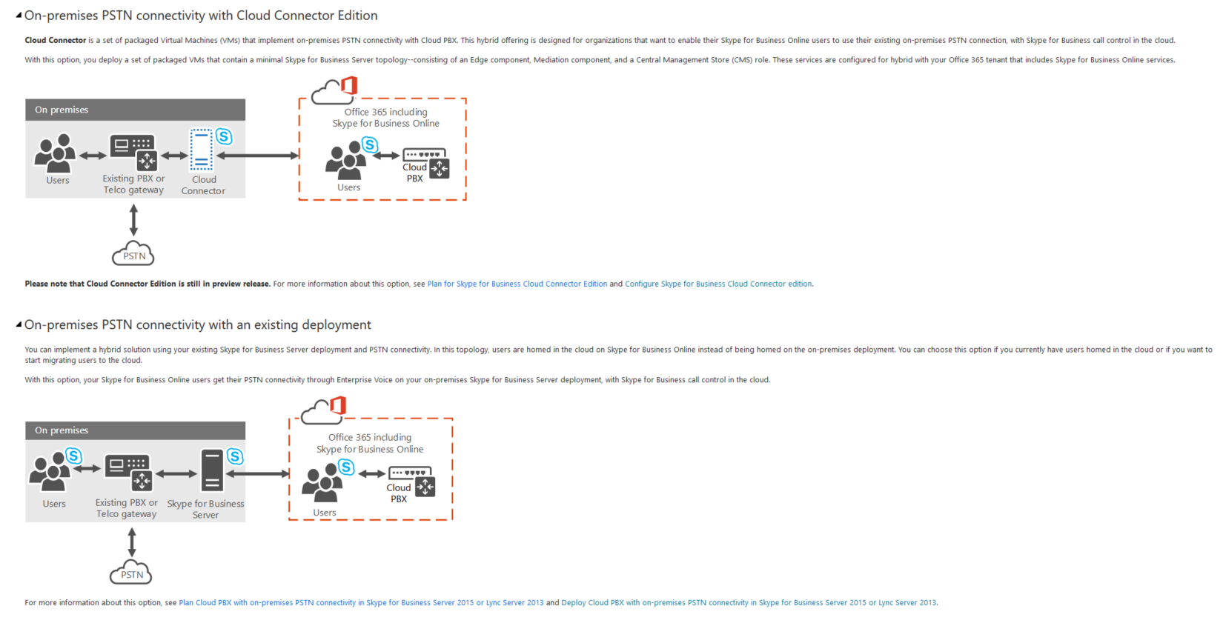
More on CloudPBX
Okay, Cloud Voice – how do I get there?

Slide 27
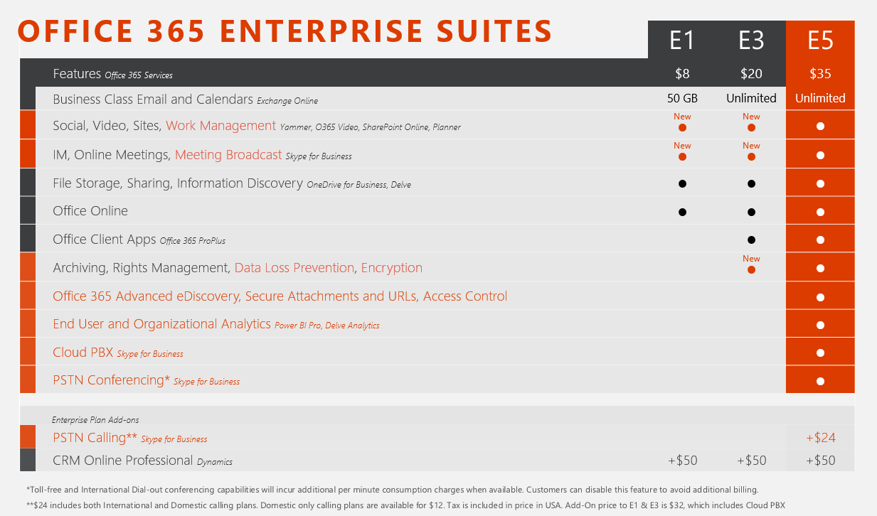
Office 365 Licensing
Summary

Slide 28
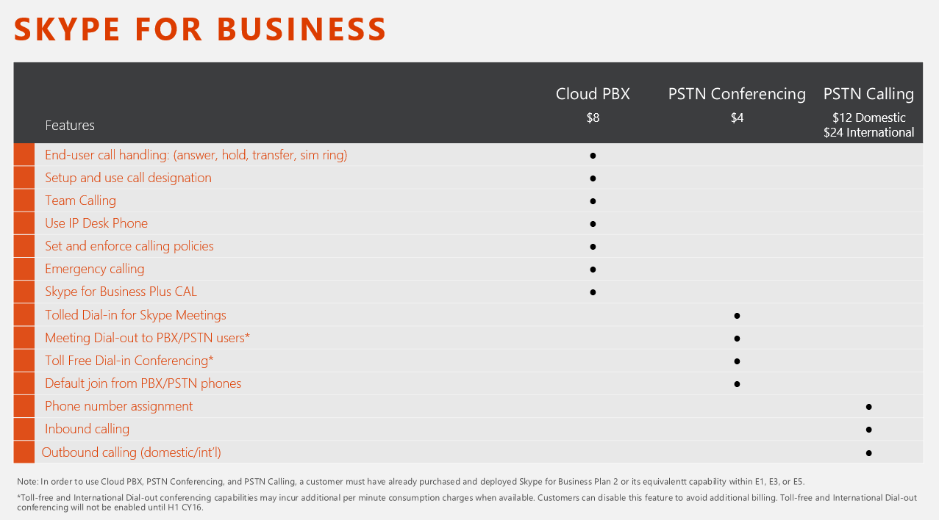
Office 365 Licensing
Summary

Slide 29
Shifting Topics
Before We Move On…
Let’s wrap up Office 365 & Skype Online
Anything to talk about or discuss that we haven’t gotten to yet related to O365?

Slide 30
Demo
Let’s see what we can see…
Skype Client (briefly)
Cloud Voice (what we can)
Shenanigans

Slide 31
Customer Experience Lounge
Demo Room @ Mirazon – Hands On Discussions
Best Utilized with 4-6 people
Demo Room
  Lots of Skype Phones
  Lots of Skype Headsets
  Mondopad / Touch Preso
Show and Tell / Touch and Feel
The “vision” of this room is immersive and repeatable experience / demo

Slide 32
Q&A – Wrap Up
Email/S4B: daryl.hunter@mirazon.com
Twitter: @darylhunter
Mirazon.com/blog
502-240-0404
mirazon.com

