Slide 1
Windows Server 2016
New Features & Enhancements
December 18, 2015
mirazon.com

Slide 2

Brent
Mirazon engineer since 2007
Currently storage and virtualization practice lead
MCITP-EA
MCSE 2003
Hyper-V 2008 SME with Microsoft
VCAP-DCA, DCD 5
Brent.earls@Mirazon.com
Mirazon.com/author/brentearls

Slide 3
Disclaimer!
Beta software (Technical Preview 4)! Some of it is still Alpha
Microsoft’s documentation is currently seriously lacking
LOT of new features (similar to when 2008 came out)
Features are STILL being added as of Tech Preview 4

Slide 4
Agenda
Licensing change
Nano servers
Containers
Active Directory
Failover Clustering
Hyper-V
Remote Desktop Services
File and Storage Services
Storage Replica
Deduplication Improvements
PowerShell 5.0
Windows networking
mirazon.com

Slide 5

Licensing Change
Per Core
Previously per socket, now per core
Won’t change cost if you have 16 or fewer cores on a server
For more than 16, now might have to buy an extra license
Ex: a server with 2 processors, each at 8 cores will be the same cost
Ex: a server with 2 processors, each at 16 cores will now cost double

Slide 6
Nano Servers
Very small server – configured, up and running server: 450 MB (answer to VMware touting their “32 MB hypervisor”)
Can be installed in a VM, or on physical servers (either way you’re just making a VHD and pointing a boot config to it)
Can run the following roles and features: Hyper-V, Failover Clustering, File Server, DNS (not AD), IIS
Managed exclusively remotely

Slide 7
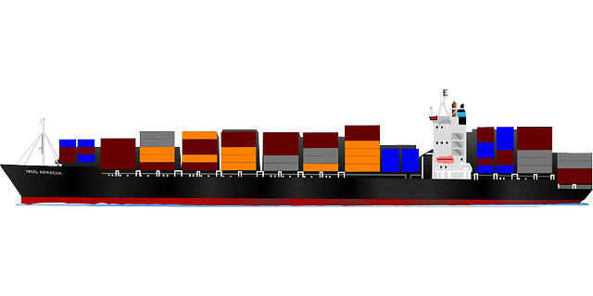
Containers
Allow for compartmentalization of applications into their own unique space
Allows multiple applications to run on a single host yet be isolated
Allows applications to be transportable
Allows resources to be limited per application

Slide 8
Containers
Traditional Server functionality
All applications run in the same user mode
Kernel processes still separate
No separation between applications

Slide 9
Containers
Container functionality
Same Kernel capable of running multiple disparate user mode processes (containers)
Minimal duplicated resources

Slide 10
Containers
Diagram

Slide 11

Active Directory
Privileged access management – Allows for extra security in a time based (checkout) method for privileged credentials.
Azure AD Join – Allow more devices to “join the domain” more easily and get better access to resources. In the cloud, of course.
Microsoft Passport – It’s back!!! Except… not really. Allows for user login using biometrics and randomly generated numbers.

Slide 12
Active Directory
Deprecation of File Replication Service (FRS) and Windows Server 2003 functional levels – “Although File Replication Service (FRS) and the Windows Server 2003 functional levels were deprecated in previous versions of Windows Server, it bears repeating that the Windows Server 2003 operating system is no longer supported.”
ADFS now supports other authentication sources outside of AD.
  X.500 compliant LDAP
  SQL Databases

Slide 13

Failover Clustering
Cluster Operating System Rolling Upgrade
Workgroup and Multi-Domain Clusters
Virtual Machine Resiliency
Diagnostic Improvements in Failover Clustering
Cloud Witness
Site-Aware Failover Clusters

Slide 14
Failover Clustering
Cluster Operating System Rolling Upgrade
Clusters now possess functional levels
These exist as 2012 R2 or 2016 currently
New 2016 servers can be added to a 2012 R2 cluster and will function with 2012 R2 features
Once all 2012 R2 servers are removed from the cluster the functional level can be raised to 2016
Previously a whole new cluster had to be created, workloads had to be migrated manually, and then the old cluster destroyed

Slide 15
Failover Clustering
Workgroup and Multi-Domain Clusters
Can now create failover clusters that span multiple domains
Can create failover clusters in a workgroup
Multi-domain clusters – migration scenarios
Allows for small customers without servers outside of their Hyper-V cluster to bring the hosts up after a failure (and the VMs)
Provides support for Linux VMs that don’t exist in an AD environment

Slide 16
Failover Clustering
Virtual Machine Resiliency
In modern redundant datacenters, most failures are transient
2 new states for hosts in Hyper-V failover clusters in 2016
Isolated: Host has lost access to the failover cluster, resources can keep running if on SMB3, paused if on block storage (CSV dependency)
Quarantined: Problem keeps repeating, gracefully evacuate resources (when online) and remove from cluster
Storage resiliency: The whole cluster will no longer melt if storage is lost – pause VMs then resume

Slide 17

Failover Clustering
Cloud Witness and Site-aware Failover Clusters
Site aware failover clusters allow you to specify which hosts in a cluster are in which site
Provides intelligent placement of VMs in a recovery situation
Allows for better heart beating and quorum operations within a site
Cloud Witness allows a 3rd party (Azure) to be the witness for the cluster to compensate for local site issues causing massive failovers
Couples together to form a coherent failover methodology

Slide 18
Site-Aware Failover Clusters & Cloud Witness

Slide 19
Hyper-V
Hot add and remove for network adapters and memory
Integration services delivered through Windows Update / WSUS
Production checkpoints - VSS
Storage quality of service (QoS) – Scale-Out File Server mins and maxes assigned at the virtual disk level

Slide 20
Hyper-V
Linux Secure Boot – Like Windows secure boot, requires modern OS
Nested virtualization – Run a hypervisor inside of a hypervisor
Networking features – Further optimizations, RDMA with virtual switches and switch embedded teaming, VMMQ (improves throughput over VMQ), QoS with software–defined networks
Storage quality of service (QoS) – Requires Scale-Out file server. Allows for minimums an maximums per virtual disk

Slide 21
Hyper-V
Shielded virtual machines
  make it harder for malicious admins or malware to test/inspect/modify virtual machines
  Data and state is encrypted
  Admins can’t see video output or disks
  Only run on healthy hosts
Virtual machine configuration file format – Easier to read and more resilient to corruption
Virtual machine configuration version – Doesn’t automatically upgrade so you can move back if necessary

Slide 22
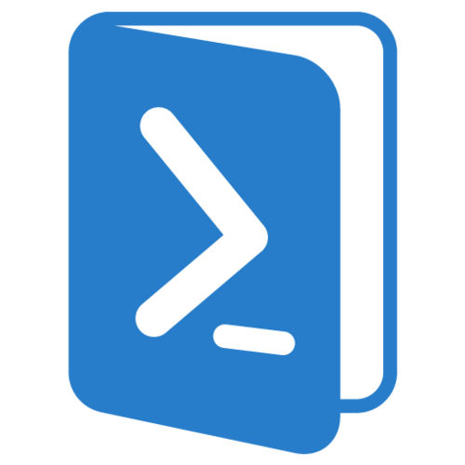
Hyper-V
Windows PowerShell Direct
Directly connect to VMs to run PowerShell commands
No networking required
No firewall rules
No special configuration of Remote Management
Requires 2016 Server or Windows 10
Requires Hyper-V administrative credentials
Requires VM guest administrative credentials
VM has to stay on the host you’re running the commands from

Slide 23
Remote Desktop Services
Personal session desktops - Persistent desktop assignment, specifically around the cloud
Support for Gen 2 VMs
Pen remoting support – No longer treated like a mouse, recognized as a pen and supported as such
Edge browser support in RDSH
Client updates – New Remote Desktop Apps for Windows 10 (Microsoft Store) and Mac (iTunes) available with new features

Slide 24
Remote Desktop Services
Windows MultiPoint Services
Now a part of Server 2016 as opposed to a separate product
Previously 20 user limit per MultiPoint Server
Allows a “Server” to be connected to by many local thin/zero clients to run multiple sessions (“Server” is normally a big desktop PC)
Can connect by direct video card, USB, or LAN from a low cost station device
Lower TCO for proper deployment
Easy management of several local machines
Use cases: Education primarily, retail, transient low-demand users

Slide 25
Remote Desktop Services
OpenGL applications and guest VMs in Remote Desktop
OpenGL 4.4 and OpenCL 1.1 now supported
Up to 1GB of dedicated VRAM per VM, set independent of the number of monitors or resolution (as it previously was)
Great for design/engineering/architecture firms or other Adobe/AutoCAD/3D modeling software users
Allows a much more desktop-like experience for users

Slide 26

File and Storage Services
Storage Spaces Direct
Storage Replica
Deduplication improvements
REFS!
Storage Quality of Service (Scale-Out File Server)

Slide 27
File and Storage Services
Resilient File System
Finally supported in primetime!
Resists corruption that can occur in NTFS using metadata
Is now RECOMMENDED for Hyper-V workloads – gives advantages like instant checkpoint merging, instant fixed size VHDX creation
Faster than ODX for many operations
Recommended for Exchange 2016
Recommended for most structured file storage

Slide 28
File and Storage Services
Storage Spaces Direct
Highly available storage systems with local storage (scale-out/grid/Software Defined Storage)
Runs on SMB3 with multi-channel throughput and SMB Direct (RDMA capable NIC required in production)
Software Storage Bus (SSB) allows all servers to see all storage
Minimum 4 nodes, Internal disks or JBOD, SATA, NVMe or SAS disks
ReFS with CSV for shared mounting of volumes
Either hyper-converged or separate

Slide 29
File and Storage Services
Storage Replica
Storage agnostic
Synchronous mirroring at a block level of data from one server to another (holds acknowledgements)
Asynchronous replication at a block level of data from one server to another (no snapshots needed)
Uses SMB3 with all its features
Can be used with a stretch cluster, from one cluster to another, or from one server to another

Slide 30
File and Storage Services
Storage Replica
Volumes is offline on destination (not active/active)
Volume won’t come online in destination unless the cluster is down at the source side
Requires a log volume on each side (fast storage)
Consistency groups for multiple volumes (can delay IO acknowledgements)

Slide 31
File and Storage Services
Deduplication Improvements
Dedup sounded great in 2012… but had long-term issues and scaling problems
Integrated support for virtualized backup workloads
Optimized throughput for large volumes up to 64 TB (more processors per volume)
Support for files up to 1 TB and optimizations for their performance
Rolling cluster upgrade of a file server failover cluster running deduplication is now supported
Can run on Nano Server

Slide 32
PowerShell 5.0
Loads of new cmdlets and modules
  Can find and install modules and packages from the internet now directly from PowerShell
PowerShell can now manage Desired State Configurations
ISE can now edit and debug remote PowerShell scripts in a local instance of ISE

Slide 33
Windows Networking
Standardized protocols – Representational State Transfer (REST) Open vSwitch Database Management Protocol (OVSDB)
Flexible encapsulation technologies - VxLAN, NVGRE
Converged NIC – Single NIC for Management, RDMA storage, tenant traffic
Packet direct – Improves network throughput with lower latency
Switch embedded teaming – SDN based NIC teaming.

Slide 34
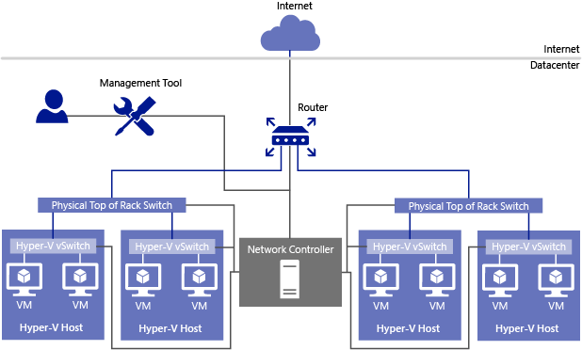
Windows Networking
Software Defined Networking Infrastructure
Network Controller – Central management point for Hyper-V VMs and virtual switches, physical switches and routers, VPN gateways, load balancers and firewall software

Slide 35
Windows Networking
Software Defined Networking Infrastructure
Hyper-V Virtual Switch – support distributed switching and routing, tenant isolation, traffic shaping, open for developers to add plug-ins. Plays with network controller to provide a full control solution (Especially with SCVMM)
  ARP Poisoning protection
  DHCP Guard protection
  Port ACLs (MAC or IP filtering)
  Private VLAN

Slide 36
Windows Networking
Network Function Virtualization
Virtualization of what used to be physical appliances. Appliances are currently provided for:
  Layer 4 software load balancer (based on Azure’s load balancer)
  Site-to-Site gateway – Manage site VPN endpoints
  Forwarding gateway (routing demark between virtual and physical)
  GRE tunnel gateway – for non-encrypted traffic tunnels
  Routing Control Plane (BGP) – distributed routing and control plane of the distributed virtual switches
  Distributed Multi-tenant firewall – Policies enforced on the SDN-vswitch ports of each tenant VM

Slide 37
New Features for Familiar Networking Technologies
DHCP – Network Access Protection is deprecated
GRE tunneling
IPAM
  Supports DNS Resource records, conditional forwarders, DNS zone management for AD DNS and File-backed DNS
  Works with DNS and DHCP for forests with two-way trust relationships
Nano Server support for file-based DNS
Hyper-V network virtualization
  Programmable switch, VXLAN encapsulation, Software load balancer support

Slide 38
New Features for Familiar Networking Technologies
DNS Policies – Specify responses based on client location (IP Address, time of day, load balancing, split-brain DNS
Response Rate Limiting – Prevent your DNS servers being used for DoS by sending too many responses to a single client
DNS-based authentication of named entities – tells clients which CA they should expect to see a certificate from (prevent man-in-the-middle attacks)
Unknown record support – add records Windows doesn’t necessarily support
New PowerShell commandlets

Slide 39
Other Features
Console improvements – Command prompt and PowerShell get new improvements to help with user interface: extra shortcuts, better copy/paste, better navigation
Windows 10 start menu: finally a usable server start screen

Slide 40
Thank You / Questions?
http://www.mirazon.com/category/windows-server-2016/
https://technet.microsoft.com/en-us/library/dn765472.aspx
https://azure.microsoft.com/en-us/blog/containers-docker-windows-and-trends/
mirazon.com

