Slide 1
Playing in the Sandbox
Presenter: Jim White from Fortinet

Slide 2
Presentation overview
Related terms and definitions to Advanced Persistent Threats/Attacks and Sandboxing
Explanation of the threats
What is sandboxing
Benefits of sandboxing
Lessons from the past
Create an ATP Action Plan

Slide 3
The many definitions of Advanced Persistent Threat …
APT is a set of stealthy and continuous computer hacking processes, often orchestrated by human(s) targeting a specific entity.
APT is a network attack in which an unauthorized person gains access to a network and stays there undetected for a long period of time.
APT refers to a cyberattack launched by an attacker with substantial means, organization and motivation to carry out a sustained assault against a target. An APT is advanced in the sense that it employs stealth and multiple attack methods to compromise […]. The attack is difficult to detect, remove, and attribute. An APT is persistent because the attacker can spend months gathering intelligence […]. It is threatening because perpetrators are often after highly sensitive information, such as the layout of nuclear power plants or codes to break into U.S. defense contractors.

Slide 4
Advanced Targeted Threats/Attacks
APT could be considered as a subset of ATA
Both are advanced attacks and share common criteria like long-term infiltration, stealth and sophisticated techniques
ATAs are pragmatic: they are likely designed to steal confidential information or intellectual property
APTs are dogmatic: they are largely driven by emotional or philosophical motivations, primarily politics. Business disruption is the main goal of such attacks

Slide 5
APT/A Related Definitions
The following will be a list of commonly used terms and brief definitions for each term

Slide 6
Attacker
An attacker is a program that performs a wide range of hacking related tasks without the user knowledge nor permission.
Activities may include disabling an anti-virus software or personal firewall or modifying system settings.

Slide 7
Target
The victim of an attack

Slide 8
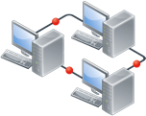
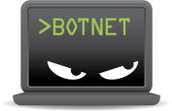
Botnet
A botnet is a group of computers, infected with a robot malware (the bot), that share program processing amongst them.
Command & Control servers are central points used for the control of botnets.
Bots will usually report back in some way, often via IRC or other simple messaging protocols, once a new system is infected, and will then receive commands from the central server.
Among the most popular applications of botnets are the DDoS and spamming

Slide 9
Infector
File infectors are malwares that are capable of attaching themselves to executable files, e.g. “calc.exe” and “notepad.exe”.
When we run an infected file, we don’t notice that “calc.exe” is infected, since it still shows the calculator running properly. But, behind the scenes, the malware is doing its malicious activities.
A file infector is a computer virus.
File Infection
foo.exe
foo.exe

Slide 10
Worm
A computer worm is a standalone malware computer program that replicates itself in order to spread through the network to other computers.
Unlike a computer virus, it does not need to attach itself to an existing program.
Replication and Spreading

Slide 11
Stealer
Stealer is a type of malware designed to steal information (credentials, address book, files, etc.) from the compromised computer.
Multi-purpose key loggers are the most known technique that can record user credentials when the user is sign-in into an application. Some have the ability to make screenshots of the computer.
Data exfiltration

Slide 12
Greyware
A greyware is a program not classified as a virus but that has is annoying, undesirable.
Often greyware performs a variety of undesired actions such as irritating users with pop-up windows, tracking user habits and unnecessarily exposing computer vulnerabilities to attack.
Greyware encompasses spyware, adware, dialers, joke programs, remote access tools, and any other unwelcome files and programs apart from viruses

Slide 13
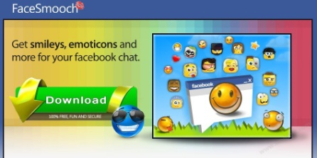
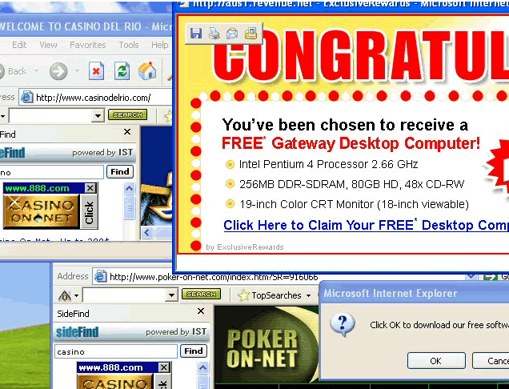
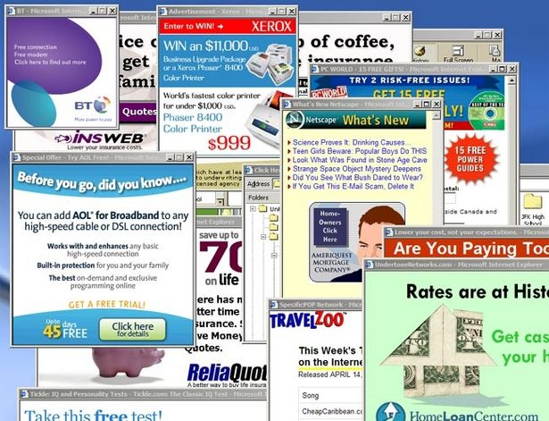
Adware
The term adware is frequently used to describe a form of malware (malicious software), usually that which presents unwanted advertisements to the user of a computer. The advertisements produced by adware are sometimes in the form of a pop-up.
!

Slide 14
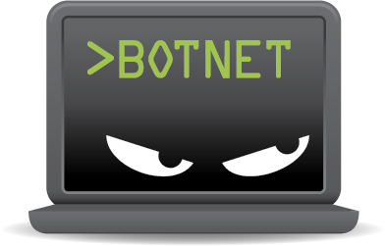
Riskware
Riskware covers legitimate programs which can cause damage when they fall into the hands of malicious users.
Such software can be installed by a malware (ex.: WinVNC) or be already installed but can see their configuration modified (ex.: mIRC) without the user knowledge.
IRC> JOIN #BOTNET

Slide 15
Downloader
A downloader is a malware that will download and install other malwares onto a computer without the user knowledge.
Downloader architectures involve generally an Command and Control channel as well as a download channel. The downloader first contacts a C&C server in order to get the URL of the malware to download/install.
Both channels generally use IRC/HTTP and may obfuscate their communication by using cyphering technologies or TLS protocols.

Slide 16
Dropper
A dropper is a malware component designed to install another malware to a target system.
In order to avoid virus detection, the malware code is usually embedded into the dropper (single stage) or may be downloaded (two stages).
Drop File
foo.exe

Slide 17
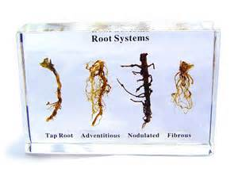
Rootkit
A rootkit is a type of software designed to hide the fact that an operating system has been compromised.
Rootkits themselves are not harmful; they are simply used to hide malware.

Slide 18
Injector
Code injection is a method that force a legitimate program to run a piece of malicious code.
Most popular code injections:
DLL: force a program to run with a malicious DLL that override legitimate system calls with malicious code.
Web-based: force the browser to execute some malicious code without the user knowledge (i.e. drive-by attack)
<iframe src=”http://malware.tld/foo.js” width=0 …

Slide 19
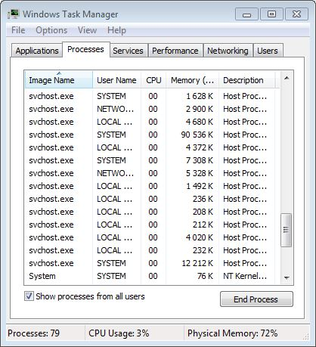
Trojan
A Trojan is a program that appears legitimate, but performs some illicit activity when it is run.

Slide 20
Hijack
Hijacking is a type of network security attack in which the attacker takes control of a communication.
One of the most popular form of hijacking is the Man in the Middle
There are also some malware whose purpose is to silently modify the browser settings (like the home page, the search engine, etc,). This techniques is called browser hijacking as the user is not aware of this modification (except when the browser is running).

Slide 21
Backdoor
A backdoor is a method, usually hidden, of bypassing normal authentication of a computer system.
It can take the form an installed program, a rootkit, a default password not changed or some debug commands that are not disabled by default.

Slide 22
Why are signatures based solutions are not enough?
Zero Days
Obfuscation
Runtime Packers
Encryption

Slide 23
Zero-day is like…
The latest hit wonder…. You’re so 2000 and late!
Who really understands it?

Slide 24
Zero-day Vulnerabilities (aka the known-unknown)
[…] attack that exploits a previously unknown vulnerability in a computer application
A key component for maximizing the success of an advanced attack
Easy to find or buy on continuously growing grey market
Information to Public
Known
Unknown
Vulnerability publicly known
Risk assessment and
mitigation possible
Vulnerability known to privileged group only
Risk assessment and
mitigation not possible
Known
Vulnerability
Vulnerability not discovered
?
No exploitation or risk - not yet discovered
Unknown
Source: https://www.nsslabs.com/system/files/public-report/files/The%20Known%20Unknowns_0.pdf

Slide 25
Obfuscation is like…
Think of the Sci-Fi TV Show – FACE OFF
Or shape shifting like X-Men’s Mystique
Some files can mutate to change its appearance

Slide 26
Obfuscation
In software development, obfuscation is the deliberate act of creating obfuscated code, i.e. source or machine code that is difficult for humans to understand. In the malware industry, this technique is massively employed to evade detection by anti-virus software.

Slide 27
Runtime packers is like…
No, not those packers

Slide 28
Runtime
A runtime packer is a (legitimate) software program used for obfuscating a malware. The result is a new executable file embedding the necessary code to unpack itself and launch the malicious code.

Slide 29
Encryption is like…
The Matrix code - beware of Cypher!

Slide 30
Encryption
Encryption is another obfuscation technique. The original executable file is embedded into a new one, containing a the decryption code and the key
-OR-
Where the malicious payload is delivered over through and encrypted session, like HTTPS / SSL / TLS, in an attempt to avoid detection in transit from Antivirus and IPS scanners

Slide 31
What other tools are there beyond Signature Protection?
AV Heuristics
Code Emulation
Sandboxing

Slide 32
Heuristic
Heuristic is a set of well-defined rules to apply to a problem in the hope of achieving a known result

Slide 33
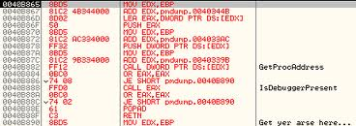
Code Emulation
A code emulator is a software which has the capability to take a program instruction by instruction and imitate what that program would do if it were ran. BUT, the code emulator will never allow a program to really do what it should do. It only tries to come to that program's goal and guess it with a set of heuristic rules.

Slide 34
What does Sandboxing offer?
Sandboxing helps detect these advanced threats by coaxing malicious threats into exposing themselves

Slide 35
How does Sandboxing exposes threats?
Sandboxing uses isolated and controlled environments designed to observe and record file behavior, typically in VMs
After executing file(s) in the controlled VM environments, the sandbox analyzes behavior to determine any malicious intent within the target OS

Slide 36
Why Do You Need Sandboxing for Protection?
Benefits of Sanboxing
Detects advanced persistent threats
Expose previously unknown malware
Block more spear phishing attacks
Increase effectiveness of your NGFW, or UTM or Secure Email Gateway solutions
Increase incident response times
Sandboxing provides the ability to detect &reveal details of new and nameless APTs & APAs

Slide 37
Will simply adding Sandboxing be enough effort?
NO! Sandboxing technology alone is not enough to protect against APTs and ATAs
Reminder: TARGET Corp. breach occurred while a sandboxing solution was present

Slide 38
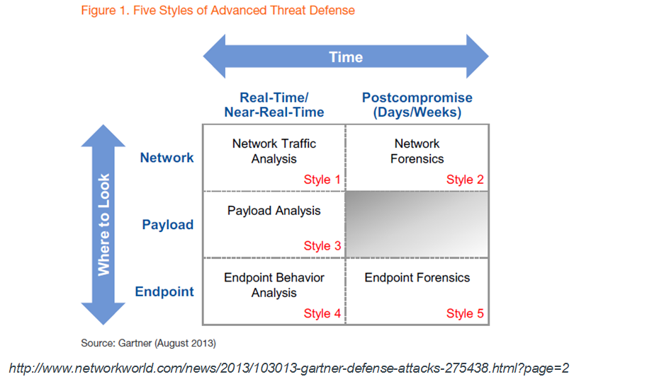
Lesson Learnt! ATP - Advanced Threat Protection
ATP is the framework that helps to protect against APT Advanced Persistent Threats and Advanced Targeted Attacks
The framework covers techniques, processes and tools

Slide 39
Advanced Threat Protection Framework “The Action Plan”
Access Control
Next Generation Firewalls
2 Factor Authentication
Vulnerability Management
Threat Prevention
IPS, App Control, DLP
Deep Flow Antimalware
Email/Web Filter
Deep SSL Inspection
Antibot
Reduce Attack Surface
Inspect and Block Threats
Assess, Audit, Improve
Identify new
incidents
Advanced Threat Detection
File Sandbox analysis
Network behavioral analysis
Client reputation
Botnet reporting
Continuous Monitoring
Regular Security Assessments
Reporting
Research
SIEM/Log Mgt/Intelligence
Service partners
Validate and
Contain
Incident Response
Research, Plan, Study & Practice!
Notes:
39

Slide 40
Questions?

Slide 41
Time is up!
Thank You

